Slide 1

Judy Center Mobile Community Outreach Education Initiative
in Collaboration with
Garrett County Local Management Board & Partnerships
Garrett County Board of Education
June 20, 2019

Slide 2
GCPS’s Annual Evaluation on 12 Components in the
Judy Center Grant
What are we doing to improve the level and intensity of outreach programs in our Judy Center Grant that will address the 0-5 population of children and families not involved in an early learning program?
What enhancements have we made in our Judy Center for providing effective early intervention services to children in our communities?
Goal: To increase the level of school readiness for families that have children 0-5 year old population that are not enrolled in an early learning program in each school district throughout the county.

Slide 3
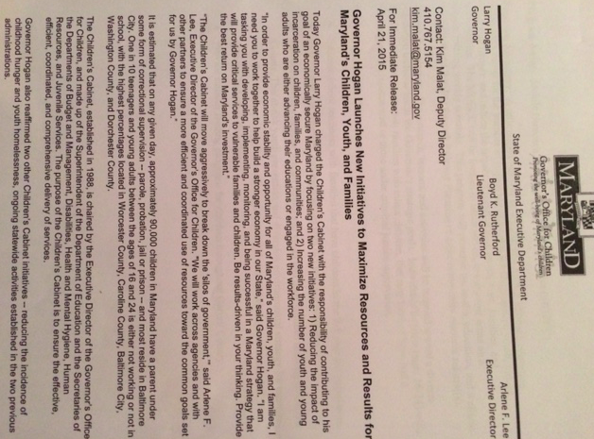
Local Management Board
STRATEGIC GOALS
Goal # 1: Reduce the impact of incarceration on children, families, and communities;
Goal # 2: Improve outcome of disconnected/opportunity youth.
Goal # 3: Reduce childhood hunger.
Goal # 4: Reduce the number of incidences of childhood homelessness.
A monetary contribution of $18,000 from Garrett County’s Local Management Board

Slide 4
Mobile Community Outreach Education Center
Goals:
Increase school readiness with families that have children in the 0-5 year old population in 10 geographical areas throughout Garrett County. [Judy Center Grant Goals]
Provide fine arts programs and experiences for the 0-5 year old programs [Supported by Samantha Funding the Arts]
Provide feeding programs [Food Pantry, Nutritional Education, and distribute toiletries items to families] for children throughout Garrett County to reduce childhood hunger.

Slide 5
Mobile Community Outreach Education Center
Target Population:
The outreach, lessons, and activities will be targeted toward a diverse population.
Individuals/families (ages 16-24) with children ages 0-4; families with minor children, that may have or have had a parent/guardian incarcerated or those under criminal justice supervision. [This targeted population should be met by focusing on the school readiness goals within this initiative.]

Slide 6
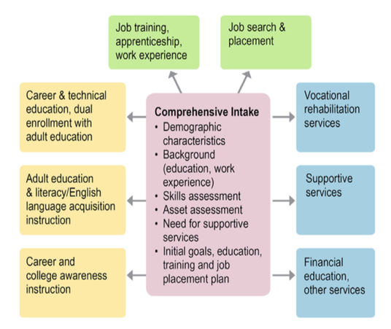
Supporting Families by Creating Pathway Plans

Slide 7
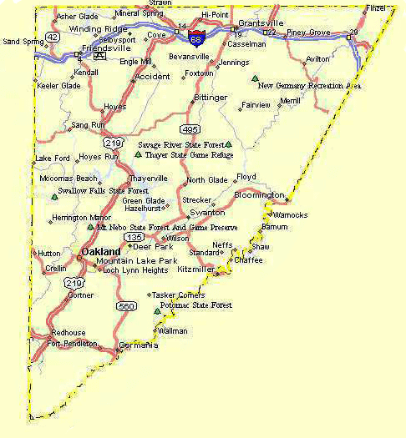
Garrett County: Potential Mobile Community Outreach Education Center Locations
Friendsville
Grantsville
Finzel
McHenry
Bloomington
Mt Lake Park
Crellin
Loch Lynn
Kitzmiller
Red House
* The sites are examples

Slide 8
Mobile Community Outreach Education Center
Monthly Schedule
Staff Schedule: Third week of each month
 | Monday | Tuesday | Wednesday | Thursday | Friday
Location | Friendsville | Grantsville | Bloomington | Oakland | Swan Meadown
 | Accident | Finzel | Kitzmiller | Loch Lynn | Crellin
Staff | Northern End Judy Center Staff | Northern End Judy Center Staff | Alternate NE & SE | Southern End Judy Center Staff | Southern End Judy Center Staff

Slide 9
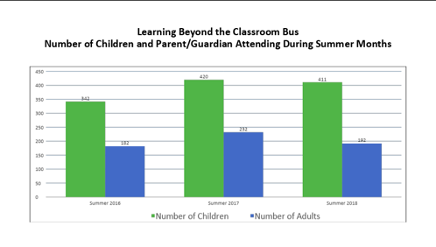

Slide 10
Mobile Community Outreach Education Center
Daily Schedule
Activity [90 minute block of time] | Time
Social time/Free play | 30 minutes
Story time: Lending Library Family Wellness Activities | 15 minutes
Craft/Music/Dance/Art | 15 minutes
Gross motor activity | 15 minutes
Wrap up (Food & Book Giveaway) | 15 minutes
Total | 90 minutes

Slide 11
Inside Design: Mobile Community Outreach Education Center
Storage
Wall Storage
Counter Top Work Area
Seat
Driver
Food Pantry Items
Toiletries Items
Supplies & Materials
Art/Music Activities
STEM Centers
Lending Library
Storage
Chalkboard/Centers
Info Desk
Stairwell

Slide 12
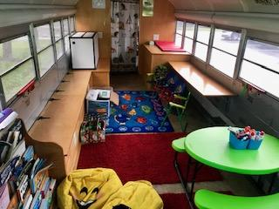

Slide 13
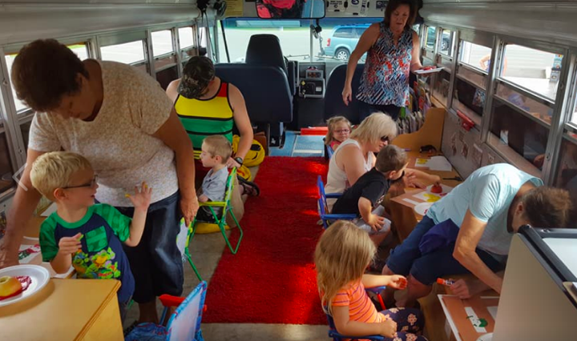

Slide 14
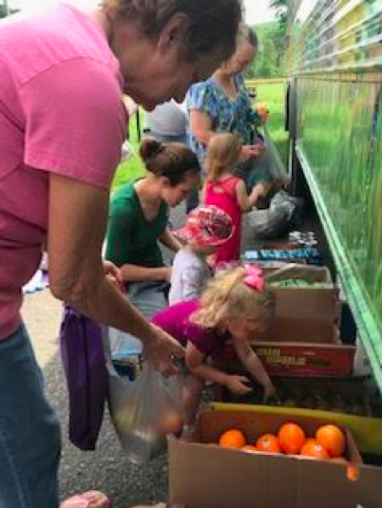
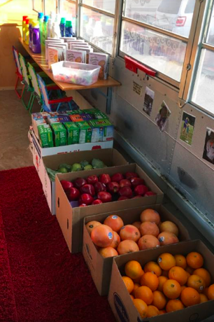
FY 2018 Learning Beyond the Classroom distributed 911 bags of food.

Slide 15
Local Management Board,
We
THANK YOU
for your continued support!
LBTC Staff

