Slide 1
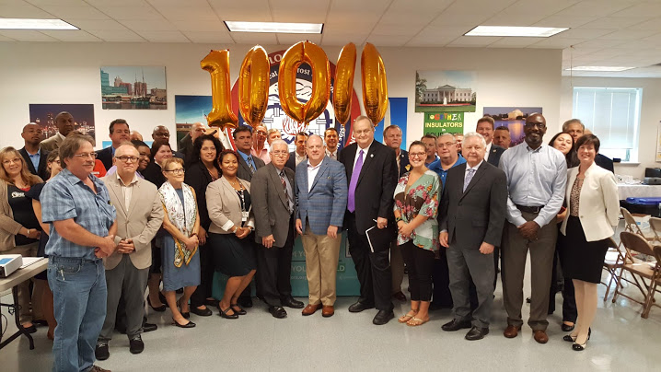
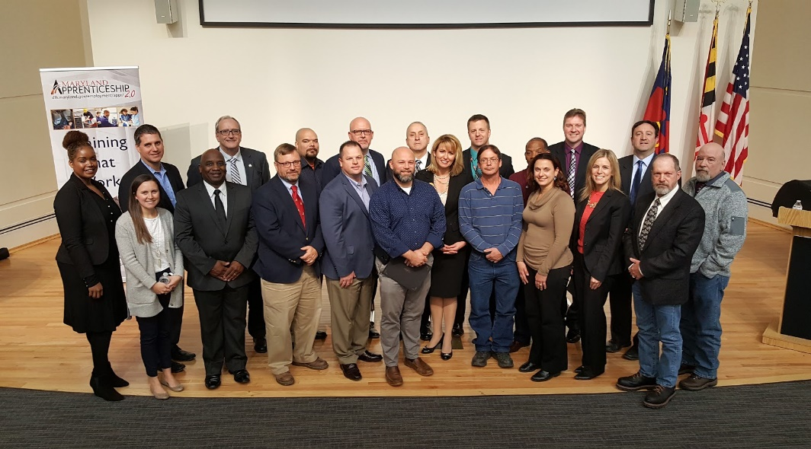



Registered Apprenticeships in Maryland

Slide 2


Apprenticeship Expansion
Opportunity
“Apprenticeships are proven workforce development tools that greatly benefit our students, workers, and job creators. This program’s ongoing growth provides our state’s workforce with expanded opportunities to learn new skills and grow in their careers. These apprenticeships provide Maryland workers across numerous industries with more opportunities to succeed, and our job-creators with the skilled workforce they need to compete in today’s market.”
--Maryland Governor Larry Hogan
“Maryland’s growing apprenticeship program is providing more and more opportunities for our workers and employers. Apprenticeship is an ideal option for job seekers desiring hands-on training and career advancement, and for employers to develop and grow their future workforce.”
--Acting Secretary James Rzepkowski, Maryland Department of Labor, Licensing and Regulation

Slide 3
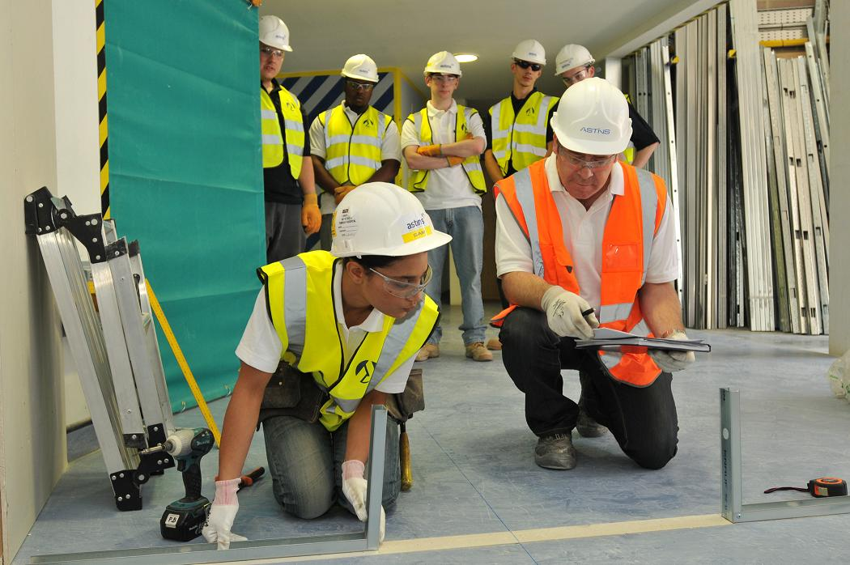
What is Apprenticeship?
Review
Official Definition
Apprenticeship is an earn-and-learn strategy combining on-the-job training with related (classroom) instruction, blending the practical and theoretical aspects of training for highly-skilled occupations.
Apprenticeship programs are sponsored voluntarily by a wide range of organizations, including individual employers, employer associations, joint labor-management organizations, and other workforce intermediaries.

Slide 4













What is Apprenticeable?
Review
The position must meet the training criteria below. The occupation can be in a traditional or non-traditional occupation.
Think Outside of the Box!
There’s a 1st Time for Everything!
On-the-Job Training (OJT) must:
  Consist of at least 2,000 hours per year of the apprenticeship.
  Take place at the work site under the direction of a highly skilled journeyworker(s).
Related Instruction (RI) must:
  Have at least 144 hours of related instruction per year of the apprenticeship.

Slide 5
Types of Apprenticeships
Opportunities
The required apprenticeship terms noted on the prior slide may be measured by any of the following approaches.
Time-Based Approach:
  A method that measures skill acquisition through the individual apprentice’s completion of at least 2,000 hours of on-the-job learning as described in a work process schedule.
Competency-Based Approach:
  A method to measure skill acquisition through the individual apprentice’s successful demonstration of acquired skills and knowledge, as verified by the program sponsor.
Hybrid Approach:
  A method to measure an individual apprentice’s skill acquisition through a combination of a specified minimum number of hours of on-the-job learning and the successful demonstration of competency as described in a work process schedule.

Slide 6
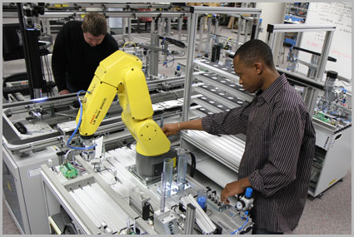

Registered Apprenticeships
5 Components
Employer Involvement
  Programs start with employer needs
  Employers are the foundation for the program
Structured and Supervised On-the-Job Training (OJT)
  Provided by sponsor/employer
  Competencies are attained through a minimum of 2,000 hours of On-the-Job Training
Related Instruction (RI)
  The classroom training or associated curriculum (144 hours per year)
Rewards for Skill Gains
  Progressive wage increases as apprentice increases proficiency
National Occupational Credential
  RA Completion Certificate is a recognized
  post-secondary credential under WIOA
  Stackable and portable

Slide 7
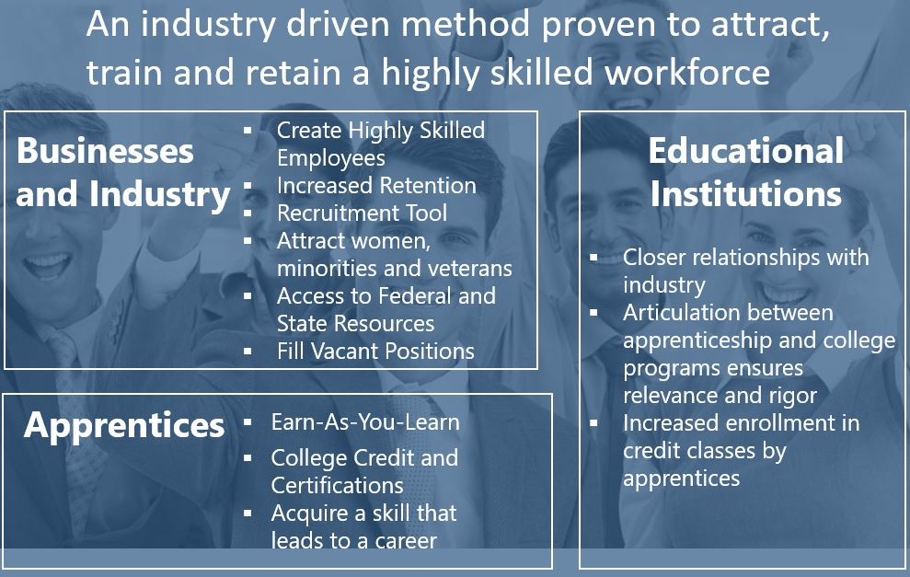
Registered Apprenticeship
Benefits

Slide 8
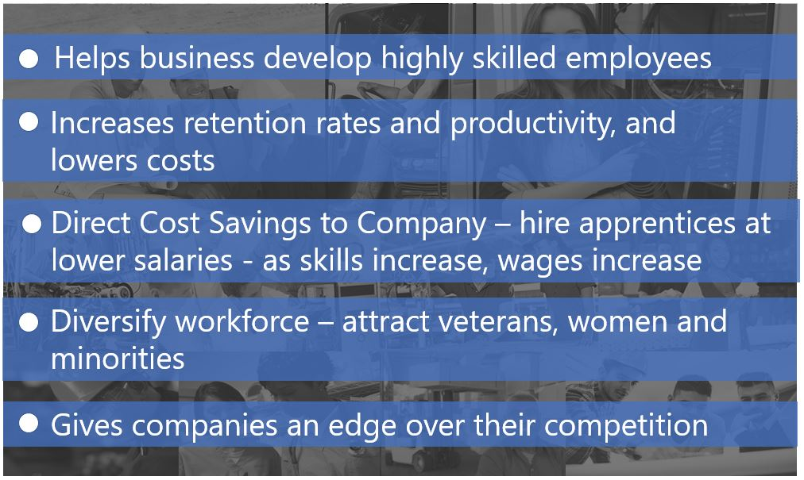
Registered Apprenticeship
Employers

Slide 9
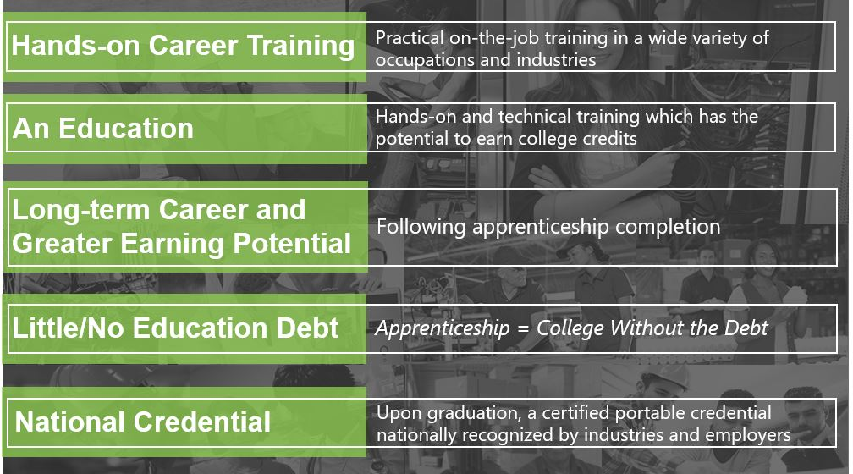
Registered Apprenticeship
Apprentices

Slide 10
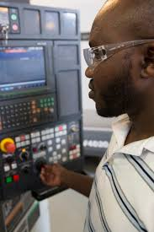
The Apprentice
Roles
Basic Requirements
  Anyone 18 years or older who meets the program specific qualifications can be a registered apprentice. However, some programs allow individuals 16 years and older with parental permission.
  You must be physically able to perform required tasks and have access to transportation.
  Most, but not all, Registered Apprenticeship programs require a Maryland high school diploma by means of high school graduation or successful completion of the GED® Test or National External Diploma Program®.
  You may have to pass specific tests in math and English. Individual program requirements may vary.

Slide 11

Maryland Apprenticeship
Defined
Active Apprentices in October 2018
(36.2 % Growth
Since 2012)
10,162
Apprentices Completed
During 2018
1,132

Slide 12
Sample of New Industries and Occupations
Opportunities
Healthcare:
  Environmental Care Supervisor
  Patient Care Technician
  Surgical Technologist
  Pharmacy Technician
  Licensed Practical Nurse
  Medical Assistant
  Central Sterile Processing Technician
Information Technology:
  Information Technology Professional
  Digital Marketing Professional
  Cyber Security Professional
  Data Science & Analytics Specialist
  Secure Software Programming
  Computer User Support Specialist
Biotechnology:
  Instrumentation Technician
Emergency Management:
  Emergency Management Specialist
Transportation/Logistics:
  Auto Maintenance Technician
  Diesel Technician
  Truck Driver, Heavy
Retail:
  Store Manager
Manufacturing:
  Maintenance Mechanic
  CNC Specialist
  Welding Technician
  Additive Manufacturer/3D Printer
  Machinist
  Electrical Technician
Hospitality/Tourism:
  Lodging Manager
Public Sector:
  Police Cadet
  Natural Resources Police Officer
  Deputy Sheriff
  Senior Wastewater Operator
Finance, Insurance and Real Estate:
  General Insurance Associate
  Licensed Financial Representative
Shipbuilding:
  Shipwright
Tree Care:
  Arborist

Slide 13
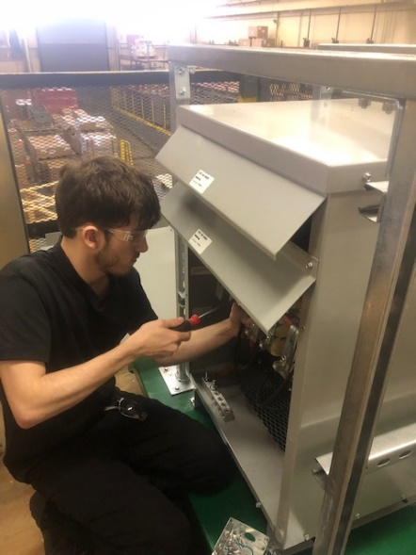
High School Students and Apprenticeship
Overview
High school is a critical time for development of career choices, and communities across the country are launching programs allowing high school students to pursue career-oriented coursework coupled with work-based learning opportunities.
These programs have different names, school-to apprenticeship or youth apprenticeship, but all have the same goals – providing students with access to high-quality, industry-focused training that combines classroom and on-the-job learning, and affordable pathways to college and careers in high-demand industries.

Slide 14
School to Apprenticeship
Overview
The School to Apprenticeship model allows youth ages 16 or 17 to be registered as apprentices with a Registered Apprenticeship sponsor prior to graduation (with the consent of the youth’s parent or guardian).
Youth becoming Registered Apprentices will receive the appropriate Related Instruction while in high school and will begin working part-time to accrue On the Job Training hours as their schedules allow.
Upon high school graduation, these youth will then be full-time Registered Apprentices. All hours of OJT and RI accrued during high school are part of their required hours to complete the RA program.
Current RA sponsors that presently allow for School to Apprenticeship include: Associated Builders and Contractors – Baltimore Metro; Associated Builders and Contractors – Chesapeake Shores; Associated Builders and Contractors – Cumberland Valley; Independent Electrical Contractors – Chesapeake; Prince George’s County Public Schools, Heating & Air Conditioning Contractor of Maryland (HACC); the Tree Care Industry Association; and the Harford County Electrical Contractors Association.
Notes:
JD/NEG and HCCT

Slide 15
Apprenticeship Expansion
Opportunity
Advancing Innovative Practices
DLLR has established an Apprenticeship Innovation Fund (AIF) to invest in programs that support and enhance Registered Apprenticeship expansion strategies.
The AIF is a competitive grant fund intended to seed the implementation of new and promising ideas, or to adapt proven strategies at the systems or service delivery level, so as to expand the reach of Registered Apprenticeship programs in Maryland.
DLLR’s commitment to innovative practices includes funds for expanded Pre-Apprenticeship and Registered Apprenticeship activities.

Slide 16
Apprenticeship Expansion
Opportunity
Apprenticeship Innovation Fund Recipients to Date
Finishing Trades Institute
Tranzed Apprenticeship Services (expand non-traditional IT RA program)
Tranzed Apprenticeship Services (create pre-apprenticeship program)
Maryland Manufacturing Extension Partnership
Tree Care Industry Association
Community College of Baltimore County (develop RI for Arborist RA program)
Community College of Baltimore County (create CNC Machinist pre-apprenticeship)
Alliance Technology Group
Virginia L. Grant Foundation
Mid-Atlantic Carpenters Training Center
Cyber Security Association of Maryland
1199 SEIU Training and Upgrading Funds MD/DC
Frederick Community College, Mid Atlantic Center for Emergency Management
Education Foundation for Baltimore County Public Schools
National Association of Insurance Professionals
Franklin Apprenticeships
Carter Enterprise Solutions
The Children’s Guild
Hagerstown Community College
IEC-Chesapeake
SMACNA Mid-Atlantic
RAMP-MD

Slide 17

Leveraging Other Programs
Opportunity
MARYLAND BUSINESS WORKS
Maryland Business Works (MBW) is an incumbent worker training program. Training funds are provided to businesses serious about increasing employee productivity, upgrading the skills of current employees, and creating opportunities for expanding their existing workforce.
Specifics about MBW include the following:
Private sector businesses with 500 employees or fewer that provide in-demand products or services are eligible to apply.
There is a dollar-to-dollar match requirement, and a $4,500 training cap funding level that may be awarded to a specific trainee for a project or series of projects.
Maximum request per year cannot exceed $40,000 per business applicant.
MBW can fund: classroom-based training, in-house training, apprenticeships, and other opportunities for Maryland’s businesses as they create and foster their talent pipeline.
The program was funded with an initial $1 million investment.
To date, many apprenticeship programs or participating employers have benefitted from MBW funding. Over 490 apprentices have benefitted from MBW funding with over $471,130 obligated to this training.

Slide 18
Apprenticeship Tax Credit
Benefits
Effective July 1, 2017, an income tax credit is available for individuals or Maryland businesses that employ Registered Apprentices. Special considerations are as follows.
The tax credit is available starting in the 2017 taxable year.
The Apprentice must be employed for at least seven months during a taxable year.
The Apprentice must be in a program registered with the Maryland Apprenticeship and Training Council (MATC).
The tax credit is for up to $1,000 per apprentice for the first year of his/her employment. Administered through DLLR, the taxpayer must provide proof of eligibility to accompany the tax return.
DLLR may approve tax credits of up to $500,000 annually statewide.
Since program inception, 564 tax credits have been awarded.

Slide 19
Where to Start…
Resources
Become a Sponsor
  Register a program
  Present your program to the Maryland Apprenticeship Training Council (MATC) for approval
  Maintain your program with continued Maryland Apprenticeship staff assistance and support
Use the Maryland Workforce Exchange
Advertise your program to a wide audience
Pre-screen applicants
Go beyond standard job descriptions by listing program requirements and specifications, as well as choose the number of applicant referrals accepted
Partner with local American Job Center Business Solutions Consultants and Higher Education Community
Set up workshops or recruitment events
Identify education and training opportunities statewide
Access workforce training fund

Slide 20


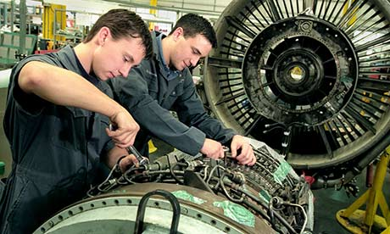

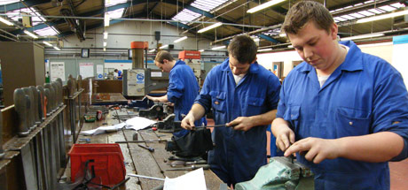
Thank You!
Rev. 06-10-2019

