Slide 1

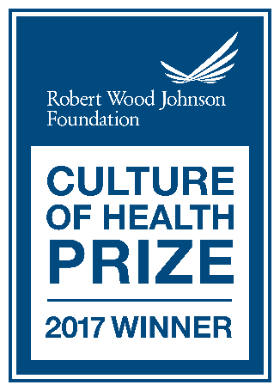
2018 STATUS OF HEALTH
Garrett County, Maryland
2021 STATUS OF HEALTH
Presented to Garrett County Board of Health By: Robert Stephens – Health Officer
5/27/2021
Notes:
41 Slides: Give credit to Beth B to John C.
Health is a Community Effort: The presentation is organized along broad SHIP categories
In some areas the Health Department takes a lead in others we partner with the community.

Slide 2
DATA SOURCES
State Health Improvement Process, SHIP Rankings by Jurisdiction
Census Data – data.census.gov
Vital Statistics for Garrett County and Maryland Behavioral Risk Factor Survey
Youth Risk Behavior Survey
Ready at Five Partnership
Robert Wood Johnson County Health Rankings & Roadmaps
Hyperlocal data collected on mygarrettcounty.com
Notes:
County Health Rankings and Roadmaps are interactive and gather data from multiple sources.

Slide 3
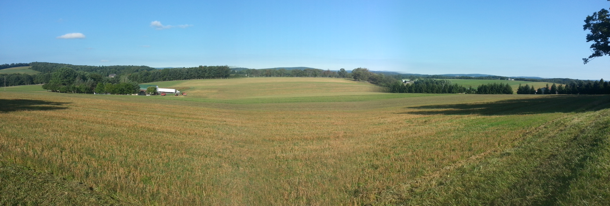
Demographics
Persons over 18 years of age: Maryland 78% Garrett County 81.2%
Persons 65 years old and over: Maryland 15.9% Garrett County 22%
Median Household Income: Maryland $86,738 Garrett County $52,617
Persons in Poverty: Maryland 9% Garrett County 10.4%
Population Per Square Mile (2010): Maryland 594.8 Garrett County 45.19
Source: U.S. Census Bureau

Slide 4
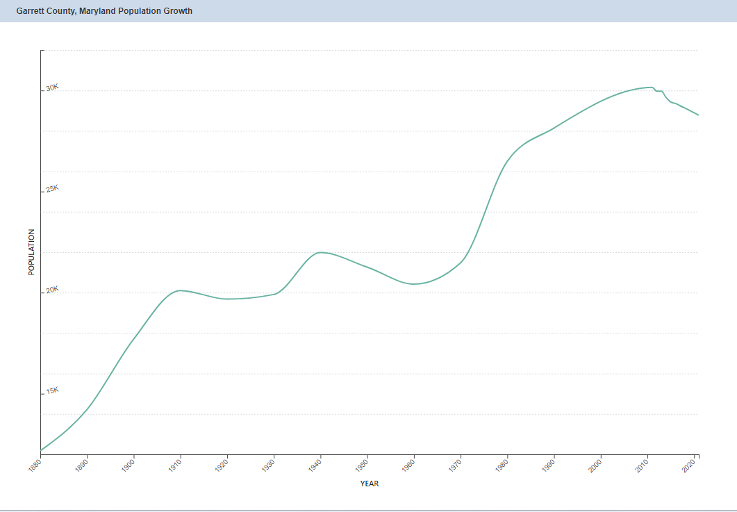
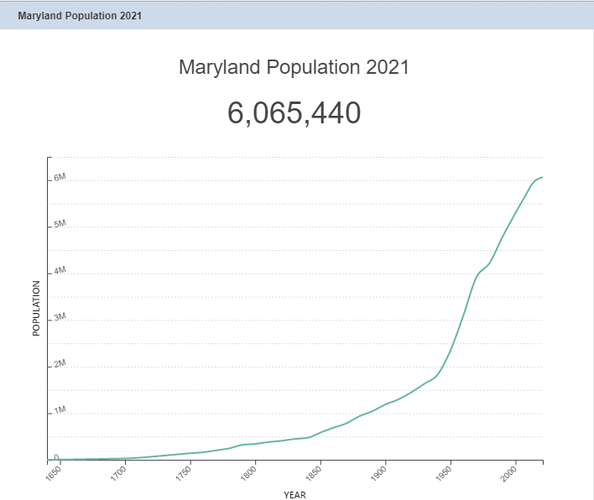
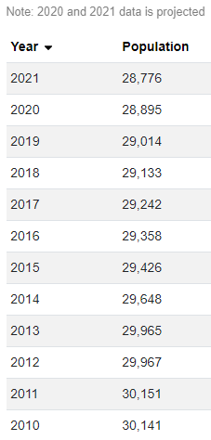
POPULATION TRENDS
Garrett County Population 2021
28,776
30,141
28,776
5.8 m
4.8m
2.3m
World Population Review
Notes:
Maryland –
2010 – 5.8m
2000 – 5.3m
1990 – 4.8m
1950 – 2.3m

Slide 5
2019 Vital Statistics
Notes:
Decline of nearly 900 since 2010.
Net Gain in 2006 of 26
Net loss in 2019 of 97

Slide 6
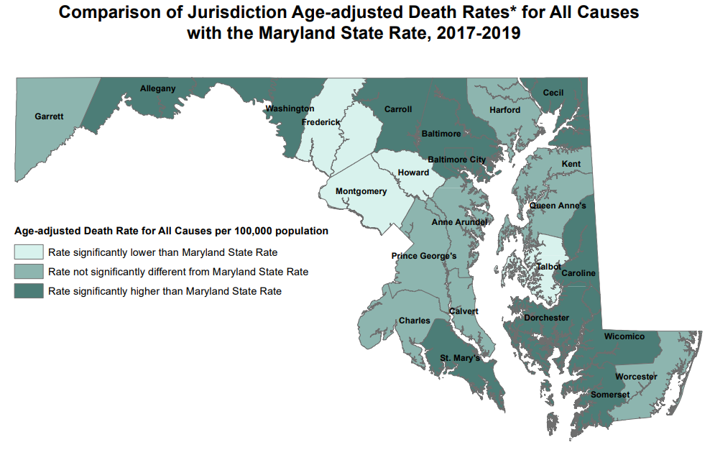
2019 Vital Statistics

Slide 7
2019 CAUSES OF DEATH IN GARRETT COUNTY
Malignant Neoplasms 16%
Other 26.2%
Diabetes 4%
Alzheimer's 8%
All in the other categories has less that 3% of deaths. Examples are: Accidents, Nephritis, Suicide, Homicide, Poisonings (OD), Peptic Ulcer, Parkinson's, Septicemia, etc.
Chronic Lower Respiratory 4%
Diseases of the Heart 31%
Cerebrovascular 6%
Source: MD Vital Statistics, 2019
Notes:
Septicemia is down to 1% so it is off the leading causes of death. Liver disease/Cirrhosis is up and has been added to the wheel.
Heart Disease and Cancer are still the largest causes of death in Garrett County.
131 of the 361 deaths in the county were primarily caused by heart disease.

Slide 8
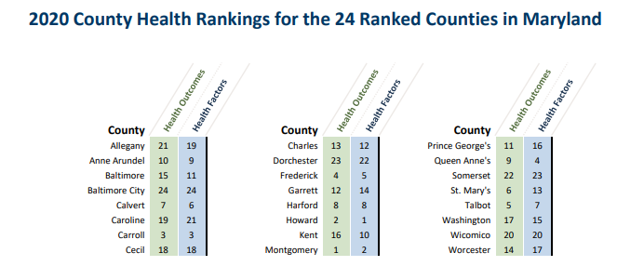
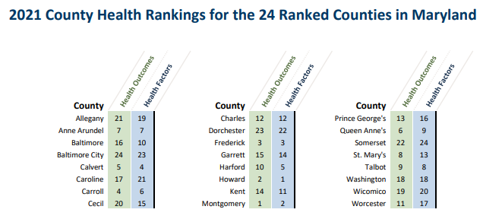
County Health Rankings and Roadmaps
Notes:
Factors are causes such as smoking lack of exercise, status of health insurance, etc. The Outcomes are the results such as death, morbidity, educational attainment, etc.
Social Determinants of Health: Income, health care, housing, geography, nutrition, transportation, social connectedness, etc. Population traits like smoking,
Adult obesity and STDs led to the drop in the health outcome change. Slide on adult obesity is included in the presentation.
Note where the two most affluent counties in the State are for both outcomes and factors.

Slide 9
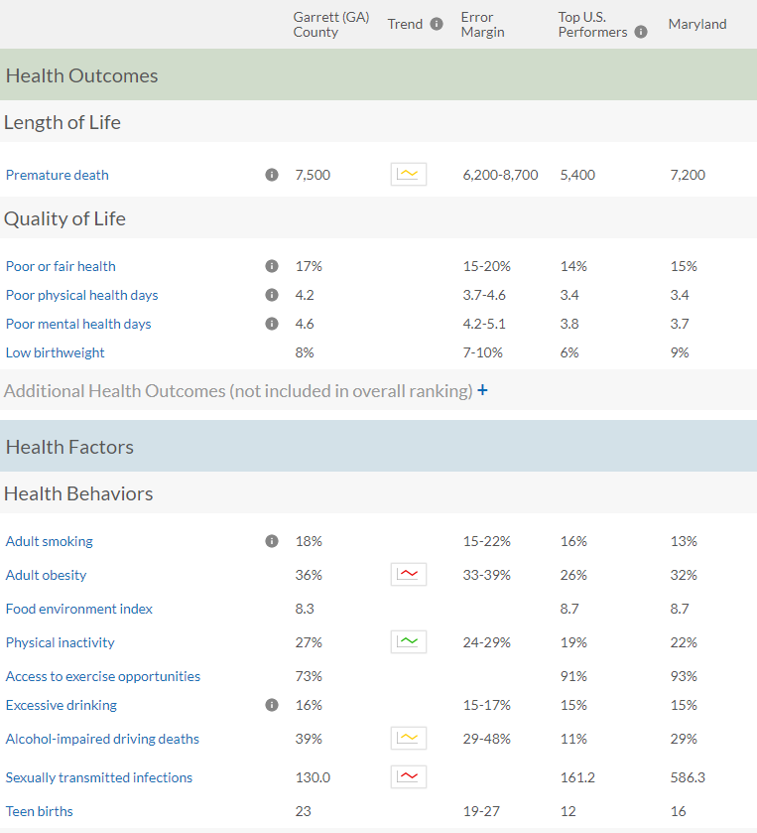

GARRETT COUNTY HEALTH RANKINGS
2021
Note: Blank values reflect unreliable or missing data
Notes:
Will notice that with healthy behaviors we need to do better.
Premature Death = Years of life lost per 100,000

Slide 10
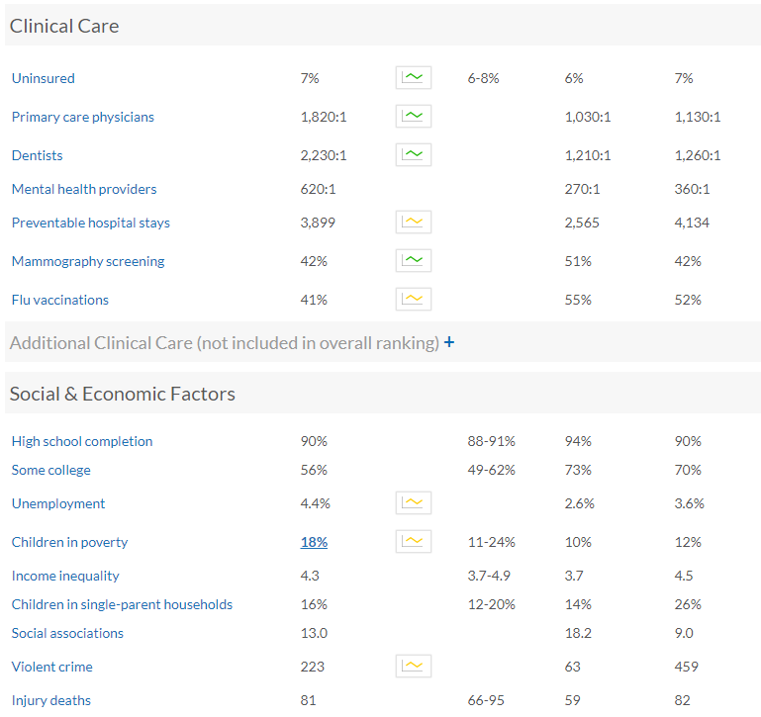
GARRETT COUNTY HEALTH RANKINGS
2021
Note: Blank values reflect unreliable or missing data
Notes:
Notice that income is not on this the Social and Economic factors.
Child poverty for the Appalachian region really changed in reducing childhood poverty.
We need to look at all of the factors as an aggregate or a gestalt. For instance we lag way behind many other counties for the number of physicians, dentists, etc. but we have a better health outcomes.

Slide 11
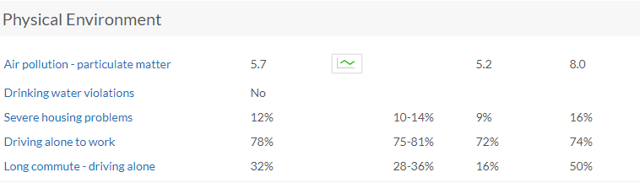
Garrett County Health Rankings
2021
Notes:
Notice the long commute alone is lower than the rest of MD.

Slide 12
State Health Improvement Process
SHIP provides a framework for continual progress toward a healthier community.
Including 39 measures and 5 focus areas
Focus Areas:
Healthy Beginnings
Healthy Living
Healthy Communities
Access to Health Care
Quality Preventive Care
Notes:
The rest of the presentation is ordered along these lines.
****Much of this data has not been updated since March 10, 2020 – often reporting data from 2017 results.

Slide 13

✔️ Look for a check mark to indicate inclusion or considerations in the upcoming Garrett County Community Health Improvement Plan and/or the 2019-2021 Garrett County Community Health Assessment.

Slide 14
Healthy Beginnings
 | Meets or Exceeds State Goal | Needs Improvement
6 Measures | Early Prenatal Care ✔️ | Children Receiving Blood Lead Screening
 | Students Entering Kindergarten Ready To Learn ✔️ | Babies with Low Birth Weight ✔️
 | High School Graduation Rate ✔️ | Teen Birth Rate ✔️
Notes:
Early Prenatal Care 78. MD GOAL 66.9
Students Entering K ready to Learn 89% (however in our CHIP we did not meet our objective of maintaining the percentage of children who enter K-baseline was at 94% [2010-2010] MD GOAL 85.5
Teen Birth Rate 23.2, MD GOAL 17.8
High School Grad Rate 93.2 , MD GOAL 95
Babies with low birth weight 10.6 MD GOAL 8 CHIP-maintain or reduce at a baseline of 8.4% --did not meet our obj
Children receiving lead screening 58.1, MD GOAL69.5

Slide 15
Mothers Who Received Prenatal Care
HP 2020 SHIP Goal 77.9
Notes:
We exceed the State Goal in this area

Slide 16
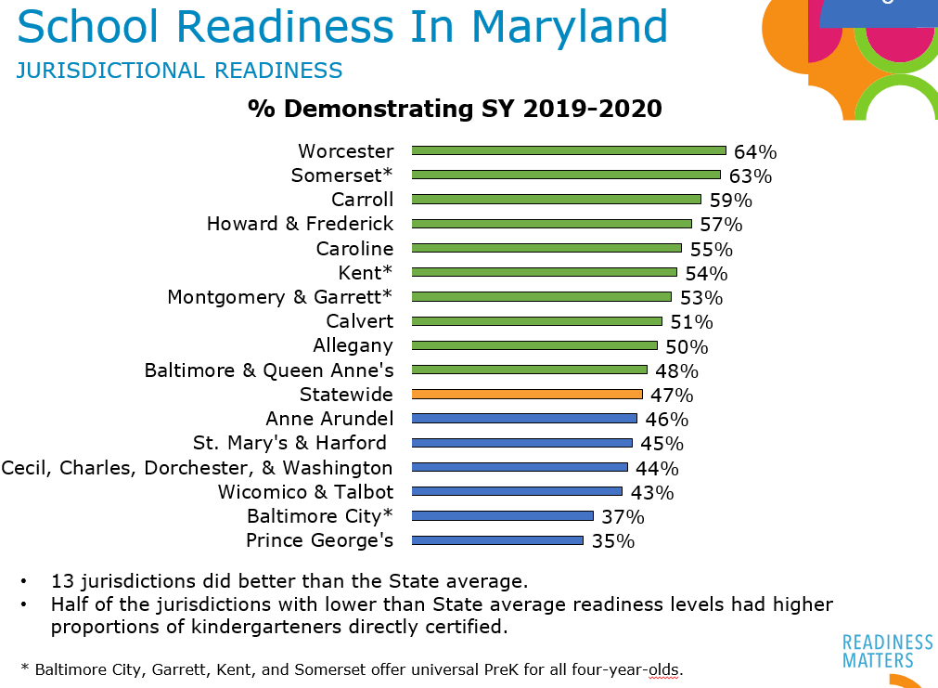
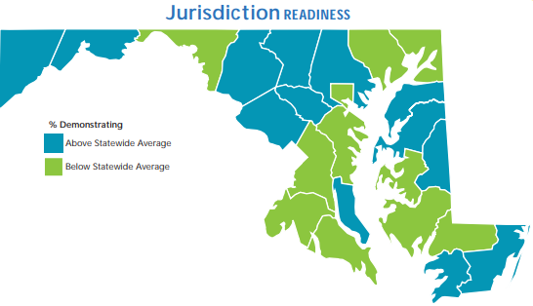
Ready at Five Partnership
Notes:
Nice to be lumped with Montgomery County on something

Slide 17
Infant Mortality Rate
Per 1,000 Live Births
4 Deaths
4 Deaths
3 Deaths
Source: Maryland Vital Statistics Administration
https://health.maryland.gov/vsa
Notes:
*** Rates based on <3 events in the numerator are not presented since such rates are subject to instability
MD Garrett
2004 8.5 6.4
2005 7.3 3.2
2006 7.9 0
2007 8 0
2008 8 10.8 3 Deaths
2009 7.2 0
2010 6.7 10.8 3 deaths
2011 6.7 3.5 1 death
2012 6.3 0
2013 6.6 10.8 3 deaths
2014 6.5 14.1 4 deaths
2015 6.7 8.1 4 deaths
6.5 3.77 1 death
6.5 7.57 2 deaths
2019 5.90 7.58 2 deaths

Slide 18
Births to Adolescents, All Races
Rates per 1,000 Females, Ages 15-17
7 births
0 births
Source: Maryland Vital Statistics Administration
https://health.maryland.gov/vsa

Slide 19
Healthy Living
 | Meets or Exceeds State Goal | Needs Improvement
8 Measures | HIV Incidence Rate ✔️ | Life Expectancy ✔️
 | Chlamydia Infection Rate | Increase Physical Activity ✔️
 |  | Adolescents Who Use Tobacco Products ✔️
 |  | Adults Who Currently Smoke ✔️
 |  | Adults Who Are At A Healthy Weight ✔️
 |  | Children & Adolescents Who Are Obese ✔️
Notes:
HIV 3.9 MD GOAL 26.7
Chlamydia Infection 198.4 MD GOAL 431
Children and adolescents who are obese 15.6 MD GOAL 10.7
Adults who currently smoke 15.1 MD GOAL 15.5 (close…but it’s probably bc they all switched to vaping)
Adolescents who use tobacco products 34.3 MD GOAL is 15.2
Life Expectancy 79.5 MD GOAL 79.8
Increase in physical activity (11th in the ranking) measurement period 2013 45.9 MD GOAL 50.4
Moved since last time, Adults who are at a healthy weight 27.3 MD GOAL 36.6
Eight Measures
Adolescents who use tobacco products: WORST IN THE STATE

Slide 20
Percentage of students who were obese
(> 95th percentile for body mass index, by age and sex)
Healthy People 2020 Target Goal: 16.1
MD SHIP 2017 Target: 10.7
2019 YRBS
Notes:
In 2014, Garrett County’s percentage was 16%, and Maryland was 11.5%. Garrett County’s rate was going down in 2016 to 13.5, but has spiked to 18.3
The Adolescent Survey showed that High School Students (even though there were only 39 responses) that 47% would like to talk to a health care professional about Weight gain/obesity and 44% would like to know the healthiest diet for them. The Middle school student survey shows that only 18.5% of the 316 responses wanted to talk to a health professional about weight gain/obesity, but 35% want to talk about the healthiest diet for them

Slide 21
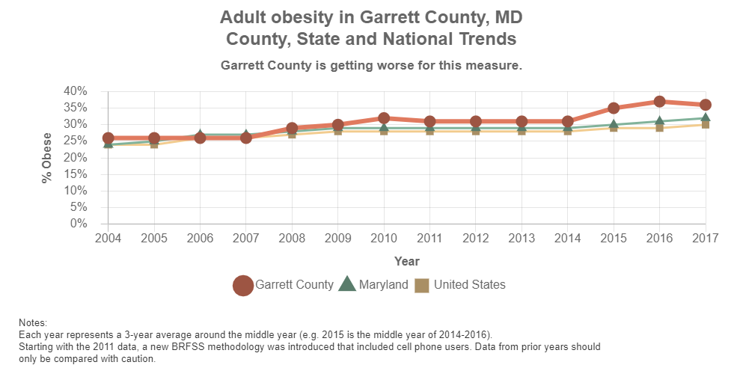
Notes:
Obesity Trend in Garrett County – from County Health Rankings and Roadmaps – 3 year average with County Rankings and Roadmaps

Slide 22
Percentage of students who had five or more drinks of alcohol in a row, that is, within a couple of hours, on one or more of the past 30 days
Source: YRBS, 2019High School
Notes:
According to the Adolescent Wellness survey, both high school and middle school students believe 23% of the students binge drink. We are making progress in this area and we hope that it will continue.

Slide 23
Overdose Deaths by Year
By Year | Total OD Deaths | Rx Opiate | Fentanyl | Heroin | Any Opiate | No Opiates
2010 | 4 | 2 | 0 | 0 | 2 | 2
2011 | 3 | 1 | 0 | 2 | 3 | 0
2012 | 0 | 0 | 0 | 0 | 0 | 0
2013 | 6 | 2 | 0 | 1 | 2 | 4
2014 | 2 | 2 | 0 | 1 | 2 | 0
2015 | 5 | 4 | 0 | 4 | 4 | 1
2016 | 1 | 0 | 0 | 0 | 0 | 1
2017 | 8 | 4 | 0 | 1 | 5 | 3
2018 | 3 | 2 | 2 | 1 | 3 | 0
2019 | 9 | 1 | 6 | 1 | 7 | 2
Total | 47 | 18 | 11 | 12 | 31 | 15
Average: 2010-20 | 4.7 | 1.8 | 1.1 | 1.2 | 3.1 | 1.5
2020 | 9 | 1 | 6 | 1 | 6 | 3

Slide 24
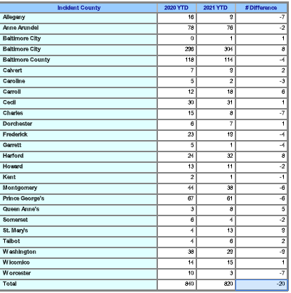
Unintentional Drug Intoxication Deaths
2020 – April, 2021

Slide 25
Healthy Communities
 | Meets or Exceeds State Goal | Needs Improvement
4 Measures | Pedestrian Injury Rate On Public Roads | Children Maltreatment Rate ✔️
 | Affordable Housing ✔️
 | Domestic Violence ✔️
Notes:
Healthy Communities does not have any areas where the GCHD directly impacts the measures. This is the value of interagency collaboration. Pedestrian Injury Rate on public roads 3.4 (best in the state) MD GOAL 35.6
Child Maltreatment Rate 9.2, MD GOAL 8.3 In our CHIP we did not meet our objective—maintain or reduce child maltreatment baseline was 4.2
Domestic Violence 475.1, MD GOAL 445
MIGHT BE A GOOD TIME TO MENTION GARRETT TRAILS
Actually 7 Measures
3 are considered statistically insignificant because of low numbers.
SO, Out of the 4 we can count, GC is meets or exceeds the state goal in one area and needs improvement in three.
Suicide Rate, Children with elevated blood lead levels and Fall related death rate are measures with small numbers

Slide 26
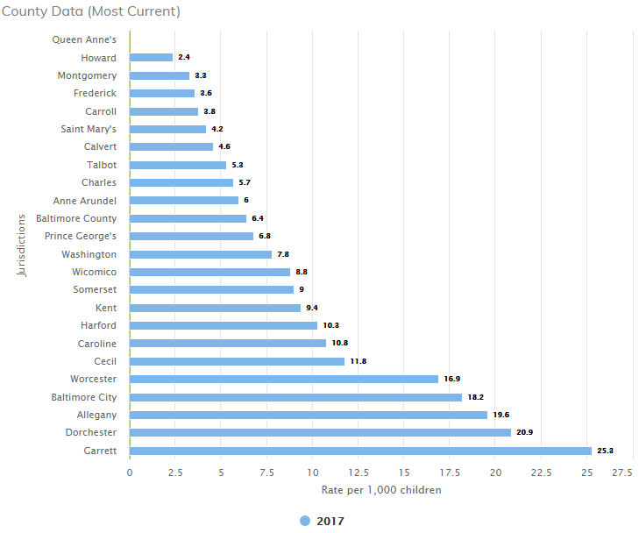
CHILD
MALTREATMENT
This indicator shows the rate of children who are maltreated per 1,000 population under the age of 18. Child abuse or neglect can result in physical harm, developmental delays, behavioral problems, or death. Abused and neglected children are at greater risk than other children for delinquency and mistreatment of their own children
MD SHIP
Notes:
The 2015 SHIP showed Garrett County at 10 and it has risen to 25.3 in 2017
Unduplicated count of children in Maryland with either an indicated or unsubstantiated finding of child maltreatment (physical and sexual abuse, mental injury-abuse, neglect, and mental injury-neglect) during the State fiscal year
Garrett County trend: 2010-4.2 / 2011-10.2 / 2012-4.9 / 2013-7.1 / 2014-9.2 / 2015-10.0 / 2016-18.4 / 2017-25.3
Adolescent wellness group is working on these issues. Identify the problems before we can begin to make a change. Meth?

Slide 27
Access To Care
 | Meets or Exceeds State Goal | Needs Improvement
4 Measures | Uninsured ED Visits
 | Children Receiving Dental Care in The Last Year ✔️ | *WORST IN THE STATE* Adolescents Who Received A Wellness Checkup In The Last Year (2017 Data) ✔️
 | Persons With A Usual Care Provider ✔️
Notes:
The Adolescent wellness committee has been working hard on strategies to address the issue of low percentage of adolescents receiving a wellness check.

Slide 28
Adolescents who received
wellness checkup in last year
Measurement Period 2017
Source: MD SHIP
Notes:
This indicator shows the percentage of adolescents (ages 13-20 years old) enrolled in Medicaid (320+ days) who received a wellness visit during the past year
Adolescent Wellness survey question: What keeps you from attending wellness/prevention check-ups in the last 12 months?
The most used answer for Middle and High School students “I am generally well and not in need of routine wellness visit.
The most used answer for the Middle and High School parents was the same “my child is well, and not in need of routine wellness checks.
Other close seconds were: My child had wellness exams up to age 12 and now have sports physicals and go to the doctor when needed.
Not enough time
Minimum of one hour appointment

Slide 29
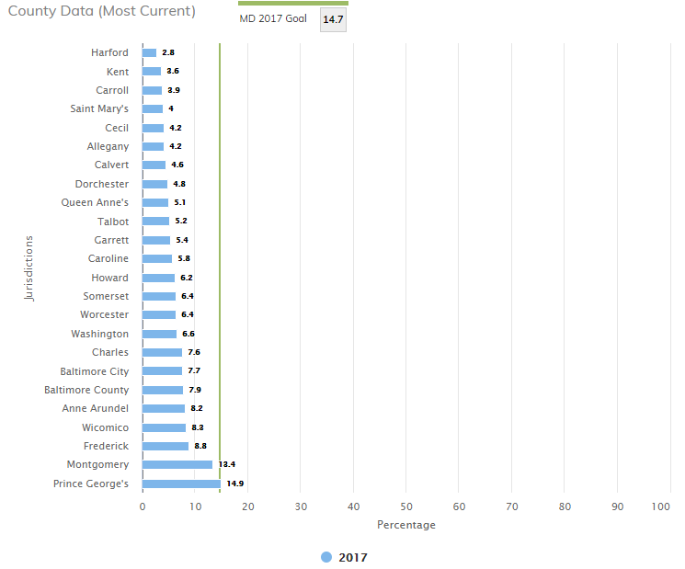
UNINSURED EMERGENCY DEPARTMENT VISITS
This indicator shows the percentage of persons without health (medical) insurance.
Garrett
5.4
Measurement Period
MD SHIP
Notes:
People without health insurance are more likely to be in poor health than the insured. Lack of health insurance can result in increased visits to the emergency department and decreased routine care visits with a primary care provider. Better job of enrollment in MA in poorer counties

Slide 30
Quality Preventive Care
 | Meets or Exceeds State Goal | Needs Improvement
10 Measures | *4th Best In The State* Age-Adjusted Mortality Rate From Cancer ✔️ | Hospitalization Rate Related to Alzheimer’s or other dementias ✔️
 | ED Visit Rates Due to: Hypertension (3rd Best in State) Addiction Related Condition | ED Visit Rates Due to: Mental Health Conditions Asthma Heart Disease Diabetes ✔️
 | ED Visit Rate Due to Dental Care ✔️ | Annual Seasonal Flu Vaccinations ✔️
Notes:
Twelve Measures
Two are considered statistically insignificant because of low numbers or lack of data.
Drug induced death rate and Children (19-35 months old) who receive recommended vaccines
SO, Out of the ten we can count, GC is meets or exceeds the state goal for 3 and needs improvement in 7.

Slide 31
COVID 19 Current Data
Garrett
7-Day Positivity Rate: 3.21%
7-Day Case Rate 4.92
Deaths: 62
Hospitalized: 0
Vaccinated: 38.7% 11,206
Maryland
7-Day Positivity Rate: 1.87%
7-Day Case Rate: 5.0
Deaths: 8,846
Hospitalized: 262
Vaccinated: 51.5% 3,112,742

Slide 32

Notes:
Garrett County Planning Tool - Increase for FY. My GarrettCounty.

Slide 33

Notes:
CHIP Action Group Pageviews - For groups or are in any part of the CHIP. These were for pages that have something to do with our Health Improvement Plan

Slide 34

Notes:
From Shelley:
GoGarrettCounty.com is the latest innovative digital initiative from the Population Health, Innovation & Informatics Unit within the Garrett County Health Department. Collaboratively designed with the Health Planning Council and the Child & Adolescent Wellness Workgroup, the well-being program is entirely community-led with a powerful micro-sampling component that has provided new data insights to inform future programming. GoGarrettCounty.com was designed, built, and soft-launched December 16, 2020 and already has close to 300 registered participants. Participants watch videos online submitted by local individuals representing various agencies and community groups. The participants earn points which can then be redeemed in their online store on various items that support active and healthy lifestyles. The process of creating a program that cultivates compassion with an aim of elevating others, making connections, supporting local businesses, and measuring wellbeing is a new approach to addressing chronic disease prevention, especially diabetes. We’ve learned from the micro-sampling efforts collected on gogarrettcounty.com (193 surveys) that a large portion of our participants don’t consider themselves “unhealthy” although their reported BMI, activity level, and diet classifications would indicate otherwise. By approaching chronic disease more broadly leading with well-being it naturally makes the program more inclusive by finding similarities and then honing in on potential areas of concern. Creating space for buy-in of various agencies and local businesses (47 and counting) allows us to galvanize our collective efforts. Consistently delivering vetted health messages (74 to date) that synergistically tie available resources by topics create a unique spin that makes talking about chronic disease more palatable to many who are not yet ready to acknowledge they may be at risk for pre-diabetes. For others who are in different stages of behavior change the program creates ease and accessibility to the existing diabetes management programs in the county.
Microsampling 193

Slide 35

Notes:
From Shelley:
The Child & Adolescent Wellness Workgroup has expanded and focuses now on three major goals:
1) Increase Well Child Checks
Strategies to achieve that goal
-------Knowing our baseline from providers
-------Provider education
-------Surveying (primary data collection)
-------Marketing efforts
2) Ensure children, adolescents, and their families have access to mental health services
Strategy to achieve that goal
-------Created a Behavioral Health Provider Guide
MENTAL HEALTH MATTERS CAMPAIGN
-------Seeking Funding for SBIRT
3) Increase the number of children and teens that maintain a healthy weight
(new action group on my garrett county called healthy weight workgroup)
Primarily physician offices interested in implementing a program that will be piloted at Crelin Elementary.
Oversight, strategy development and LHIC Funding are being managed through the Population Health, Innovation & Informatics Unit.
Moved from a data-gathering workgroup to program implementation across sectors

Slide 36

Notes:
Garrett County Resource Guide Started in 2017 with the resource guide. Important because it is collecting what people are actually searching for.

Slide 37

Notes:
These resource gaps are identified through the analysis of unreturned (no results for specific search) or repeated searches by the same individual/device. These are not in any order, but are emerging themes that will be further dissected as the Population Health Unit resumes its “Garrett County Insights” program this summer. Sample insight: https://garretthealth.org/county-insights-chronic-diseases-cancer-heart-disease-diabetes-etc/
Themes: dentures primarily, including younger adults + dental access and affordability

Slide 38
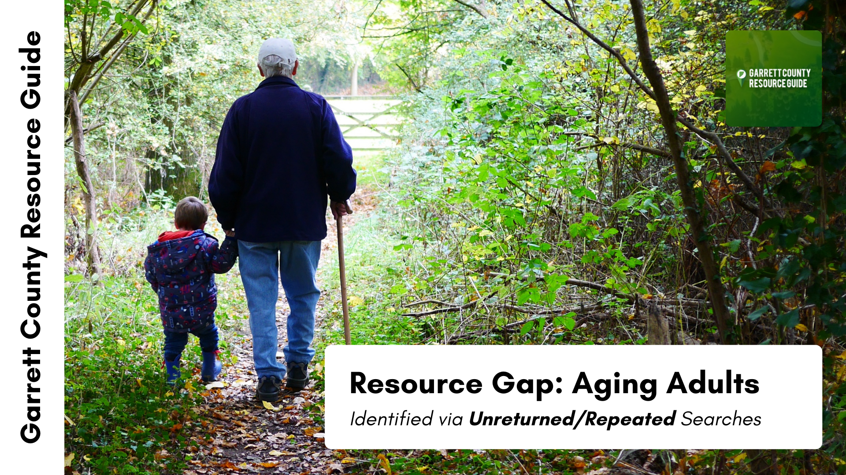
Notes:
Themes: wide spectrum of assistance needs for aging populations – will need further analysis

Slide 39

Notes:
Themes: counseling and therapy + matches Adolescent Wellness Workgroups findings for acute care and group settings

Slide 40

Notes:
Themes: affordable housing, bill and cash assistance, and jobs

Slide 41

Notes:
Themes: internet access in specific areas + affordability

Slide 42

Notes:
Themes: transportation; services that come to “me”

Slide 43
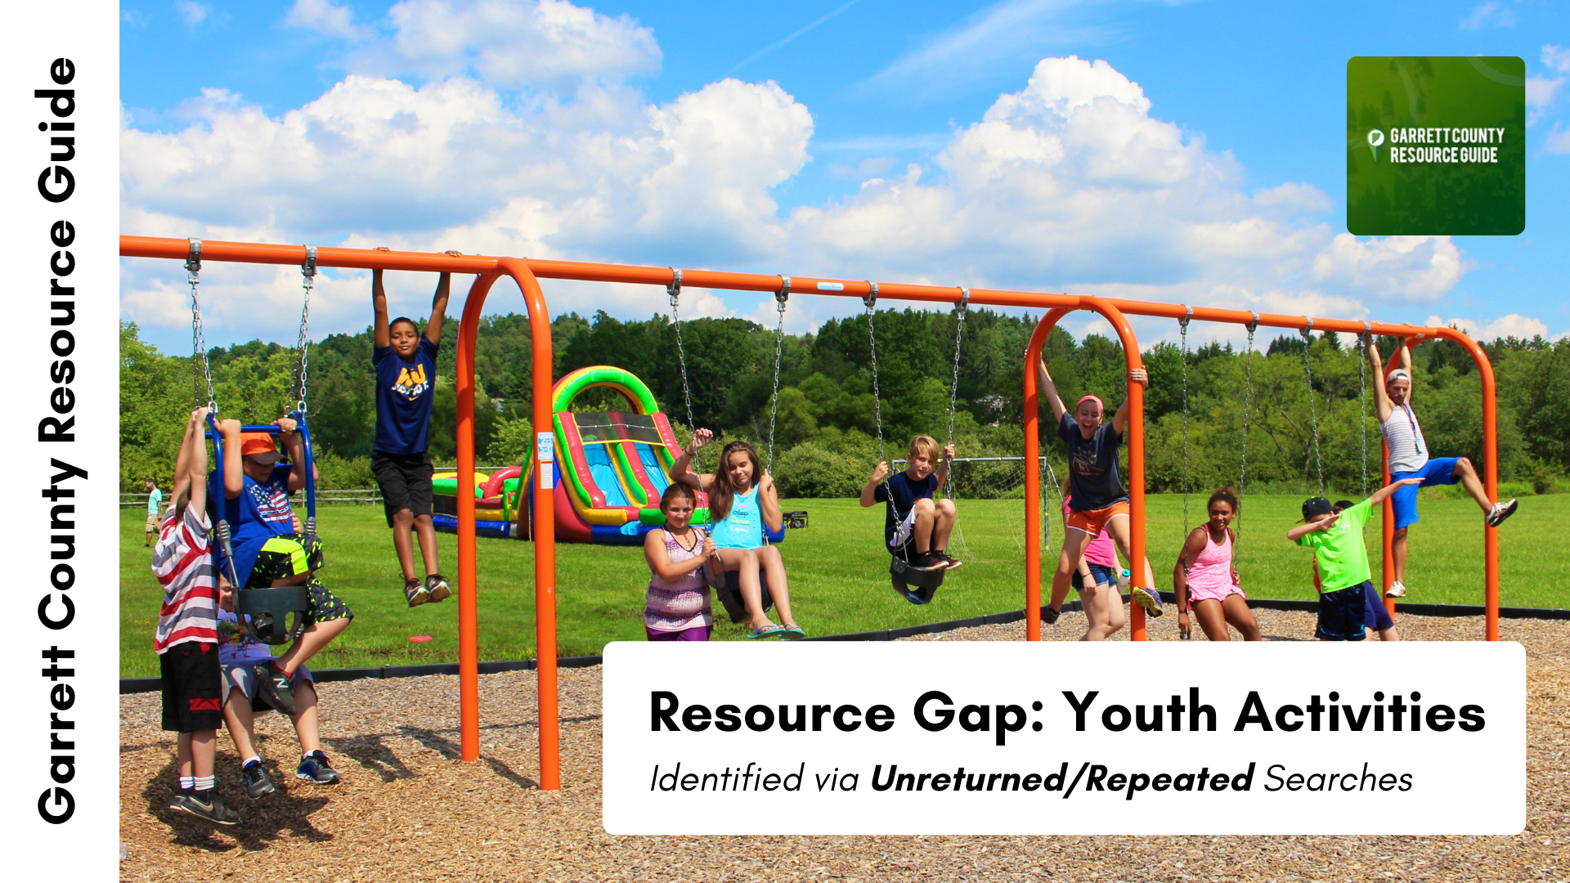
Notes:
Themes: things to do, youth sports, sports leagues, clubs, activities

Slide 44
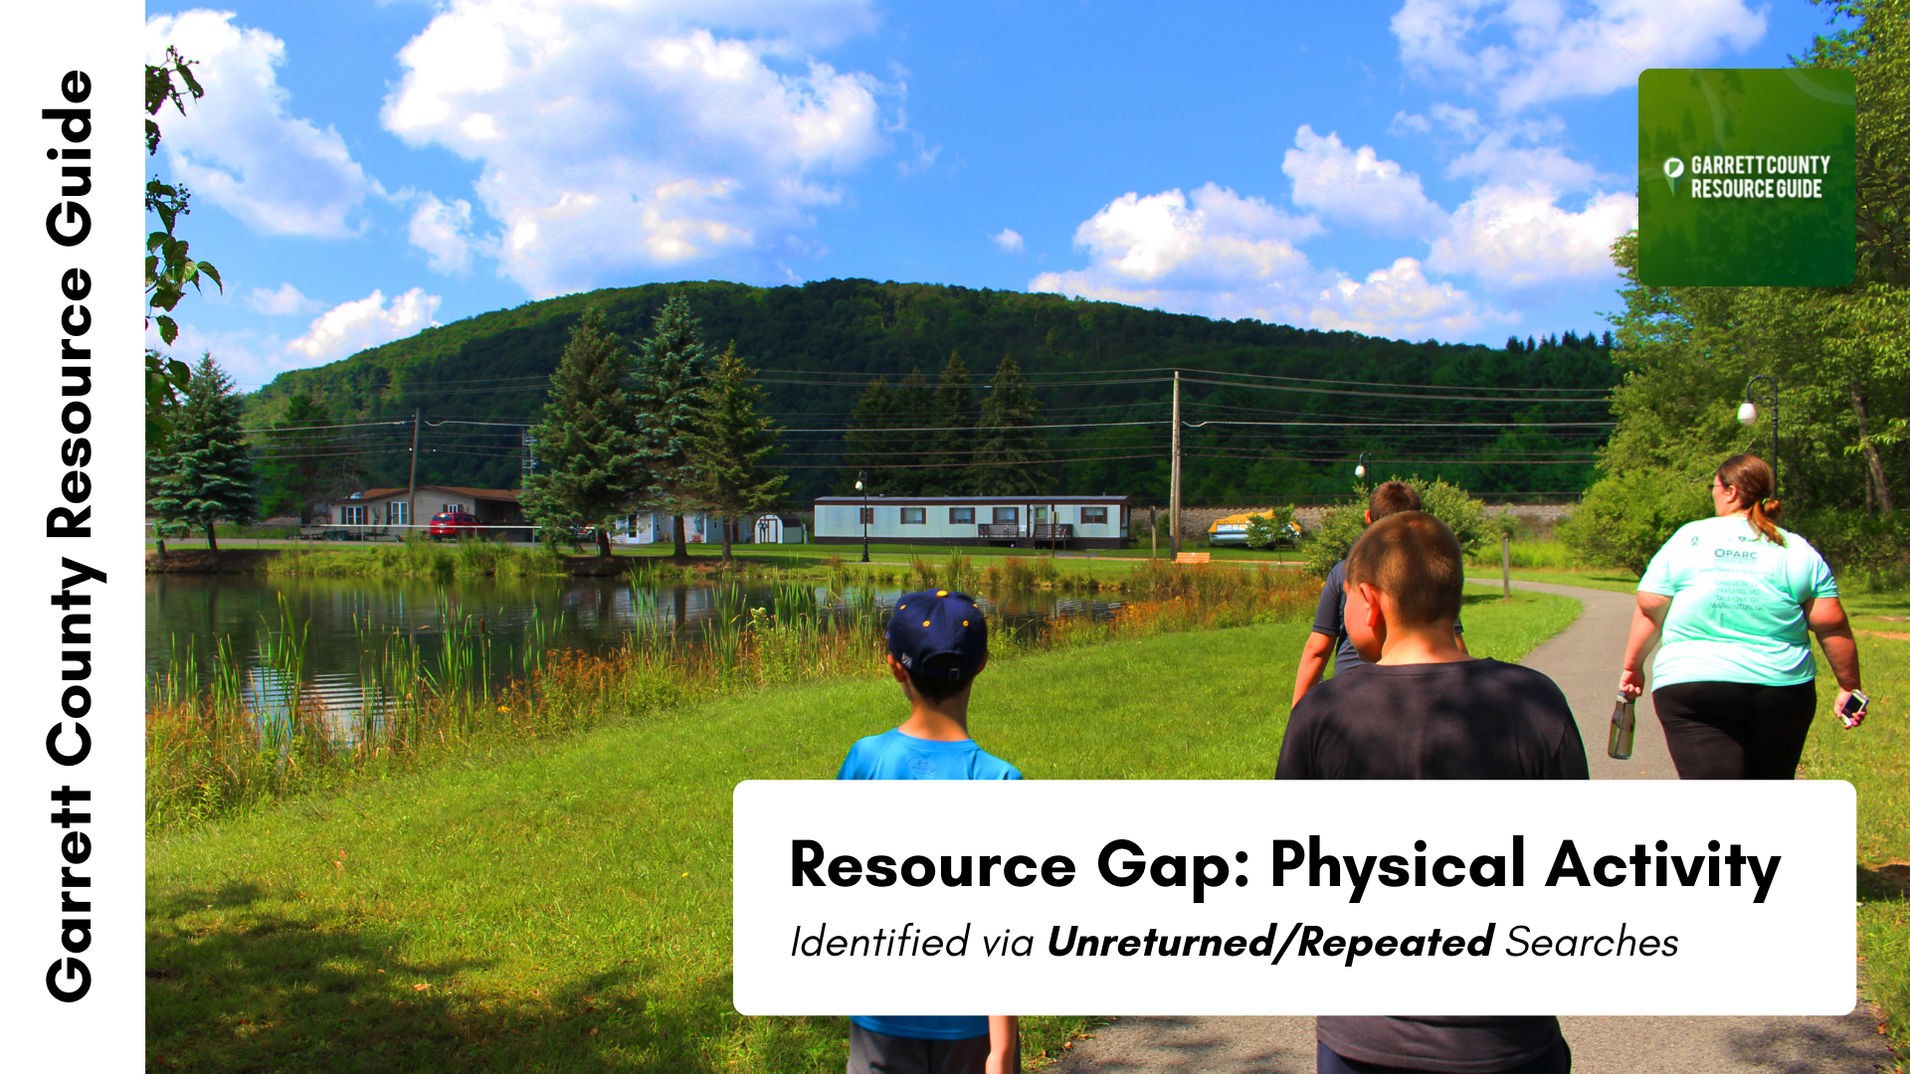
Notes:
Themes: facilities near me, sports, walking trails, weight loss groups ++ searches overlap w/ youth activities

Slide 45
Priorities for 2021
Prevent local outbreaks of SAR CoV-2 (COVID-19)
Chronic Disease, focusing on risk factors-nutrition, physical Activity and tobacco
Access to Care & Linkages to Community Resources
Behavioral Health: Mental Health & Substance Use
Family Structure with emphasis on maternal, child and adolescent health
Social Determinants of health, specifically economic inequities and poverty

