Slide 1
Garett County
Harm Reduction Efforts
Chelsie Dever,
Overdose Response Program Coordinator
Presentation for Garrett County Health Planning Council
March 25, 2021

Slide 2
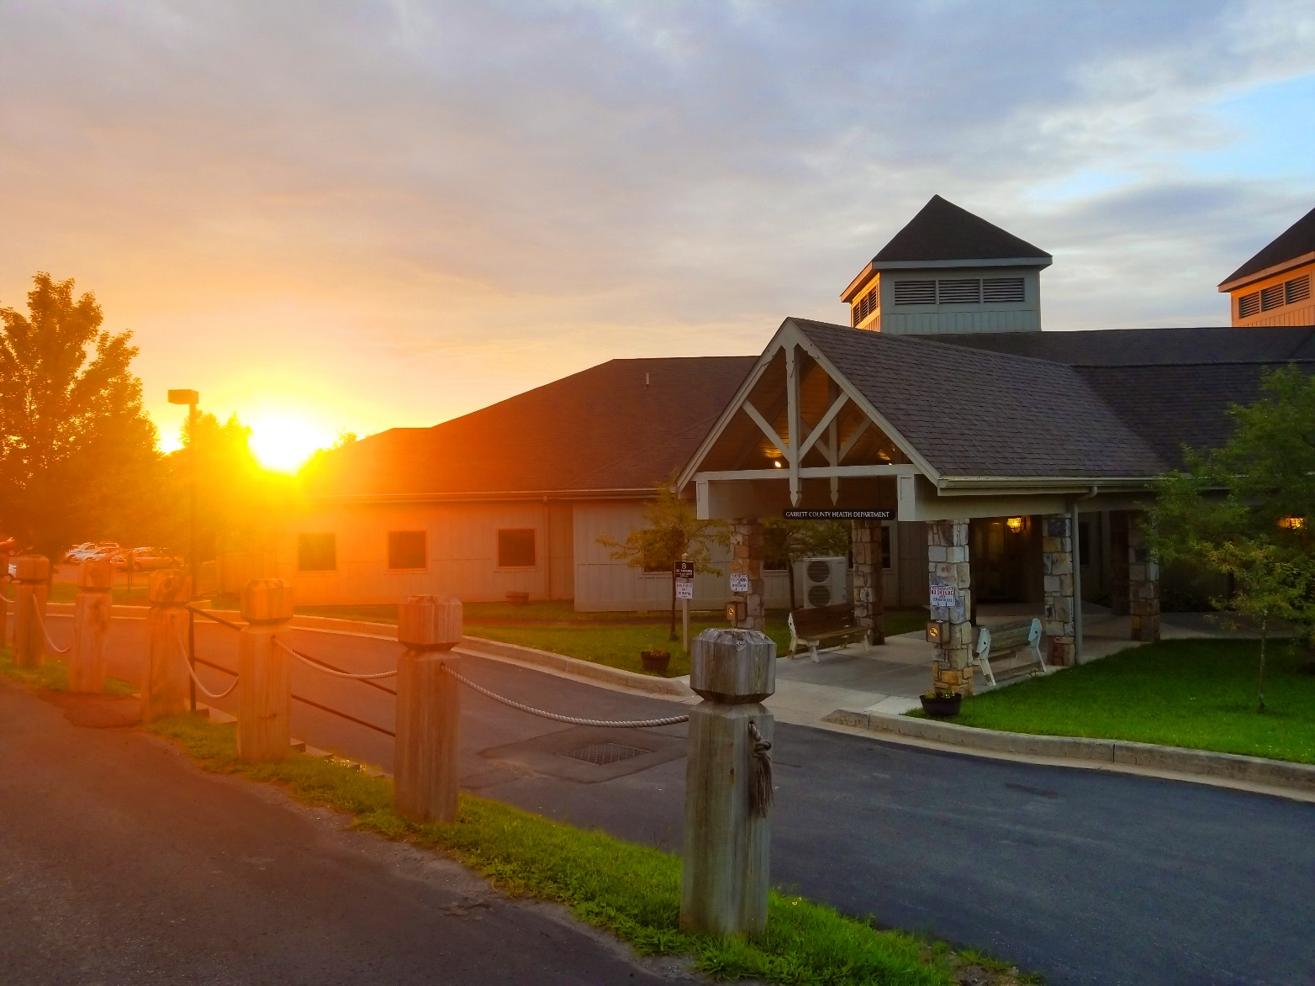
Fentanyl Test Strips
Narcan Distribution
Academic Detailing
Community Resource Team
Stand Together Consortium
Medication-Assisted Treatment Providers

Slide 3
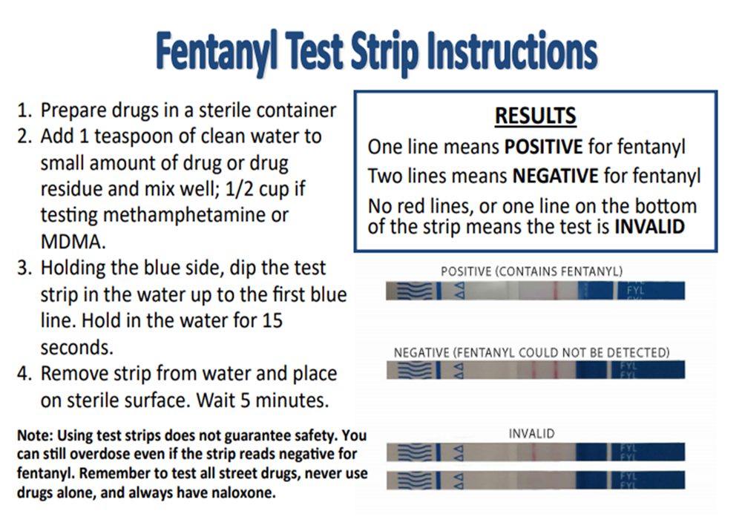
Fentanyl Test Strips
Since July 2020,
we have distributed 504 strips
to 84 individuals
Test Strips are offered in our Behavioral Health Department, Narcan Pick up sites, and Overdose Response Trainings

Slide 4
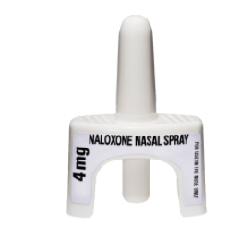
Narcan Distribution
GCHD:
Overdose Response Trainings
Narcan Pick-up Sites
Behavioral Health Department
Mail
Dispensing Partners:
Dove Center
Garrett Treatment Center
GRMC Emergency Room
GRMC Health & Wellness
Garrett County Lighthouse
GCHD Healthy Families Department

Slide 5
Narcan Pick-up Locations
Towns that have shown support:
Crellin
Bloomington
Deer Park
Kitzmiller
Mountain Lake Park
Accident
Friendsville
Grantsville
Loch Lynn

Slide 6
Since July, 2020 we have distributed 410 units of Narcan for a total of 810 doses.

Slide 7
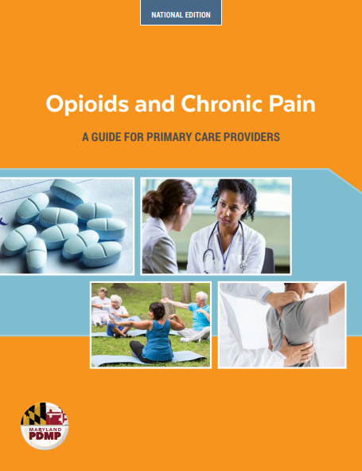
Academic Detailing
As an initiative through the Overdose Data 2 Action grant, Academic Detailing is described as outreach education for health care professionals. The purpose of this educational program is to discuss the most recent research data on a particular medical topic with the ultimate goal of improving patient care.
In January of 2021, physician meetings began to be scheduled with the purpose of educating on
co-prescription of Naloxone with Opioids.
Each meeting lasts around fifteen minutes and the provider is offered a CME credit.

Slide 8
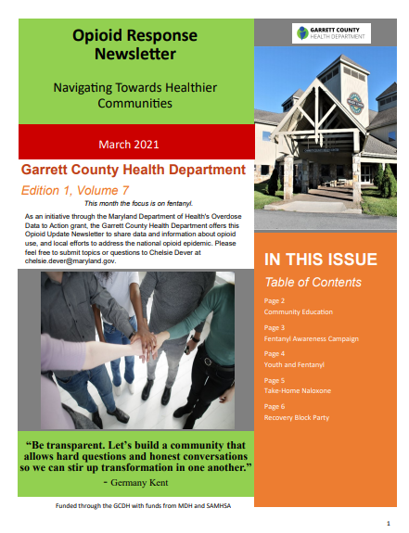
Opioid Response Newsletter
Launched in September 2020, The Opioid Response Newsletter is a monthly publication sent out to share data and information about opioid use, and local efforts to address the national opioid epidemic.
Local Data
Maryland Opioid Related News
Local Offerings and Programs
Events
Other Opioid related topics of interest

Slide 9
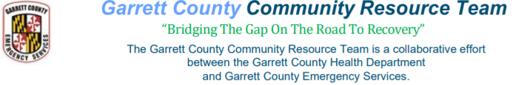
24/7 assistance is available from a team member, 301-334-7249
The members include educated and experienced Peer Support Specialists from the Garrett County Health Department and clinicians from Garrett County Emergency Services who are knowledgeable and skilled in Advanced Life-Support
  Provide information about several different recovery programs that are local to Garrett County.
  • Assist families who have a loved one struggling with opioid addiction.
  Assist in helping an individual overcome barriers with getting into treatment
Since July 2020, The CRT team has referred 41 people to treatment services and Peer Support Specialists.

Slide 10

Stand Together is a grassroots effort comprised of concerned citizens and organizations dedicated to addressing drug use and abuse through prevention, intervention, treatment, recovery, and education.
Chair: Sadie Liller, Alcohol and Drug Abuse Prevention Coordinator
The Stand Together Consortium meets on the second Tuesday of every month.

Slide 11
Medication-Assisted Treatment Providers
Garrett Treatment Center, Dr. Richard Perry
GRMC Health & Wellness, Kelly Rock CRNP
Garrett County Center for Behavioral Health, Dr. Steward Callis
There have been explorations of MAT services in the Northern End of the county.

Slide 12
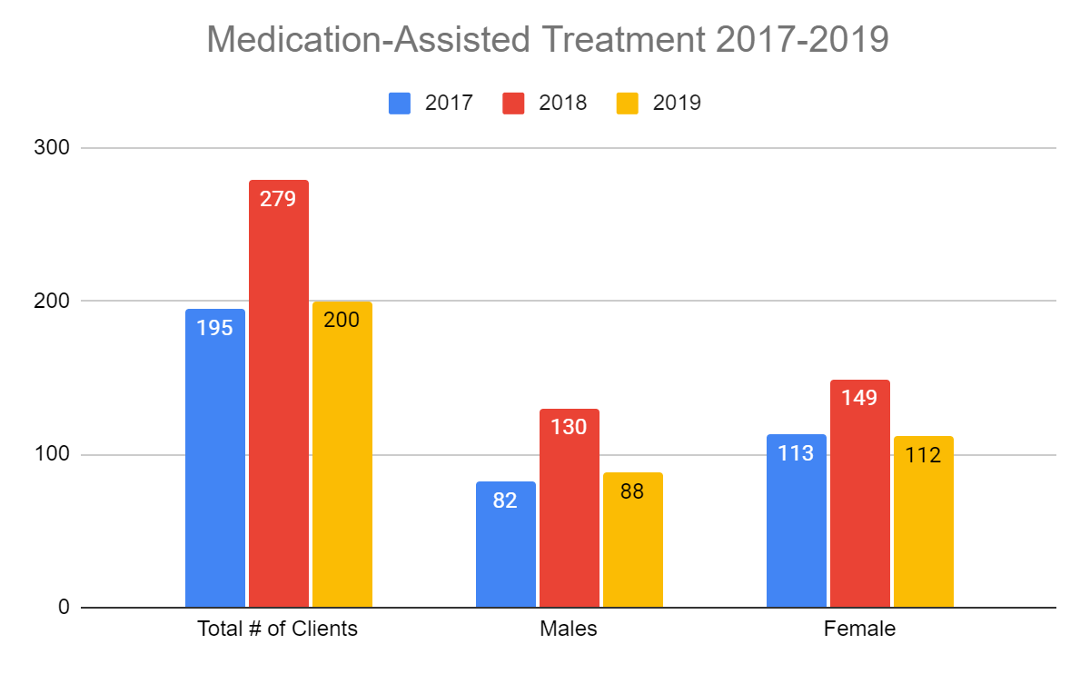

Slide 13
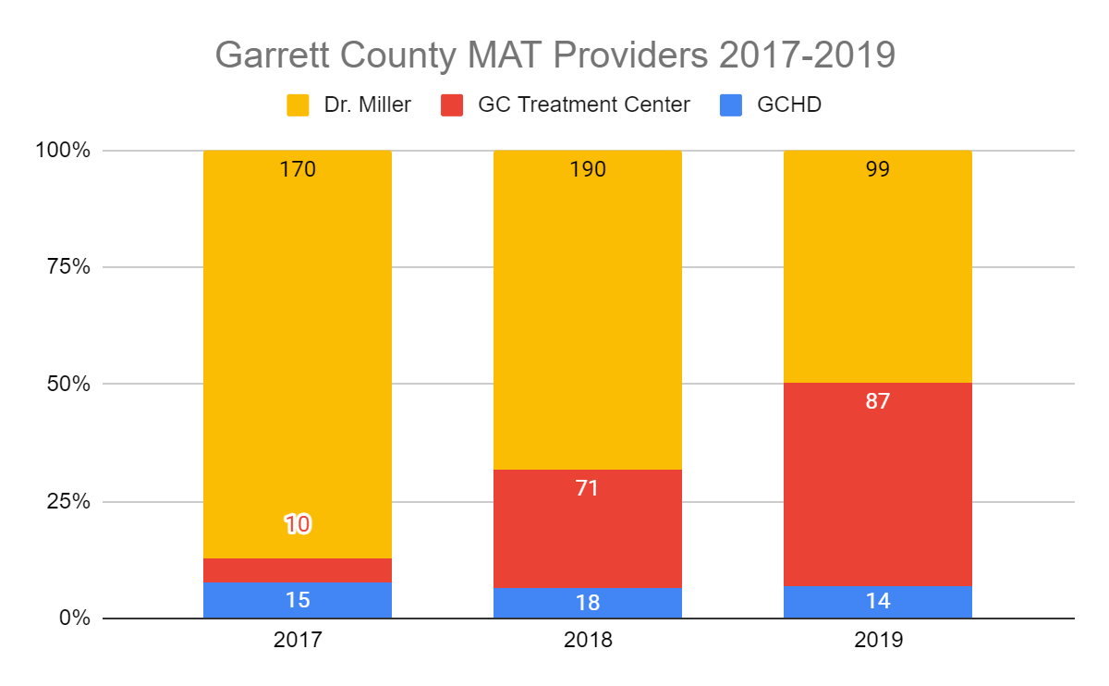

Slide 14
