Slide 1
GARRETT COUNTY HEALTH PLANNING COUNCIL
Opioid Epidemic: Intervention and Treatment Update
3/25/21

Slide 2
Overdose Deaths by Calendar Year
By Year | Total OD Deaths | Rx Opiate | Fentanyl | Heroin | Any Opiate | No Opiates
2010 | 4 | 2 | 0 | 0 | 2 | 2
2011 | 3 | 1 | 0 | 2 | 3 | 0
2012 | 0 | 0 | 0 | 0 | 0 | 0
2013 | 6 | 2 | 0 | 1 | 2 | 4
2014 | 2 | 2 | 0 | 1 | 2 | 0
2015 | 5 | 4 | 0 | 4 | 4 | 1
2016 | 1 | 0 | 0 | 0 | 0 | 1
2017 | 8 | 4 | 0 | 1 | 5 | 3
2018 | 3 | 2 | 2 | 1 | 3 | 0
2019 | 10 | 1 | 6 | 1 | 7 | 3
Total | 42 | 18 | 8 | 13 | 28 | 14
Average: 2010-19 | 4.2 | 1.8 | .8 | 1.3 | 2.8 | 1.4
2020 | 9 | 1 | 6 | 1 | 6 | 3

Slide 3
Accidental Poisonings – All ED Visits
2020 Data through November 2020
Source: Maryland Opioid-related Overdose Surveillance Enhancement Report (MDH)

Slide 4
Garrett County EMS Narcan Administrations by quarter*
*Fiscal Year:
2021 3rd quarter reflects 2 months of data

Slide 6
# EMS Referrals to Peer Support
2020 Data through November 2020
Source: Maryland Opioid-related Overdose Surveillance Enhancement Report (MDH)

Slide 7
Substance Exposed Newborns (SEN) delivered at GRMC or Collected in FP/OB Offices (Includes WV patients) by Fiscal Year.

Slide 8
Overdose Response and Harm Reduction
FY ‘21 Data through February 2021

Slide 9
COVID – 19 Update

Slide 10
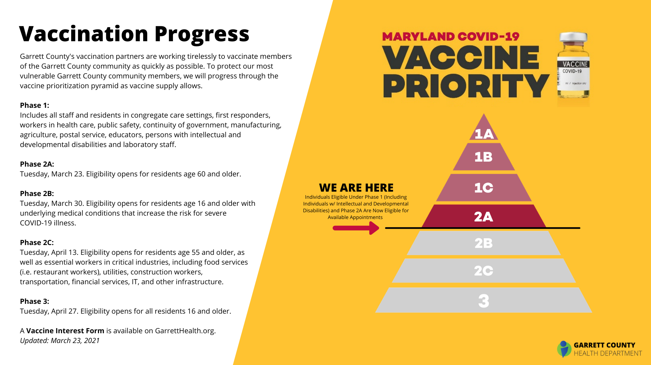

Slide 15
CRISP Public Health Information

Slide 17
