Slide 1


Board of Governors
Strategic Planning Committee
Mark Boucot, President and CEO

Slide 2
Mission Statement:
We treat each patient, and
each other, like a member
of our own family

Slide 3
Garrett Regional Medical Center
Board of Directors
BOG
COMMITTEES
GRMC
Medical Staff
Garrett Regional Medical Center
CORPORATE STRUCTURE
Executive
Committee
Medical Executive Committee
Provider Entities
Joint Ventures
Physician Practices
Finance Committee
Medical Staff Bylaws Committee
Garrett Regional Medical Center
Oakland MRI
(OMRI)
Professional Emergency Physician Services
(PEPS)
Strategic Planning
Committee
MS Credentialing Committee
Free State
Insurance Captive
Garrett Anesthesia Services
(GAS)
Quality Assurance & Risk Management
Committee
Department of
Surgery
Sub-Acute Unit
Skilled Nursing Facility
Department of Emergency Medicine
Specialty Physicians of Garrett County
Board Administrative Committee
Executive Compensation
Board Bylaws
Board Development
Department of Obstetrics
Garrett Family Medicine
(Replacing Miller)
Grantsville Medical Center
DJ Crable and Urgent Care
Joint Conference Committee
Department of Medicine
Gynecology Practice
Dr. Abigail Feathers
Critical Care Committee
Family Health and Wellness Center
(Behavioral Health)

Slide 4

GRMC STRATEGIC PLANNING PROCESS
Stakeholder Input
Community Health Needs Assessment
Health Planning Committee; Rural Health Planning Committee; MAPP; SHIP
Regulatory Analysis
TJC; State;
Market Analysis
Patient Volume Analysis
Staffing Analysis
Capacity and Capability
Situation Analysis
3 Year
Physician
Stake Holder Input & assess Capacity and Capability
Strategic Plan
3-5 Year
18 month Refresh
SWOT Analysis
Physician Recruitment Plan
Information Systems Strategic Plan (ISSP)
Master Facilities Plan
3 Year Annual Refresh
Annual Operating Plan
Goals With Metrics Reporting to Board of Governors (Stop Light) Annual Operating and Capital Budgets
Annual

Slide 5
GRMC Strategic Plan Areas of Focus:
  GRMC Strategic Aims
  High Quality and Safety
  Workplace Excellence
  Superb Patient Experience
  Market Leadership
  Financial Stewardship
  Advance the Culture of High Reliability
  Be Employer of Choice in the Region
  Achieve Excellence In Patient Experience
  Create Access to Needed Healthcare Services
  Develop Systems to Support Growth
Value Based Reimbursement

Slide 6
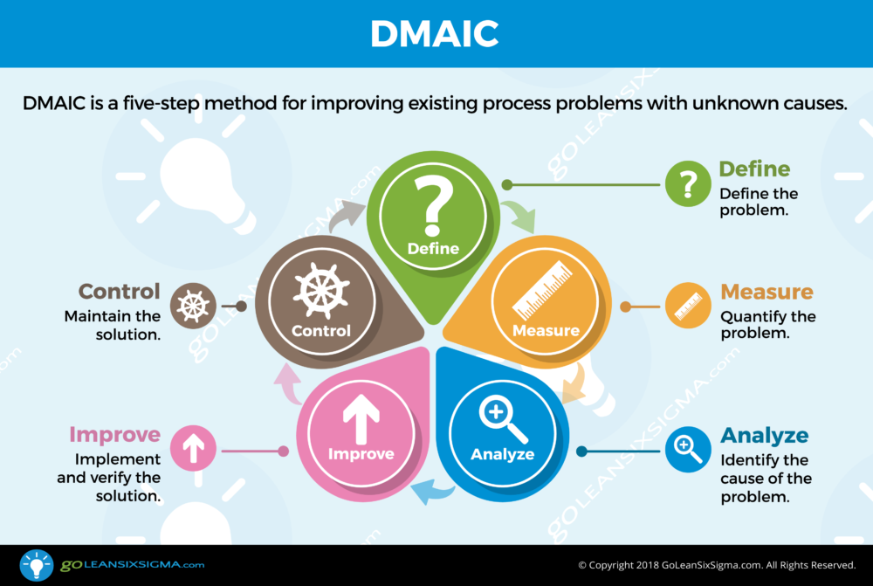
GRMC SYSTEM MODEL FOR
PERFORMANCE IMPROVEMENT
Lean Six Sigma: Define; Measure; Analyze; Improve; Control – DMAIC

Slide 7

SHARED GOVERNANCE MODEL
Hospital Leadership
FRONT LINE STAFF COUNCILS
Patient Safety
Council
Patient Experience
Council
Employee Engagement Council
EMPOWERING STAFF FOR EXCELLENCE

Slide 8

Market Assessment
& Strategy
Mark Boucot, CEO

Slide 9
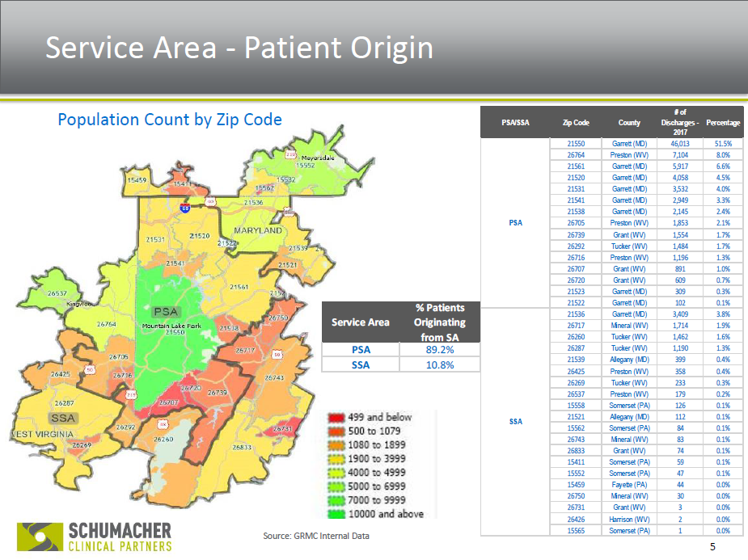
Market Assessment

Slide 10
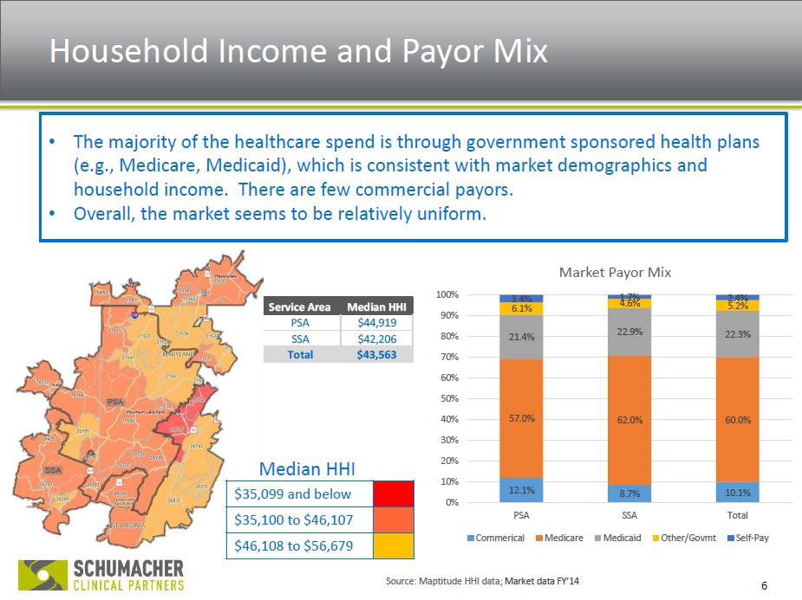
Market Assessment

Slide 11
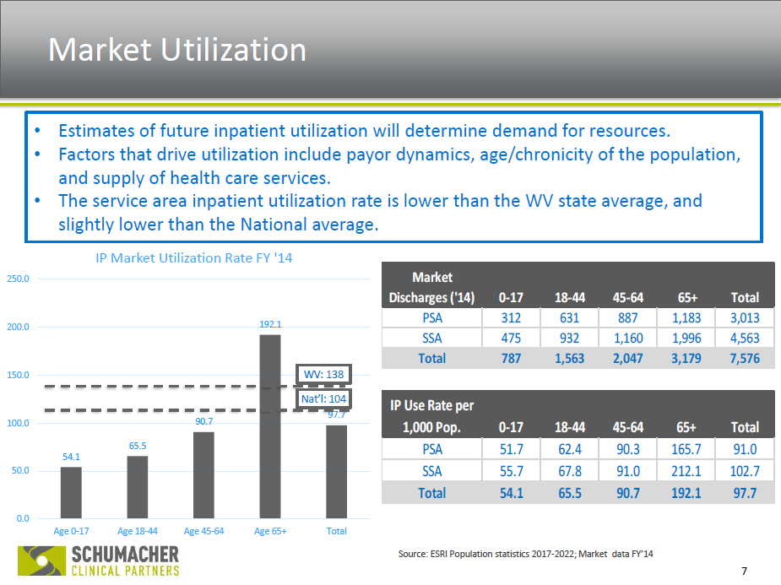
Market Assessment

Slide 12
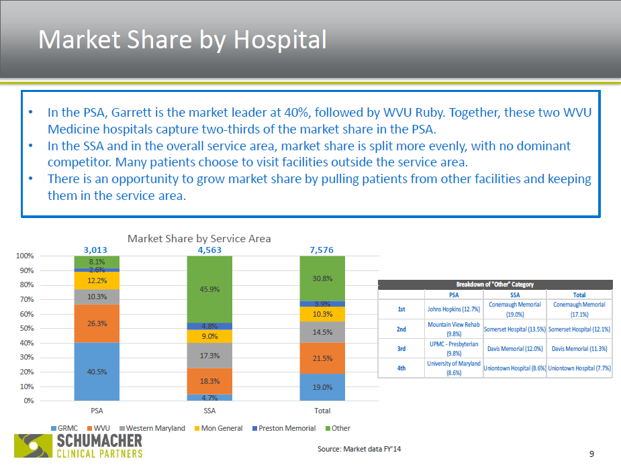
Market Assessment

Slide 13
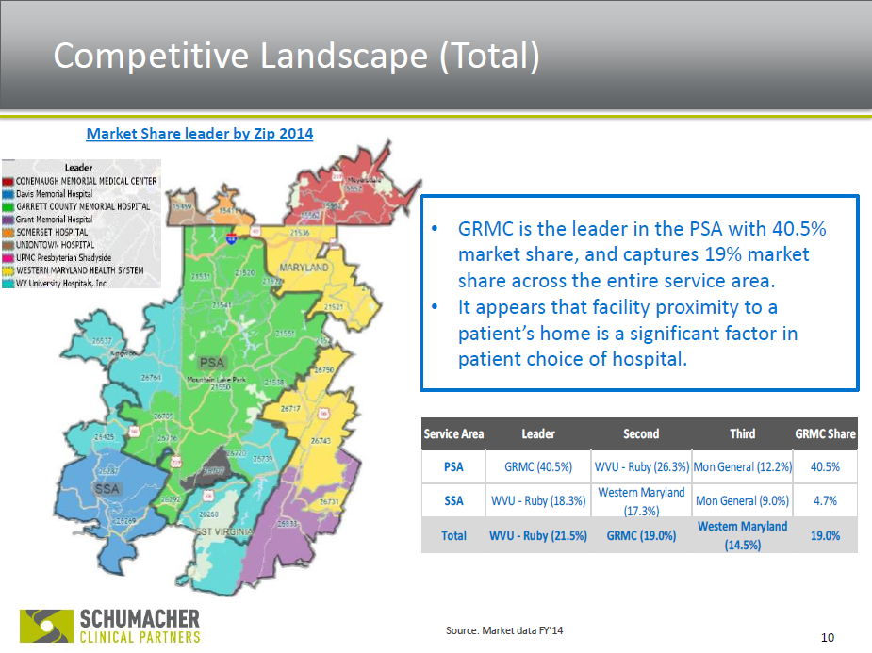
Market Assessment

Slide 14
Market Assessment

Slide 15
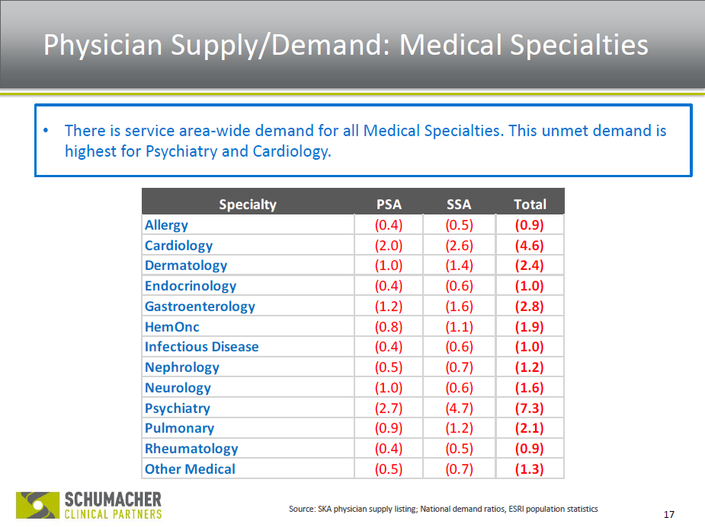
Market Assessment

Slide 16
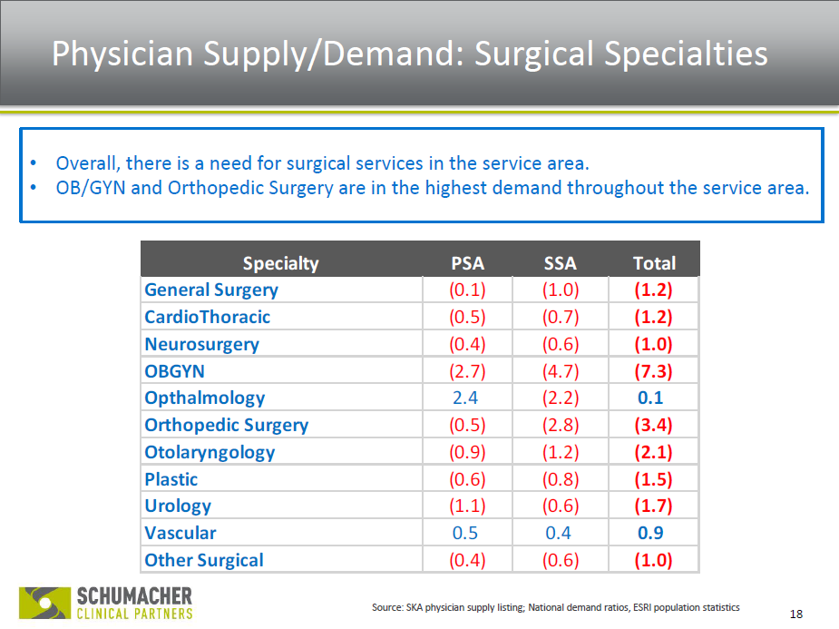
Market Assessment

Slide 17
Market Assessment
Strategic Growth Initiatives
Behavioral Health Center started up from HRSA Grant
Operating Room Renovation (Maryland Bond Fund Grant contribution of $471,000 for facilities infrastructure)
Neurology Telemedicine (adding in-patient consults)
V-ICU Project
Urology Specialist Recruitment w/WVUHS
New General surgeon recruited
New Orthopedic surgeon recruited
New Pain Management Clinic being implemented
Regional Cancer Care Expansion planned for 2021
Regional Behavioral Health Expansion planned for GRMC and PVH through HRSA grant
GRMC will incorporate the Health Planning Council’s Community Health Needs Assessment into the hospital’s strategic planning

Slide 18
GRMC WVU Medicine Affiliation
WVU Medicine and GRMC became affiliation partners in September 2015
High level goals achieved:
  Implemented hospital rebranding campaign
  Implemented a Cancer Center
  Implemented an ambulatory site for the WVU Heart and Vascular Institute in Oakland
  Increased specialty care for the community:
    Dermatology Clinic
    Nephrology Clinic
    Urology Services
  Implemented Telemedicine for tele-stroke services and Virtual ICU
    WVU Critical Care and Surgical Intensivists participate with GRMC physicians to care for patients in the ICU

Slide 19

GRMC WVU Medicine Affiliation
  Implement hospital rebranding campaign:
    GRMC rebranded as an affiliate to WVU Medicine in September 2015, identifying the hospital to the widely recognized brand of WVU Medicine
    Created DBA name change in October 2015 to center the organization’s focus on the region
    Management agreement was to serve as trial period for full system membership

Slide 20
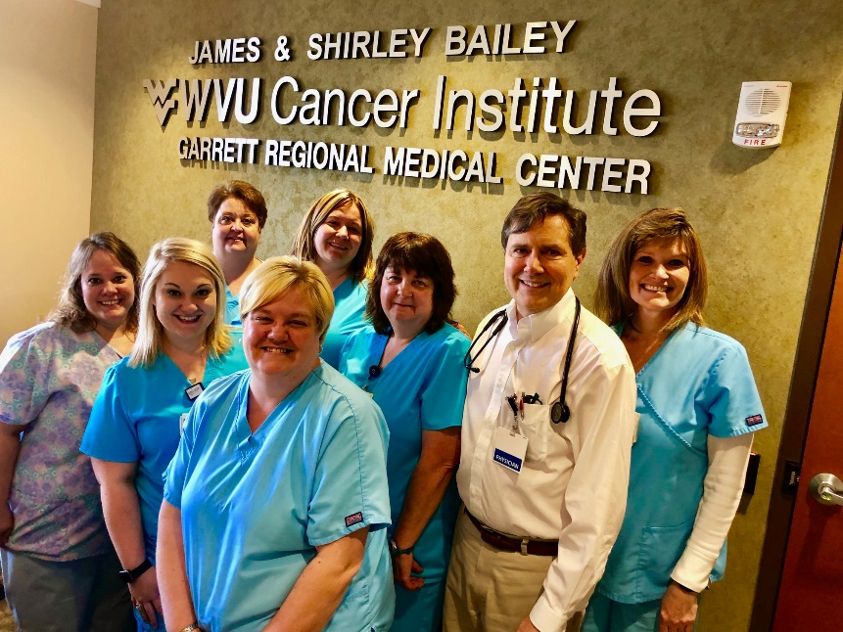

GRMC WVU Medicine Affiliation
  By January 2016; Implemented WVU Cancer Institute satellite at GRMC
    Clinical oncology services brought academic medical center level care to the Garrett Region
    The center has treated 2,700 cancer patients since opening
    In addition, the center has conducted 6178 infusions for patients with non-cancer related issues:
      Osteoporosis
      Rheumatoid Arthritis
      Crohn’s Disease
      Hemochromatosis
      Anemia
      Multiple Sclerosis
      Stickman Syndrome

Slide 21


Telemedicine Implemented 2016
WVU Medicine and GRMC implemented Tele-stroke Agreement in December 2016
Tele-stroke is a Capstone Requirement needed for GRMC’s Joint Commission Stroke Certification

Slide 22
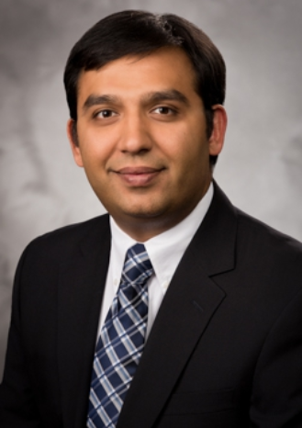
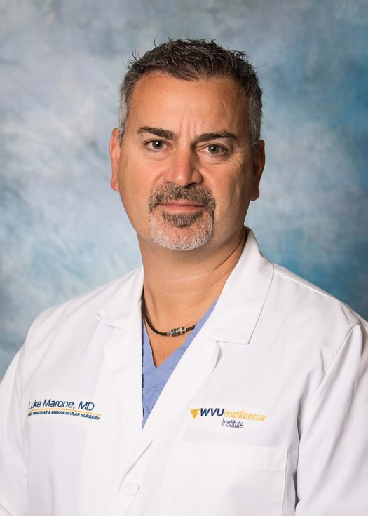
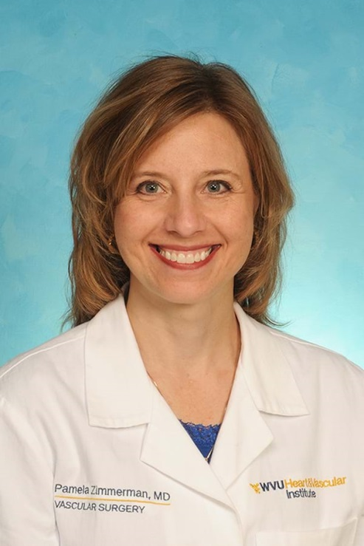
WVU Heart and Vascular Institute
In 2017, WVU Medicine made an investment of over $600,000 For the Heart and Vascular Institute (HVI) Facility at Garrett
Invested about $1.5 million in HVI annual salaries for physicians dedicated to Garrett Regional Medical Center
Brijesh Patel, MD Luke Marone, MD Pamela Zimmerman, MD
Cardiology Vascular Vascular

Slide 23
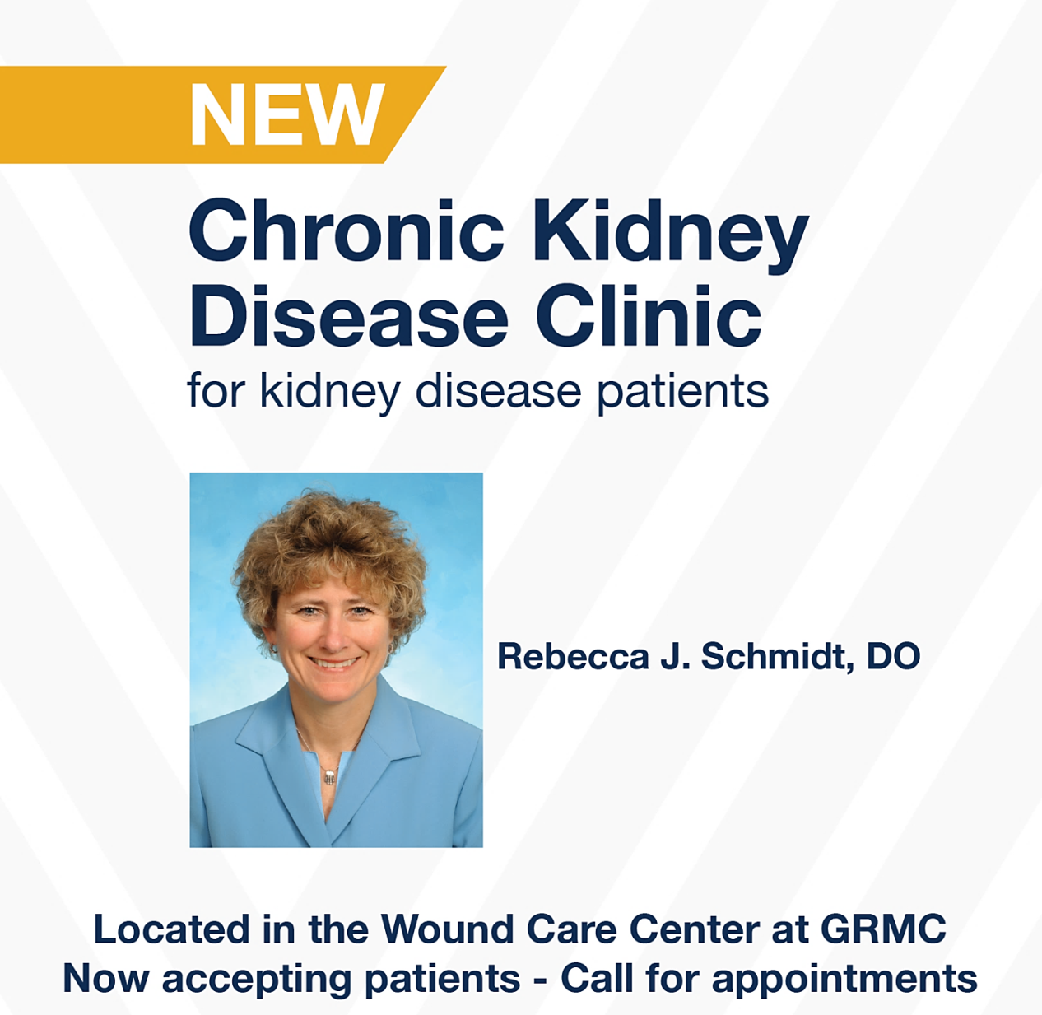
Nephrology Services
Provided at no cost to GRMC

Slide 24
WVU Medical Services based at GRMC
WVUMedicine Services represents an investment of approximately $15 million over 5 years:
Oncology-Hematology
Vascular Services
Cardiology
Urology
Nephrology (CKD Clinic)
Dermatology
Neurology Tele-stroke (Telemedicine)
GRMC Integrated to WVU Medicine Pathology

Slide 25
Advancing the Partnership
Expansion of Specialty Care in the Region:
WVU Medicine can offer additional service line opportunities for offices, rotations, and telemedicine:
  Pulmonology
  Endocrinology
  Behavioral Health and Psychiatry
  Rheumatology
  Dermatology expansion
  Neurology in patient consults

Slide 26
Advancing the Partnership
GRMC Board of Governors is considering advancing into the WVU health system as a full member partner:
  GRMC will continue to advance as a regional center for specialty care, exploring additional specialty service opportunities
  WVU offers state of the art integrated IT systems to advance patient care, i.e. EPIC to GRMC
GRMC staff will be able to participate in HR Programs:
  GRMC will be able to participate in WVU nursing float pool to reduce cost of traveling nursing
  Dependent and employee tuition reimbursement
  Student loan reimbursement for front-line staff
  GRMC will be supported with hard-to-fill positions, i.e. IT Director
  GRMC can leverage WVU’s corporate infrastructure and supply chain efficiencies with Allied Health
  Protection from competing organizations in the geography, UPMC

Slide 27
Advancing the Partnership with WVU
CONSIDERATIONS:
  GRMC Board will remain intact as the governing authority over the hospital
  Due to the Maryland payment model, GRMC will remain separate with respect to Finances
  GRMC also has representation at CEO Council for strategic decision making and CEO is given significant autonomy
  Both organizations entered into a non-disclosure agreement to complete due diligence process to determine feasibility

Slide 28
GRMC Medical Staff Requests for advancement of WVU relationship:
Employee/dependents college tuition reimbursement
Local control of service lines, Maternity services remain
Education opportunities for med staff at WVU
Independent physician training and Procedural training
Access to research WVU library
Employee training opportunities
Employees’ tenures to transfer to WVU
Employees willnot have to reapply for their jobs
GRMC to retain control of supply chain decisions with respect to clinical preference items (supplies)
Pursue Elective Resident rotations
GRMC retains final decision making into selection of any future CEO
Retain admin team
GRMC to acquire representation on corporate board
WVU to install EPIC – for hospital and independent practices
Pursue enhanced VICU
Independent physicians able to admit into the hospital
Pursue Tele-dialysis

