Slide 1
GARRETT COUNTY CANCER COALITION MEETING MINUTES
March 14, 2023
Virtual/Google Meet
9:00 AM
Notes:
ATTENDEES:
Autumn Friend - Host/Facilitator - CPEST Coordinator, CGHD), Jennifer Lee-Steckman - Facilitator, Cancer Coalition Chairperson (DON, GCHD), Heather Cooper (Director of Personal Health, GCHD), Jamie Spano (Outreach worker, GCHD), Kaitlin Lucas (Outreach worker, GCHD), Sandy Bell (Cindy’s Fund), Cristina Ruiz-McCalla (MDH), Srishti Singh (MDH), Lawrence Knapp (Friendsville Family Medicine), Linda Frazee (Friendsville Family Medicine), Paula McKenzie (DON, ACHD), Ellie Folk (CPEST/BCCP Coordinator, ACHD)

Slide 2
AGENDA
Welcome and Introductions
CPEST Grant Updates, Program Eligibility Requirements
Community Outreach/Successes/Challenges
Mission, Vision, Goals of the Coalition
Agency Updates
Next Meeting Date/Time (June 14, 2024, at 9:00 AM)

Slide 3
What is the CPEST Program & How Can It Help?
The Cancer Prevention, Education, Screening, and Treatment program is funded by the Cigarette Restitution Fund (CRF). The CRF was established in 2000 by the Maryland General Assembly to reduce the incidence of cancer and mortality in MD. The legislation required the established of a local public health component to coordinate efforts in each jurisdiction.
The CPEST program provides financial assistance and patient navigation services for skin and colorectal cancer screening to eligible Garrett County residents.
What Does the Program Actually Pay For?
A skin cancer screening exam with biopsy if needed, as well as pathology fees.
A colorectal cancer screening such as colonoscopy, sigmoidoscopy, or FIT test along with associated fees such as anesthesia, physicians, hospital, pathology, etc.
If a patient has insurance, the program will cover all co-pays, deductibles, and coinsurance.

Slide 4
CPEST Program Eligibility
Patient eligibility for cancer screening includes:
Insurance Status
Residency
Income and Family Size
Age
INSURANCE STATUS | RESIDENCY | INCOME AND FAMILY SIZE | AGE
Fully Insured: Patient Navigation Only (PNO) clients who have insurance that fully funds their cancer screening (i.e. commercial insurance, Medicaid or Medicare) Underinsured: Program funded clients who receive partial program funding (copays, coinsurance and deductibles) and navigation services. Uninsured: Program funded clients who receive full program funding and navigation services. | Must be a local, Garrett County resident for: Screening and Diagnosis Diagnostic Referrals Treatment of Complications resulting from program funded services Cancer Treatment | Income must be at or below 250% of Federal Poverty Level for household size. | Age of individuals allowed to enroll in the program is dependent on risk category and prior findings Individuals age <18 years are not eligible for enrollment into the CRF CPEST Program Recommended age to begin screening is now 45 years old!
Household Size | 250% FPL
1 | 36,450
2 | 49,300
3 | 62,150
4 | 75,000

Slide 5
Budget Type | Total Allocated | Total Spent through 02/29 | On Track? | If not on track, why:
CPEST Total | 135,496.00 | 69,937.00 | No
Purchase of Care | 29, 346.00 | 5,578.00 | No | Bills are delayed. Insurance is covering a significant amount of costs.
Printing/ Advertising | 450.00 | 120.00 | N/A | $250 will be spent in the month of April for a radio advertisement.
Educational Supplies | 1600.00 | 600.00 | N/A | New incentives will be purchased for the GC Health Fair.

Slide 6
CPEST PERFORMANCE MEASURE UPDATES
CPEST PM | FY 2024 PM | July 2023 | Aug 2023 | Sept 2023 | Oct 2023 | Nov 2023 | Dec 2023 | Jan 2023 | Feb 2023 | Mar 2023 | April 2023 | May 2023 | June 2023
# education/ Outreach activities | 74 | 3 | 17 | 17 | 18 | 46 | 66 | 70 | 70
# new individuals screened | 25 | 0 | 2 | 2 | 3 | 4 | 5 | 7 | 7
# Tobacco Cessation referrals | 13 | 0 | 0 | 0 | 0 | 2 | 6 | 11 | 15
# tobacco Cessation counseling | 13 | 0 | 0 | 0 | 0 | 1 | 2 | 2 | 2
Total # screened for CRC to date | 26 | 0 | 4 | 6 | 8 | 8 | 9 | 12 | 14
Total # colonoscopies performed to date | 20 | 0 | 2 | 4 | 6 | 6 | 7 | 10 | 12
# screened for Skin | 21 | 2 | 0 | 0 | 4 | 5 | 7 | 8 | 8
# CRC patient navigation only | 1 | 2 | 2 | 3 | 4 | 4 | 4 | 5 | 5
# cessation aids provided | 13 | 0 | 0 | 0 | 0 | 2 | 3 | 3 | 3
Notes:
# new individuals screened - PM is low due to fewer referrals coming in from providers, our FQHC, and individuals not qualifying for the program. Roughly five new patient referrals were denied due to program ineligiblity.
# tobacco Cessation counseling, # Cessation Aids Provided - PM is low due to staff vacancy in the tobacco cessation counseling program. Chelsie Dever has recently taken over the position as counselor and several group cessations are scheduled this spring. PM should increase.
Total # screened for CRC to date, total # colonoscopies performed to date, # Screened for Skin - enrollment is down to lack of referrals and ineligible clients. 5 individuals are scheduled for CRC screening between now and May.

Slide 7
COMMUNITY OUTREACH:
SUCCESSES/CHALLENGES
Total Number of Educational/Outreach Activities Completed to Date: 70
Outreach Efforts:
Posted program information in Ruth Enlow Library, Wildwood Athletic Club, and Senior Center
Posted program flyer with tear-and-share phone numbers in public restrooms as McDonald’s, Sheetz,
MLMC, GCHD, and Walmart.
Provided program information to local physician offices such as Wellspring, Garrett Medical, Western Maryland
Dermatology, Cornerstone Family Medicine, and Garrett Surgical Group.
Seasonal tree used in GCHD Lobby to advocate skin and colorectal cancer.
Challenges:
Local pharmacies Walgreens and CVS declined efforts to share program information.
Physicians are not typically available to discuss program services during outreach times.
Fewer referrals are coming in from providers despite efforts to provide information on program.
Outreach workers have voiced concerns regarding low interest in program participation and individuals being fully insured.
Notes:
Paula McKenzie from ACHD explained that they are facing similar issues with lack of referrals. Washington County is their biggest source of referrals for BCCP and CPEST. They receive several referrals for non-english speaking clients or immigrants who are uninsured,
Paula also explained that staff turnover seems to be a factor in diminished referrals. ACHD CPEST staff used to be able to just walk into physician offices and speak with the front desk staff, but staff is constantly changing and building rapport has been a challenge.

Slide 8
MISSION, VISION, & GOALS
According to the legislation, the purpose of organizing, managing, supporting, and sustaining a viable CHC within each local jurisdiction is to assist the local health program to:
Identify existing tobacco and cancer programs that are publicly funded
Evaluate the effectiveness of the publicly funded programs
Develop a cancer plan and tobacco plan that outlines a strategy for meeting goals and requirements of the jurisdiction

Slide 9
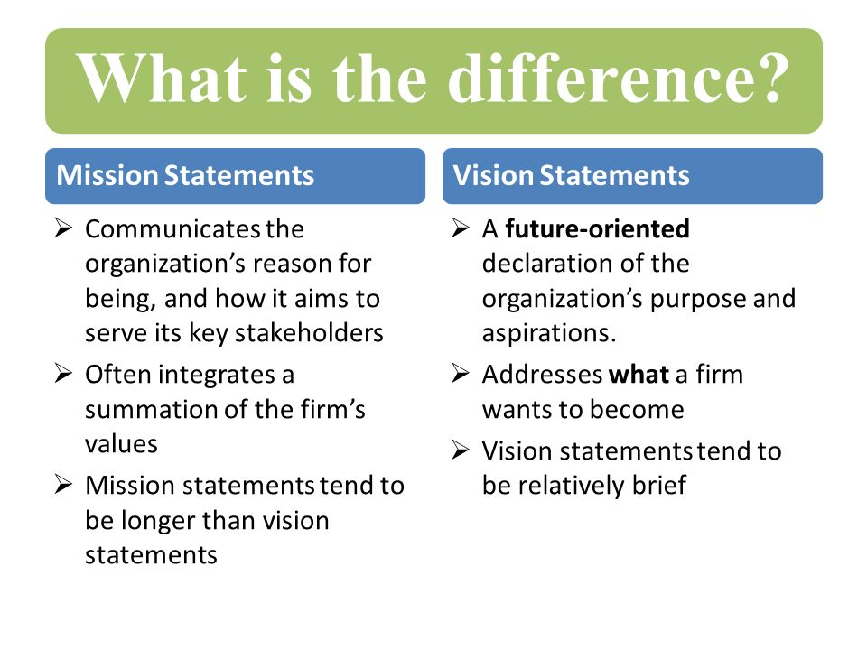
MISSION, VISION, GOALS CONT.
Mission:
  Who are we?
  What are we trying to achieve?
  Who do we serve?
  What do we value?
Vision:
  What will the community look like when we’ve achieved it?
  “Where are we going from here?”
Goals:
  Quarterly, annual goals?
Notes:
Who Are We?
What Are We Trying to Achieve?
Who Do We Serve?
What Do We Value?
What Will the Community Look Like When We’ve Achieved It?
What Are Our Goals?

Slide 10
Mission, Vision, Goals Cont.
MISSION (Example): Unite our small community in the fight against cancer by promoting awareness, providing support, and advocating for equitable access to resources and care through collaborative efforts, education, and outreach.
VISION (Example): We envision a future that fosters hope, where every individual, regardless of background, has access to comprehensive cancer care, cancer incidence decreases, and the stigma surrounding cancer diminishes.
GOALS (Example):
Short-Term - Organize a community-wide cancer awareness campaign or event aimed at educating residents about early detection methods and screening.
Long-Term - Establish a comprehensive cancer support center offering services such as counseling and support groups.

Slide 11

Recommended Community Health Coalition Structure and Operations:
Designate a health department staff person to staff and provide support to the CHC
Identify the chairperson or chairpersons (may include health officer or designee)
Identify a non-health department person to co-chair the CHC (option of health officer)
Develop a list of persons/groups from whom representatives should be sought
Seek volunteer assistance from community groups and CHC members
Develop vision, mission, goals and objectives for the CHC
Establish meeting frequency and locations

Slide 12
Agency Updates/Other Business:
ACTION ITEMS:
Coalition members will do individual research on the Cologuard test to be discussed at the next meeting
Autumn will share the Minimal Clinical Elements for skin and colorectal cancer screening as provided by MDH
Autumn will reach out to local surgeons involved in colorectal cancer screening to gather information about cologuard testing.
Coalition members will consider mission, vision, and goals to be discussed at next meeting
Sandy Bell of Cindy’s Fund and Fred Gregg of Gregg’s pharmacy want to increase screening by offering Cologuard.
Ellie Folk is Allegany County Health Department’s new BCCP/CPEST coordinator. Paula McKenzie is now ACHD’s Director of Nursing!
Notes:
Information was discussed regarding the safety, indications for use, and accuracy of cologuard. Neighboring counties have tried to adapt Cologuard, but were unsuccessful. The diagnostics company ExactScience who provides the tests has an extensive process. Paula McKenzie from ACHD explained the contracting issues and stated there were several issues in the process of trying to acquire the testing. MDH is considering working with ExactScience to begin offering this testing in the future.
Srishti Singh and Cristina Ruiz-McCalla from MDH provided information on gold standards for colorectal cancer screenings and indications for use of each test (FIT, Cologuard, Colonoscopy).

Slide 13
NEXT MEETING - HYBRID
Thursday, June 13, 2024, at 9:00 AM, In-Person Meeting Location TBD
Cancer Coalition Quarterly Meeting
Thursday, June 13 · 9:00 – 10:30am
Time zone: America/New_York
Google Meet joining info
Video call link: https://meet.google.com/awn-hqdm-obv
Or dial: ‪(US) +1 484-930-0366‬ PIN: ‪293 964 537‬#
More phone numbers: https://tel.meet/awn-hqdm-obv?pin=1155004386130

