Slide 1
GARRETT COUNTY CANCER COALITION MEETING MINUTES
June 13, 2023
Virtual Meeting
9:00 AM
Notes:
ATTENDEES:
Autumn Friend - Host/Facilitator - CPEST Coordinator, CGHD), Jennifer Lee-Steckman - Facilitator, Cancer Coalition Chairperson (DON, GCHD), Lawrence Knapp (Friendsville Family Medicine), Paula McKenzie (DON, ACHD), Christy Bernard (GRMC Cancer Center), Sierra Hagy (GRMC Cancer Center), Kirsten Nesselrodt (Hospice of Garrett County), Grace Bolyard (Hospice of Garrett County), Fred Gregg (Gregg’s Pharmacy)

Slide 2
AGENDA
Welcome and Introductions
CPEST Grant Updates, Fiscal Year-End Predictions
Mission, Vision, Goals of the Coalition
Agency Updates
Next Meeting Date/Time (Sept 12, 2024, at 9:00 AM)

Slide 3
Budget Type | Total Allocated | Total Spent through 05/31/24 | On Track? | If not on track, why:
CPEST Total | 135,496.00 | 88,104.00 | No
Purchase of Care | 29, 346.00 | 5,939.00 | No | Bills are delayed. Insurance is covering a significant amount of costs.
Printing/ Advertising | 450.00 | 300.00 | N/A | $250 was spent in the month of April for a radio advertisement.
Educational Supplies | 1600.00 | ~ 1500.00 | N/A | New incentives were purchased for the GC Health Fair and other outreach.
Notes:
Purchase of Care is low due to delayed billing and not many clients are enrolled in the program are uninsured. Most patients have Medicare or private insurance. — Goal is to increase enrollment to thus increase purchase of care spending.

Slide 4
CPEST PERFORMANCE MEASURE UPDATES
CPEST PM | FY 2024 PM | July 2023 | Aug 2023 | Sept 2023 | Oct 2023 | Nov 2023 | Dec 2023 | Jan 2023 | Feb 2023 | Mar 2023 | April 2023 | May 2023 | June 2023
# education/ Outreach activities | 74 | 3 | 17 | 17 | 18 | 46 | 66 | 70 | 70 | 80 | 83 | 83 | TBD
# new individuals screened | 25 | 0 | 2 | 2 | 3 | 4 | 5 | 7 | 7 | 7 | 19 | 20 | TBD
# Tobacco Cessation referrals | 13 | 0 | 0 | 0 | 0 | 2 | 6 | 11 | 15 | 15 | 15 | 15 | TBD
# tobacco Cessation counseling | 13 | 0 | 0 | 0 | 0 | 1 | 2 | 2 | 2 | 8 | 8 | 8 | TBD
Total # screened for CRC to date | 26 | 0 | 4 | 6 | 8 | 8 | 9 | 12 | 14 | 15 | 17 | 21 | TBD
Total # colonoscopies performed to date | 20 | 0 | 2 | 4 | 6 | 6 | 7 | 10 | 12 | 13 | 16 | 20 | TBD
# screened for Skin | 21 | 2 | 0 | 0 | 4 | 5 | 7 | 8 | 8 | 11 | 11 | 13 | TBD
# CRC patient navigation only | 1 | 2 | 2 | 3 | 4 | 4 | 4 | 5 | 5 | 5 | 6 | 7 | TBD
# cessation aids provided | 13 | 0 | 0 | 0 | 0 | 2 | 3 | 3 | 3 | 9 | 9 | 9 | TBD
Notes:
# new individuals screened - Performance measures increased greatly after the GC Health Fair, several individuals signed up for screening at this event. Numerous patients who were awaiting scheduling were also scheduled in the spring months and screenings were completed.
# tobacco Cessation counseling, # Cessation Aids Provided - PM has begun to increase now that smoking cessation counseling and services are back up and running with new coordinator Chelsie Dever.
Total # screened for CRC to date, total # colonoscopies performed to date, # Screened for Skin - PM increased after several individuals signed up at GC health fair. Several patients have been eligible for direct access screening so there is no delay in scheduling.
Outreach efforts to be explored — Providing program information to churches and places of worship, Autumn may attend outreach efforts at the senior center quarterly, incentives can be given during food drives at MLMC

Slide 5
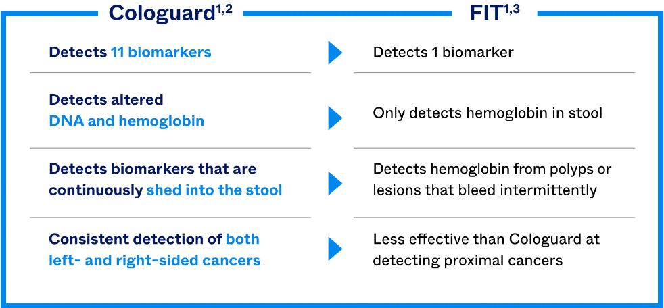
COLOGUARD VS. FIT

Slide 6
Cologuard Indications & Risk Information
Cologuard is intended for the qualitative detection of colorectal neoplasia associated DNA markers and for the presence of occult hemoglobin in human stool.
A positive result may indicate the presence of colorectal cancer (CRC) or advanced adenoma (AA) and should be followed by colonoscopy.
Cologuard is indicated to screen adults of either sex, 45 years or older, who are at typical average risk for CRC.
Cologuard is NOT a replacement for diagnostic colonoscopy or surveillance colonoscopy in high-risk individuals.
Cologuard is NOT for high-risk individuals, including patients with a personal history of colorectal cancer and adenomas; have had a positive result from another colorectal cancer screening method within the last 6 months; have been diagnosed with a condition associated with high risk for colorectal cancer such as IBD, chronic ulcerative colitis, Crohn’s disease; or have a family history of colorectal cancer, or certain hereditary syndromes.
Positive Cologuard results should be referred to colonoscopy.
A negative Cologuard test result does not guarantee absence of cancer or advanced adenoma.
False positives and false negatives do occur. In a clinical study, 13% of patients without colorectal cancer or advanced adenomas received a positive result (false positive) and 8% of patients with cancer received a negative result (false negative).
Cologuard performance when used for repeat testing has not been evaluated or established. Rx only.
Notes:
IMPORTANT NOTE: Medicare covers the cost of the Cologuard test, however, if the test comes back positive the patient MUST have a colonoscopy. Medicare will NOT cover the cost of the colonoscopy after a Cologuard has been done because the patient has technically already had a screening done.
The CPEST program has considered offering Cologuard testing to eligible patients, but the process for contracting with the manufacturer was too difficult in the last fiscal year. MDH is still currently partnering with the manufacturer to include this testing option.
Will the CPEST program pay for diagnostic colonoscopy as the payor of last resort when the patient has already had a screening Cologuard test??

Slide 7
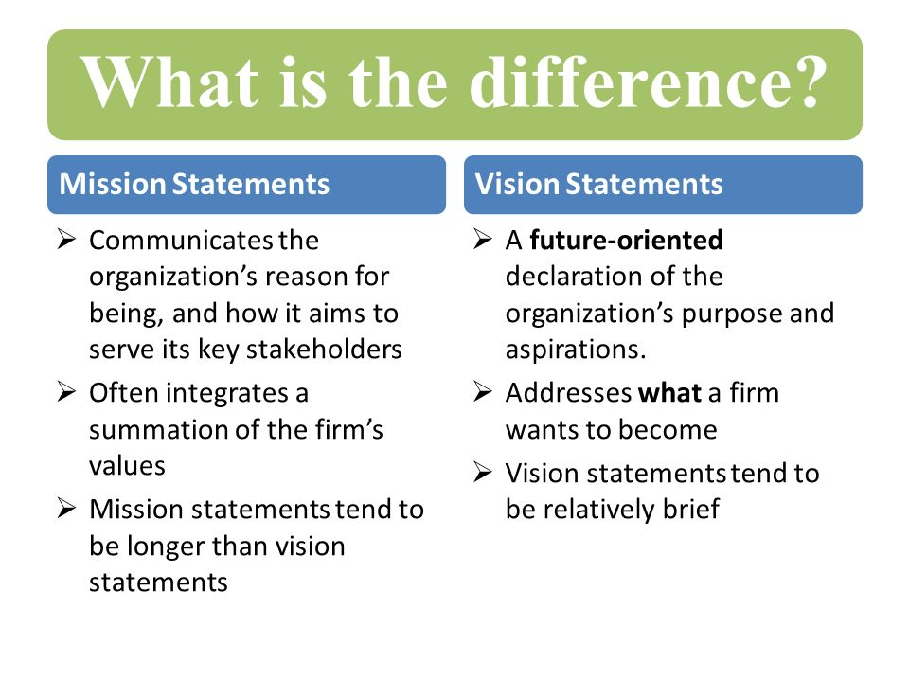
MISSION, VISION, GOALS CONT.
Mission:
  Who are we?
  What are we trying to achieve?
  Who do we serve?
  What do we value?
Vision:
  What will the community look like when we’ve achieved it?
  “Where are we going from here?”
Goals:
  Quarterly, annual goals?

Slide 8
Mission, Vision, Goals Cont.
MISSION (Example): Unite our small community in the fight against cancer by promoting awareness, providing support, and advocating for equitable access to resources and care through collaborative efforts, education, and outreach.
VISION (Example): We envision a future that fosters hope, where every individual, regardless of background, has access to comprehensive cancer care, cancer incidence decreases, and the stigma surrounding cancer diminishes.
GOALS (Example):
Short-Term - Organize a community-wide cancer awareness campaign or event aimed at educating residents about early detection methods and screening.
Long-Term - Establish a comprehensive cancer support center offering services such as counseling and support groups.

Slide 9
Mission, Vision, Goals Cont.
WHAT ARE WE TRYING TO ACHIEVE?
Reducing the risk of cancer incidence in our community.
WHO DO WE SERVE?
The population of our community regardless of race, creed, gender, age, religion, sexual identity, affiliation, or culture.
WHO ARE WE?
We are a collaborative network of organizations and advocates united by a common mission to reduce the burden of cancer.
WHAT DO WE VALUE?
Equity, ensuring all individuals have access to high quality healthcare.
WHAT WILL THE COMMUNITY LOOK LIKE?
Equitable health outcomes, informed and empowered public.
WHAT ARE OUR GOALS?
Short-Term: provide education to providers regarding screening
Short-Term: offer an in-service educational session with lung cancer screening physician
Long-Term: introduce lung and prostate cancer screening to CPEST program
Notes:
Who Are We? - We are a collaborative network of organizations and advocates united by a common mission to reduce the burden of cancer.
What Are We Trying to Achieve? - Reducing the risk of cancer incidence in our community.
Who Do We Serve? - The population of our community regardless of race, creed, gender, age, religion, sexual identity, affiliation, or culture.
What Do We Value? - Equity, ensuring all individuals have access to high quality healthcare… What else?
What Will the Community Look Like When We’ve Achieved It? - Equitable health outcomes, informed and empowered public…what else?
What Are Our Goals?
Short-Term: provide education to providers regarding screening
Short-Term: offer an in-service educational session with lung cancer screening physician
Long-Term: introduce lung and prostate cancer screening to CPEST program

Slide 10
Agency Updates/Other Business:
ACTION ITEMS:
Autumn will update the FY25 grant to include planning and implementation of lung and prostate cancer screening
Autumn will update the grant to include intentions of increasing navigation services
Jennifer or Autumn will reach out to Jessica Carr and Amanda Simmons for provider office and hospital outreach
Autumn will explore options for contracting with pulmonologists and other possible out-of-state providers for skin and colorectal cancer screening.
Autumn will put together educational packets to be delivered to GC Hospice
Paula McKenzie - Allegany County Health Department still has funds available to provide breast and cervical cancer screenings, most everything is done by mail so patients do not have to travel.
GRMC Cancer Center - NONE
Grace Bolyard - Hospice of Garrett County will take CPEST program information for admission packets that are given to families
Lawrence Knapp: NONE
Fred Gregg: NONE
Notes:
In order to initiate lung cancer services. the program must complete a readiness assessment, receive guidance and training regarding set up and requirements for lung cancer screening and receive final approval from the Maryland Department of Health (MDH).

Slide 11
NEXT MEETING - HYBRID
Cancer Coalition Quarterly Meeting
Thursday, September 19 · 9:00 – 10:30am
Time zone: America/New_York
Google Meet joining info
Video call link: https://meet.google.com/xtt-botr-qmc
Or dial: ‪(US) +1 530-871-9512‬ PIN: ‪366 080 139‬#
More phone numbers: https://tel.meet/xtt-botr-qmc?pin=1837177079553

