Slide 1



2017 HOPE Act: Impact on Naloxone Access & the Maryland Overdose Response Program
Michael Baier
Director, Office of Prevention
Department of Health and Mental Hygiene
Behavioral Health Administration
Tuesday June 6, 2017

Slide 2
Webinar Overview
Background on Maryland Overdose Response Program (ORP)
2017 HOPE Act: Changes to ORP law
Identify areas currently under legal & policy review
Begin soliciting feedback from ORP authorized entities and other stakeholders on changes to program regulations and policies

Slide 3
Background: MD Overdose Response Program
Authorized by law in 2013: Health-General Article, Title 13, Subtitle 31, Code of Maryland
Regulations effective March 2014
Goal: Provide a means of authorizing non-medical individuals to:
  Receive training on opioid recognition & response w/ naloxone
  Acquire, possess & administer naloxone to someone experiencing suspected opioid overdose when emergency services not immediately available
DHMH authorizes “private or public entities” to train and certify individuals
Certified trainees may be prescribed/dispensed naloxone & administer it in emergency situation

Slide 4
ORP Background Ctd.
Authorized entities (AE) must est. agreement w/ practitioner who conducts or supervises trainings
Regulations require entities to:
  Use DHMH-approved core curriculum
  Retain training records
  Report training data to DHMH
Legal protections for naloxone prescribers/dispensers & individuals who administer naloxone
Physicians/APNs employed by DHMH/LHDs & AE-affiliated practitioners may Rx naloxone via standing order
Employee/volunteer trainers for AE, LHD RNs and pharmacists authorized to dispense under standing orders
Providers may Rx naloxone to patients w/o AE training

Slide 5
2017 Heroin & Opioid Prevention Effort (HOPE) & Treatment Act
Assessment & funding of drug court programs
Enhance DHMH ability to deny, suspend or revoke state controlled substance prescribing/dispensing permit
Allow Overdose Fatality Review teams to review non-fatal overdose cases
Require est. of 24/7 behavioral health crisis treatment centers & toll-free crisis hotline
Requires healthcare systems & facilities to make opioid use disorder medication prescribers available to patients
DHMH est. naloxone co-Rx guidelines
Require hospitals to est. discharge protocol for OD/SUD patients including naloxone Rx
Streamlining ORP statutory requirements

Slide 6
Summary of ORP-Related Changes
Fewer statutory requirements on ORP AEs will allow for streamlined operations/reduced admin burden
Standing orders may allow pharmacists to dispense to anyone, not just ORP certificate holders
All licensed healthcare providers w/ prescribing authority may Rx naloxone to anyone, not just ORP certificate holders or their patients
Any type of healthcare provider w/ prescribing authority may est. agreement w/ entity & issue standing order
Criminal and civil immunity protections expanded to include all individuals prescribed/dispensed in accordance w/ law
Civil and disciplinary immunity protections extended to all healthcare providers w/ prescribing authority

Slide 7
What the HOPE Act DOES NOT Do
Completely remove “training requirement”
  All available naloxone products available by Rx only, per FDA
  Rx status presumes use under medical direction
  Prescriber (& dispenser) have legal obligations to provide drug recipient w/ info/education/training/counseling to ensure use in medically appropriate manner
Make naloxone “over the counter”
  There are no FDA-approved OTC naloxone products
  As Rx drug, naloxone cannot be sold on retail shelf next to aspirin, etc.
  Pharmacist must still dispense, even if person-specific paper or electronic Rx not required
  Stating naloxone now “OTC” could give false impression of ease of access; pharmacists/pharmacies still must be educated & comfortable w/ dispensing under standing orders

Slide 8
Statutory Requirements Removed
AE issuance of certificates to trainees
Age restriction on trainees
Licensed practitioner supervises or conducts trainings
Supervisory agreements between practitioner & entity; new language requires agreements that cover dispensing protocols
Specific training content
Trainee application to AE using DHMH-approved form

Slide 9
IMPORTANT: Regulations Still Effective
COMAR 10:47:08
ORP sections of HOPE Act drafted with intent to remove many requirements currently in regulations
Until changed, regulations remain effective where not contradicted/superseded by statute
Legal review being conducted to identify specific regulations affected by HOPE Act
BHA intent to expedite stakeholder feedback & regulations update
AEs should continue to abide by current regulations until updates take effect

Slide 10
Standing Orders
May be issued by a licensed healthcare provider w/ prescribing authority who:
  Is employed by DHMH or LHD
  Has a written agreement w/ AE to establish dispensing protocols
Pharmacists & employee/volunteer of AE may still dispense under SO
Effective 6/1/17 (regulations to contrary nullified):
  Prescribers may issue SO allowing dispensing to any individual
  Individuals not required to be trained by ORP AE for pharmacist to dispense under SO

Slide 11
Updated Statewide Standing Order: Dr. Haft
Dr. Howard Haft, DHMH Dep. Sec. for Public Health Services, issued updated statewide SO for pharmacist dispensing effective 6/1/17
Allows dispensing by any MD-licensed pharmacist to any individual who may be at risk of opioid OD or in a position to assist someone experiencing opioid OD
ORP issued updated pharmacist guidance as well
SO, pharmacist guidance & other docs faxed to all MD pharmacies
Pharmacies should keep faxed copy on file for Medicaid billing purposes
Pharmacies can obtain faxed copying by emailing dhmh.naloxone@maryland.gov

Slide 12
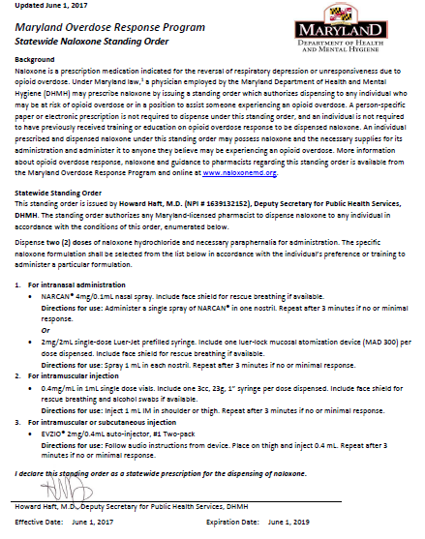
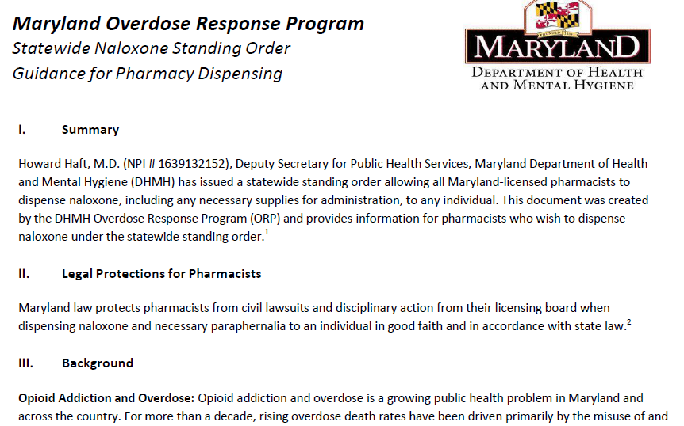
Updated Statewide Standing Order: Dr. Haft
https://bha.health.maryland.gov/NALOXONE/Pages/Statewide-Standing-Order.aspx

Slide 13
Questions?
Contact the Maryland Overdose Response Program:
Phone: 410-402-8634
Email: dhmh.naloxone@maryland.gov

