Slide 1


Rabies
A global threat requiring local vigilance
Jennifer Corder, MD, Deputy Health Officer Garrett and Allegany County Health Departments
Steve Sherrard, Director Environmental Health Services Garrett County Health Department
Visit us online at GarrettHealth.org!

Slide 2

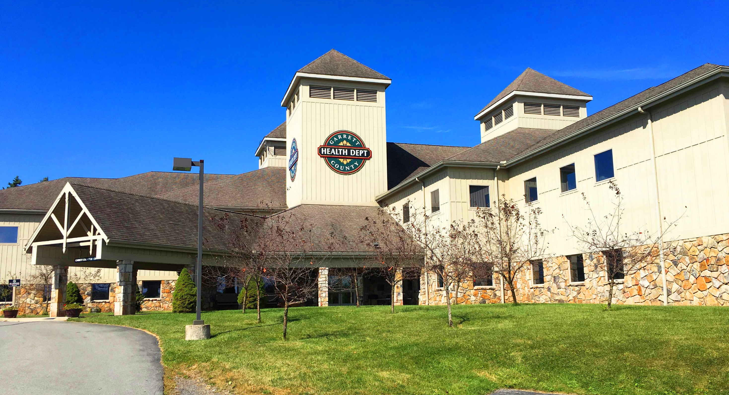
Rabies
A global threat requiring local vigilance
Jennifer Corder, MD, Deputy Health Officer Garrett and Allegany County Health Departments
Steve Sherrard, Director Environmental Health Services Garrett County Health Department
Visit us online at GarrettHealth.org!

Slide 3
Objectives
Appreciate the historical and geographical context of our local rabies challenges
Synthesize elements of the Maryland Post Exposure Prophylaxis (PEP) algorithm for nuanced clinical use
Review data reflecting local practice of PEP
Visit us online at GarrettHealth.org!

Slide 4

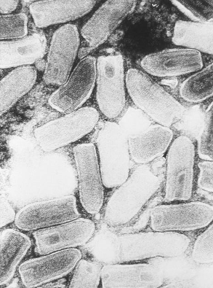
Rabies Virus
Family Rhabdoviridae
Genus Lyssavirus
- At least 6 lyssavirus species or genotypes cause rabies
Distinct strains
  - Raccoon - Coyote
  - Skunk - Fox
  - Bat - Canine
Visit us online at GarrettHealth.org!

Slide 5
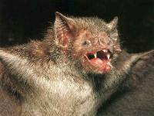

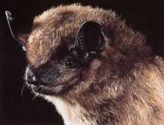
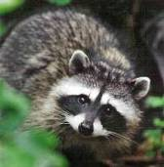
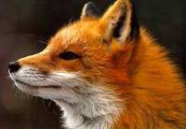
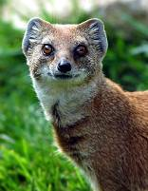
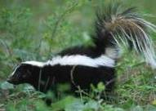
Rabies Hosts
All warm-blooded vertebrates susceptible to experimental infection
Mammals are the natural hosts of rabies
Reservoirs consist of
  Carnivora (canids, skunks,
  raccoons, mongoose, etc.)
  Chiroptera (bats)
Visit us online at GarrettHealth.org!

Slide 6
Virus and Host Adaptations
Rabies involving distinct rabies virus variants is associated with specific hosts in geographically definable regions (excluding bats) .
Transmission is primarily between members of the same species (host adaptation).
Visit us online at GarrettHealth.org!

Slide 7
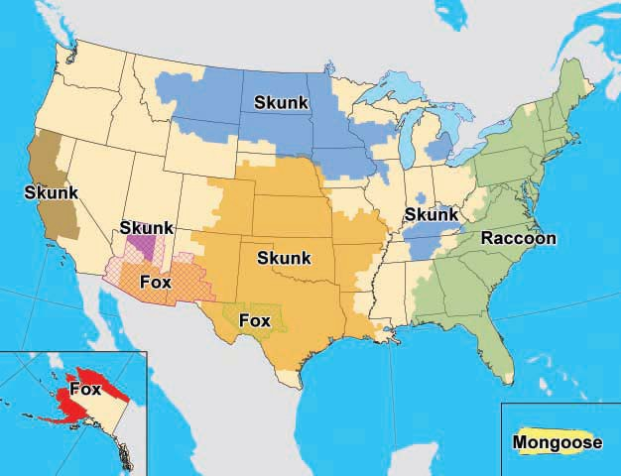
Distribution of Major Terrestrial Reservoirs of Rabies in the U.S. and Puerto Rico, 2010
Visit us online at GarrettHealth.org!

Slide 8
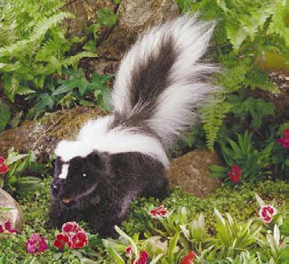
Strains of virus
Identity of species of origin
can be done by monoclonal antibody
(mAb) testing.
Reservoir (adapted) host to other species- spillover
Visit us online at GarrettHealth.org!

Slide 9
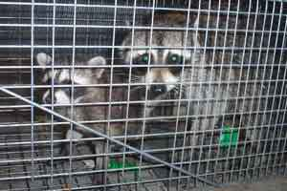
Distribution of rabies virus in the
Mid-Atlantic Region
No prior rabies in terrestrial mammals prior to 1979.
Raccoon virus variant had been endemic in South Florida since early 1900’s.
Illegal translocation of raccoons (some rabid) to W.V.
Spread up and down the east coast.
Multiple species affected in region, all with raccoon strain.
Visit us online at GarrettHealth.org!

Slide 10
Confirmed Rabid Animals – Maryland, 1945-2012
Visit us online at GarrettHealth.org!

Slide 11
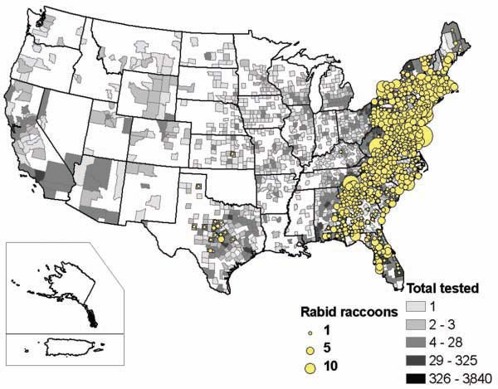
Reported cases of rabies in raccoons, by county, 2009
http://www.avma.org/avmacollections/rabies/javma_237_6_646.pdf
Visit us online at GarrettHealth.org!

Slide 12
Why is raccoon rabies problematic?
Raccoons thrive in suburban settings
Aggressive and swift
Increase in dog and cat (2X) rabies
Increase in other rabid species (foxes, groundhogs, livestock, etc.)
Increase in human exposures, need for PEP risk assessment, animal control calls
Visit us online at GarrettHealth.org!

Slide 13
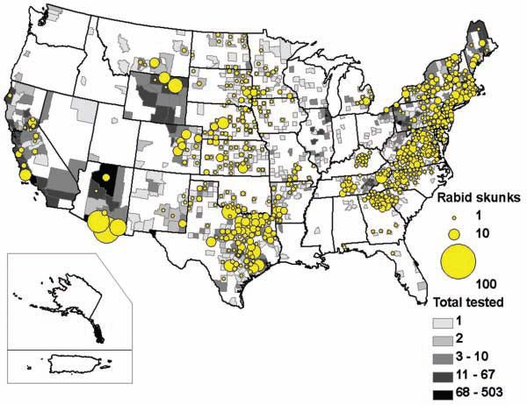
Reported cases of rabies in skunks, by county, 2009
http://www.avma.org/avmacollections/rabies/javma_237_6_646.pdf
Visit us online at GarrettHealth.org!

Slide 14
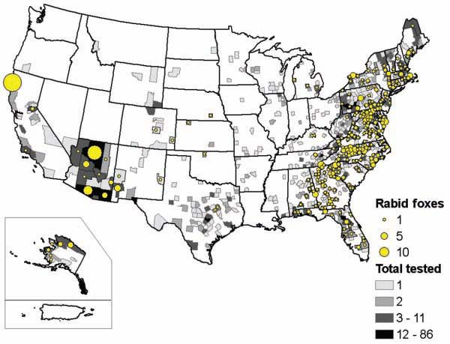
Reported cases of rabies in foxes, by county, 2009
http://www.avma.org/avmacollections/rabies/javma_237_6_646.pdf
Visit us online at GarrettHealth.org!

Slide 15
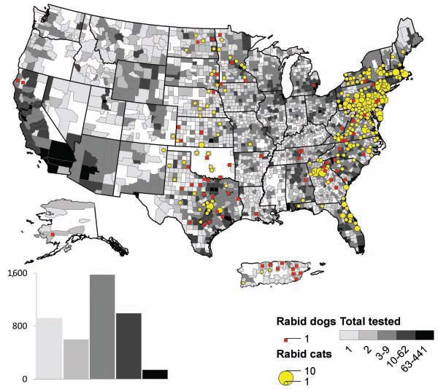
Reported cases of rabies in cats and dogs, 2010
Visit us online at GarrettHealth.org!

Slide 16
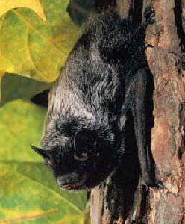
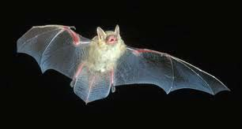
Distribution of bat rabies virus
All 49 continental United States
Ongoing work to associate strains with species and geographic location
Strains differ from terrestrial mammals.
Visit us online at GarrettHealth.org!

Slide 17
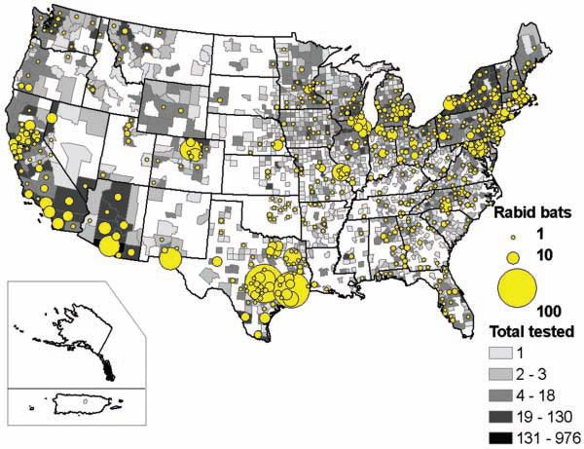
Reported cases of rabies in bats, by county, 2009
http://www.avma.org/avmacollections/rabies/javma_237_6_646.pdf
Visit us online at GarrettHealth.org!

Slide 18
Epidemiology of Rabies in Maryland
300-500 rabid animals in MD annually
Wildlife account for ~95% of all rabid animals
  Raccoons most common (65% of total)
  Bats, foxes, skunks next most common
  Always weird ones: bear, beaver, otter
Domestic animals account for ~5%
  Cats most common domestic rabid animal
Visit us online at GarrettHealth.org!

Slide 19
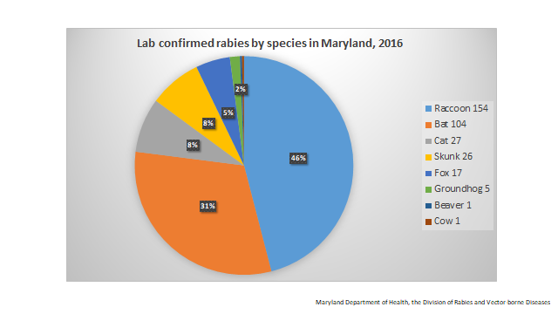
Visit us online at GarrettHealth.org!

Slide 20
Rabies in animals
in Garrett County
2011-2017
Species | Number of Positive | Total Number Tested
Alpaca | 0 | 2
Bat | 1 | 20
Bear | 0 | 1
Cat | 0 | 37
Chipmunk | 0 | 1
Cow | 0 | 11
White-tailed deer | 0 | 3
Dog | 0 | 24
Fox | 0 | 7
Flying Squirrel | 0 | 1
Goat | 1 | 7
Groundhog | 0 | 8
Horse | 1 | 1
Llama | 0 | 1
Opossum | 0 | 4
Raccoon | 23 | 60
Rat | 0 | 1
Skunk | 8 | 14
Weasel | 0 | 1
TOTAL | 34 | 204
Visit us online at GarrettHealth.org!

Slide 21
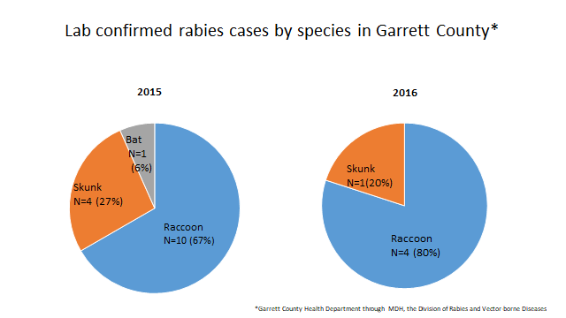
Visit us online at GarrettHealth.org!

Slide 22

Source of infection
Human exposure usually from domestic animals or bats.
Domestic animals acquire infection from wild terrestrial animals or bats.
Rabies not self perpetuating in domestic animals except for dogs
in Mexico, Latin America,
Asia and Africa.
Visit us online at GarrettHealth.org!

Slide 23
Principles of Rabies Prevention
Human rabies can be prevented by
  Eliminating exposure to rabid animals
    Vaccination of pets
    Avoidance of wildlife, especially if strange behavior
  Prompt treatment of wounds
  Administration of appropriate pre- exposure and post exposure prophylaxis
Visit us online at GarrettHealth.org!

Slide 24
Authority for Rabies Prevention and Control in Maryland
Annotated Code of Maryland, Health-General Article Title 18
  Subtitle 2, Part IV
  Subtitle 3, Part III
Code of Maryland Regulations (COMAR) 10.06.02 Rabies
Animal bites are reportable in Maryland (COMAR 10.06.02.05)
Visit us online at GarrettHealth.org!

Slide 25
Visit us online at GarrettHealth.org!

Slide 26
Measures to Eliminate Exposure to Rabid Animals
    Pet and livestock vaccination
    Education
    Animal control
    Wild animal prohibitions
    Testing and quarantine
Visit us online at GarrettHealth.org!

Slide 27
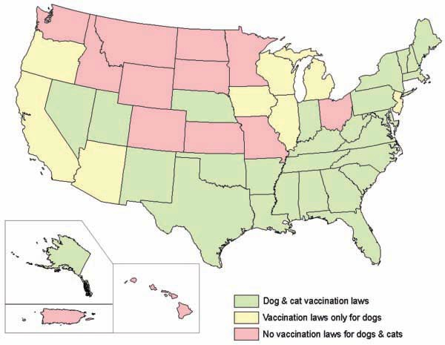
State legislation requiring rabies vaccination of cats and dogs, 2009
http://www.avma.org/avmacollections/rabies/javma_237_6_646.pdf
Visit us online at GarrettHealth.org!

Slide 28
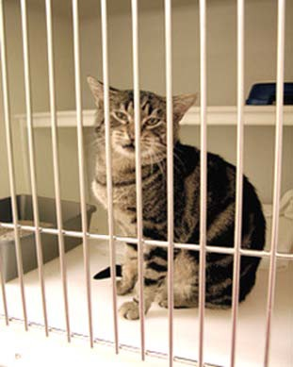
Period of Communicability
Dog, cat and ferret
  May shed up to 3 days prior to clinical signs until death.
  Death usually occurs 3-5 days after clinical signs.
Basis for 10-day quarantine if dog, cat or ferret bites a person.
Other species - unknown
Visit us online at GarrettHealth.org!

Slide 29
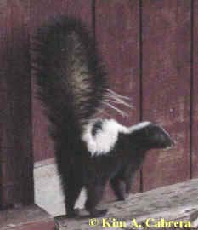
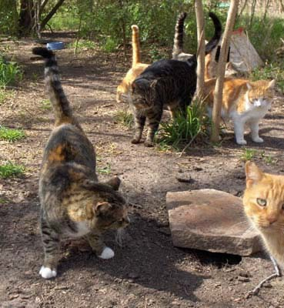
Incubation period
Definition - the period of time from infection (exposure) until the onset of clinical signs (disease)
Basis for 45-day or 6-month quarantine if dog, cat or ferret is exposed to rabies
Visit us online at GarrettHealth.org!

Slide 30
Incubation period
Dog - average 3-8 weeks, 10 days to 6 months
Cat (experimental) - 9-51 days, median 18
Ferret- preliminary data - 10-41 days
People- average 1.5 - 4 mo
(range, 9 days-7yrs?)
Extremes - >1 year wild animals & humans
Visit us online at GarrettHealth.org!

Slide 31
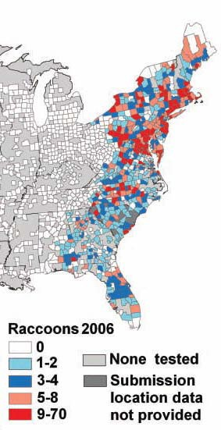
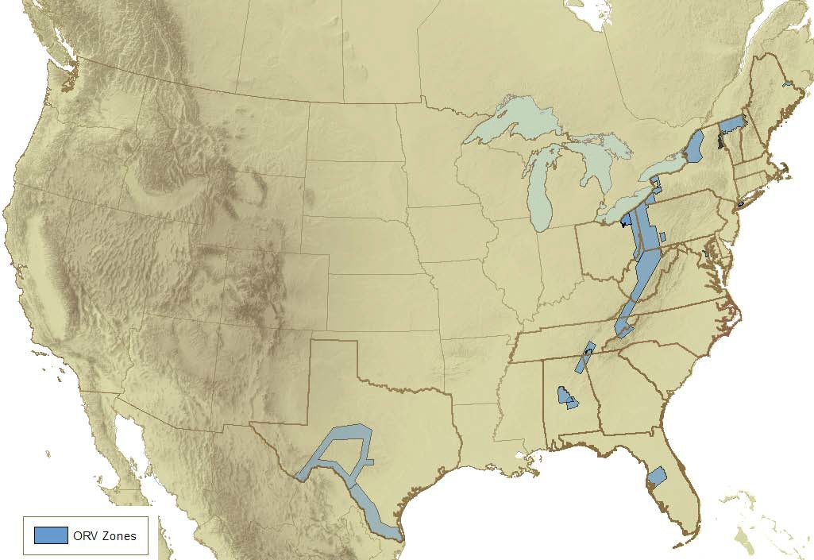
ORV Barrier Zone for Raccoon Rabies in the
United States
ORV Barrier
Visit us online at GarrettHealth.org!

Slide 32
Average number of annual deaths from rabies in humans
Global
USA
Maryland
Garrett County
59,000*
1-3**
0
0
*World Health Organization http://apps.who.int/iris/bitstream/10665/250643/1/WER9143.pdf?ua=1
**https://www.cdc.gov/rabies/location/usa/surveillance/human_rabies.html
Visit us online at GarrettHealth.org!
Notes:
From domestically acquired infections**
Mention the last death in MD: Jan 2013 (Human to human transmission by way of transplanted kidney)

Slide 33
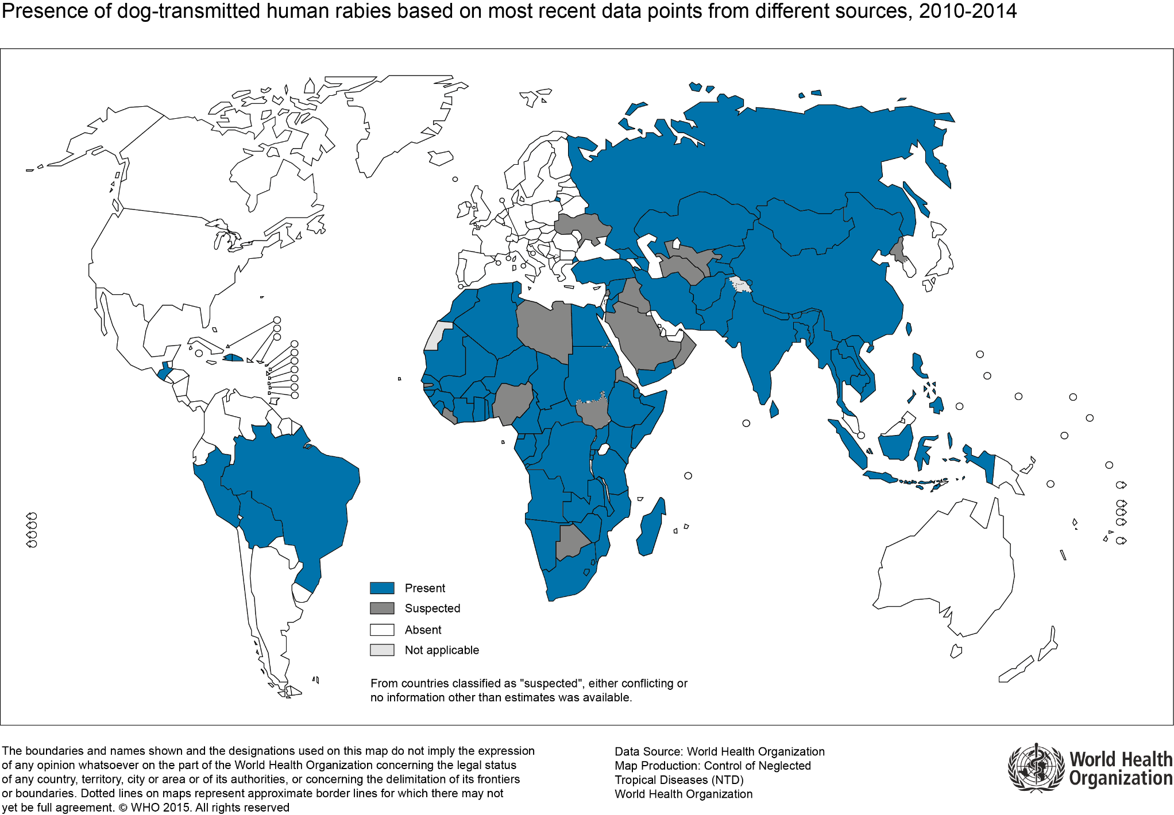
Visit us online at GarrettHealth.org!
Notes:
Where dog-transmitted human rabies cases have been reported and suspected

Slide 34
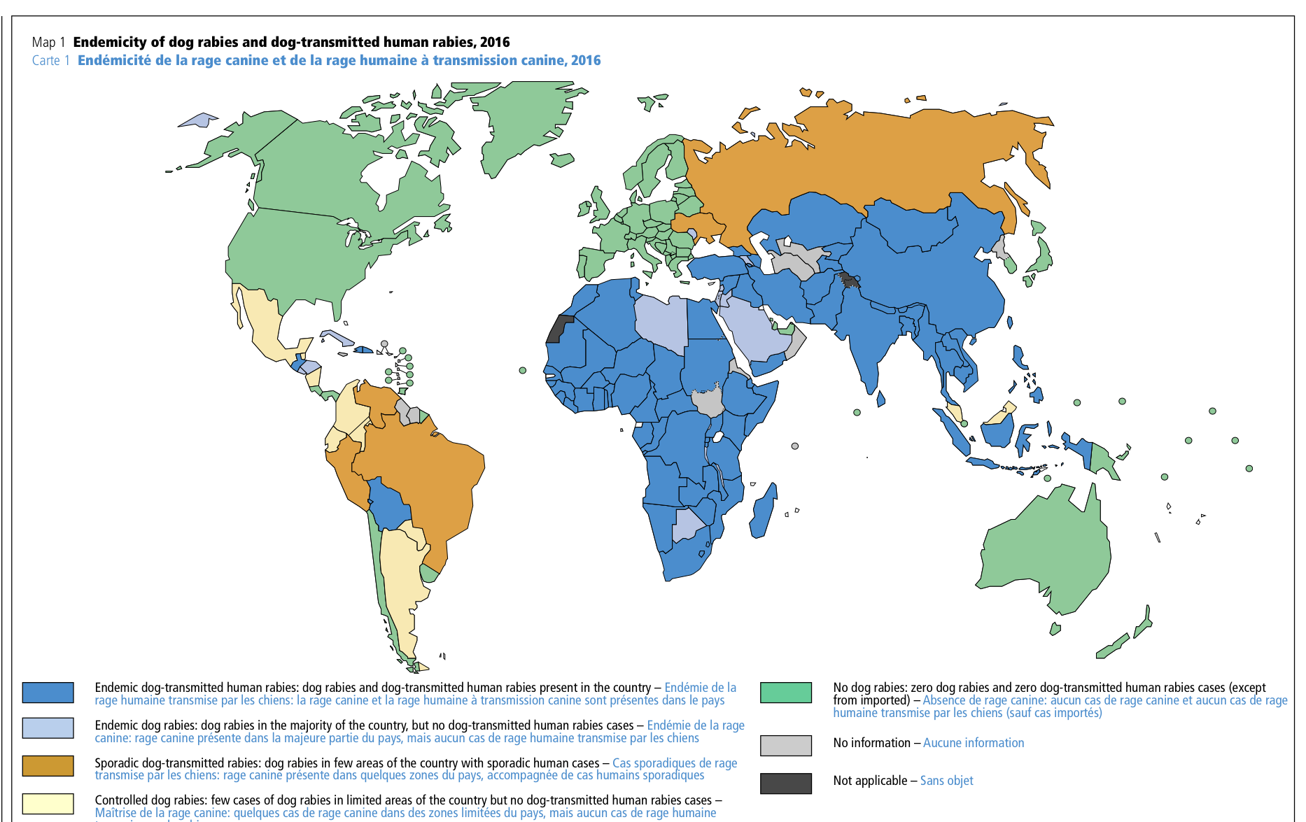
2004 Last time canine rabies identified
2007 CDC declares USA canine rabies free
Visit us online at GarrettHealth.org!
Notes:
Endemicity of canine rabies virus
Dogs with rabies since then have all been infected with a rabies virus contracted from wildlife.
Clinical tip: travelers from much of the rest of the world with dog bites are at real risk of acquiring rabies

Slide 35
Cases of Rabies in Humans in the United States and Puerto Rico from January 2008 Through September 2017 by Circumstances of Exposure and Rabies Virus Variant
https://www.cdc.gov/rabies/location/usa/surveillance/human_rabies.html
Date of onset | Date of death | Reporting state | Age (y) | Sex | Exposure* | Rabies virus variant†
5-May-17 | 21-May-17 | VA | 65 | F | Bite | Dog, India
25-Nov-15 | 1-Dec-15 | PR | 54 | M | Bite | Dog-mongoose, Caribbean
17-Sep-15 | 3-Oct-15 | WY | 77 | F | Contact | Bat, Ln
30-Jul-15 | 24-Aug-15 | MA | 65 | M | Bite, Philippines | Dog, Philippines
12-Sep-14 | 26-Sep-14 | MO | 52 | M | Unknown | Bat, Ps
16-May-13 | 11-Jun-13 | TX | 28 | M | Unknown, Guatemala | Dog, Guatemala
31-Jan-13 | 27-Feb-13 | MD | 49 | M | Kidney transplant | Raccoon, eastern USA
6-Jul-12 | 31-Jul-12 | CA | 34 | M | Bite | Bat,Tb
22-Dec-11 | 23-Jan-12 | MA | 63 | M | Contact | Bat, My sp
3-Dec-11 | 19-Dec-11 | SC | 46 | F | Unknown | Bat,Tb
1-Sep-11 | 14-Oct-11 | MA | 40 | M | Contact, Brazil | Dog, Brazil
21-Aug-11 | 1-Sep-11 | NC | 20 | M | Unknown (organ donor)§ | Raccoon, eastern USA
14-Aug-11 | 31-Aug-11 | NY | 25 | M | Contact, Afghanistan | Dog, Afghanistan
30-Jun-11 | 20-Jul-11 | NJ | 73 | F | Bite, Haiti | Dog, Haiti
30-Apr-11 | Survived | CA | 8 | F | Unknown | Unknown
24-Dec-10 | 10-Jan-11 | WI | 70 | M | Unknown | Bat, Ps
2-Aug-10 | 21-Aug-10 | LA | 19 | M | Bite, Mexico | Bat, Dr
23-Oct-09 | 20-Nov-09 | VA | 42 | M | Contact, India | Dog, India
20-Oct-09 | 11-Nov-09 | MI | 55 | M | Contact | Bat, Ln
5-Oct-09 | 20-Oct-09 | IN | 43 | M | Unknown | Bat, Ps
25-Feb-09 | Survived | TX | 17 | F | Contact | Bat, unknown
19-Nov-08 | 30-Nov-08 | MO | 55 | M | Bite | Bat, Ln
16-Mar-08 | 18-Mar-08 | CA | 16 | M | Bite, Mexico | Fox,Tb related
Visit us online at GarrettHealth.org!
Notes:
The only described mode of human to human transmission in the USA has been through transplantation of organs from person unsuspected of incubating rabies virus
2004: 4 recipients infected, donor had been bitten by a bat
23 cases in 10 years
10 imported (8/10 canine)
13 domestic (bat and raccoon)

Slide 36
Stages of clinical rabies
Incubation
20 days - years
Prodrome
2-10 days
Acute neurologic
2-7 days
Coma
Duration variable
Death
Nearly always
https://emedicine.medscape.com/article/220967-clinical
Visit us online at GarrettHealth.org!
Notes:
Although a low risk, the chance of a patient presenting with acute rabies is not zero.

Slide 37
Incubation period duration
Average | 20-90 days
Usually | 90% of cases <1 year
Rarely | 7-19 years have been described
There is no antibody response during the incubation period
Visit us online at GarrettHealth.org!
Notes:
Head, neck, heavy inoculum is usually <50 days
*Patients may have little recollection of an exposure
Virus introduced into sensory axons and travels up to the dorsal root ganglion, rapid progression once in the CNS

Slide 38
Prodromal period (virus enters CNS)
Duration | 2- 10days
Symptoms | 50% have neuropathic pain @ bite site (dorsal root ganglionitis-pathognomonic)
 | Anxiety, insomnia, agitation, anorexia, depression, headaches, fever, chills, malaise, pharyngitis, nausea, emesis, diarrhea
Visit us online at GarrettHealth.org!
Notes:
Dorsal root ganglionitis

Slide 39
Acute neurologic period
Classic rabies encephalitis (70%) | Paralytic rabies (30%)
Altered mental status Seizure (focal or generalized) Anorexia Irritability Inspiratory spasms and cough Autonomic dysfunction Hydrophobia Aerophobia Hypersalivation Agitation Priapism Muscle fasciculations | Bilateral global motor weakness Bilateral facial weakness Quadriparesis Sparing of sensory system
http://www.who.int/mediacentre/factsheets/fs099/en/
Visit us online at GarrettHealth.org!
Notes:
Paralytic rabies resembles Guillian Barre
Often misdiagnosed., contributing to underreporting

Slide 40
Coma
Onset | Within 10 days of onset of symptoms
Duration | Depends on intensive life support availabillity
Death | Almost inevitable, in absence of life support, shortly after coma begins
Visit us online at GarrettHealth.org!

Slide 41
Differential diagnosis
Classic rabies encephalitis | Paralytic rabies
Other viral encephalitides -HSV -Japanese -Eastern equine -WNV -enteroviruses Transverse myelitis Atropine poisoning CVA Psychosis Acute disseminated encephalomyelitis (ADEM) | Guillian-Barré Poliomyelitis Tetanus
Visit us online at GarrettHealth.org!

Slide 42
Radiographic appearance
Modality | Early | Late
CT (often times normal) | Hypoattenuation brainstem, temporal lobes, basal ganglia and periventricular white matter | Hemorrhage and cerebral edema
MRI | Increase T2 in basal ganglia, thalami, hypothalami, brainstem, limbic system, spinal cord, frontal and parietal lobes | Edema, petechial hemorrhages, contrast enhancement
Angiography |  | Narrowing of terminal internal carotids and distal basilar artery (may be related to arterial spasm)
Visit us online at GarrettHealth.org!
Notes:
In paralytic form the spinal cord and medulla are more pronounced

Slide 43
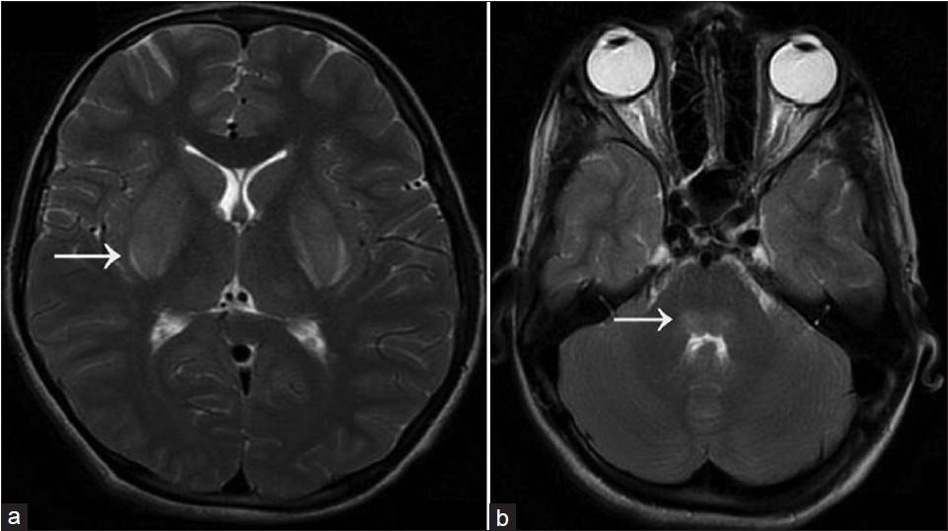
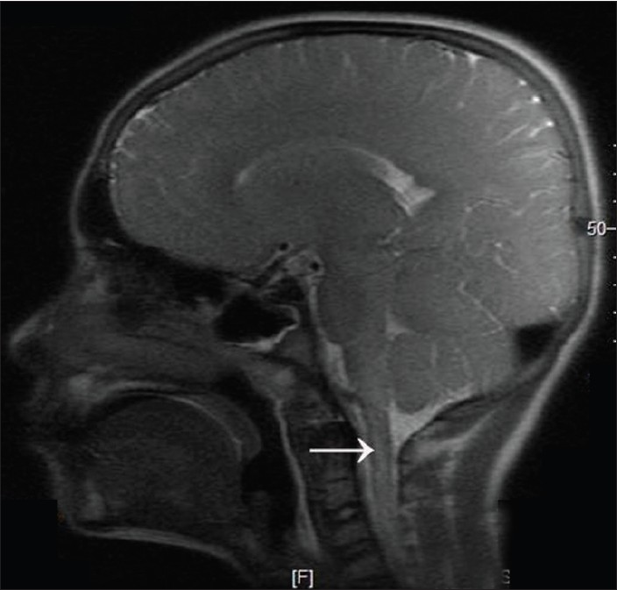
Visit us online at GarrettHealth.org!

Slide 44
Prevention
Upstream approaches | Downstream approaches
Pre-exposure administration of vaccine* -occupational risk -remote communities with endemic rabies -travelers to certain areas | Post-exposure administration of RIG and vaccine (PEP)
Immunization of animals
Avoiding contact with wild or unimmunized animals
*Kessels JA, Recuenco S, Navarro-Vela AM, et al. Pre-exposure rabies prophylaxis: a systematic review. Bulletin of the World Health Organization. 2017;95(3):210-219C. doi:10.2471/BLT.16.173039.
Visit us online at GarrettHealth.org!

Slide 45
Average annual human PEP administration
Global
USA
Maryland
Garrett County
>15,000,000*
>15,000,000
~ 40,000
~ 1,000**
~20***
*WHO
** State of Maryland Veterinarian
*** Garrett County Health Department
Visit us online at GarrettHealth.org!
Notes:
After potential or actual exposure
About 3000 USD per PEP
Pre-exposure Garrett 6-12 per year
Post exposure 16-20

Slide 46
Who needs PEP?
Category of exposure | Description
I | touching or feeding of animals, licks on intact skin, contact of intact skin with secretions or excretions of a rabid animal or human no exposure therefore no prophylaxis if history reliable
II | minor scratches or abrasions without bleeding and/or nibbling of uncovered skin use vaccine alone
III | single or multiple transdermal bites or scratches, licks on broken skin, contamination of mucous membrane with saliva (i.e. licks) and suspect contacts with bats: use immunoglobulin plus vaccine
Visit us online at GarrettHealth.org!

Slide 47
Visit us online at GarrettHealth.org!

Slide 48
Management of acute wound
Wound cleansing (15 minutes) Debridement Exploration for FB Leave wounds to close by secondary intention Tetanus prophylaxis Animal for investigation Consult LHD
Visit us online at GarrettHealth.org!

Slide 49
Exposure Level II-III
Previously Vaccinated | Not Previously Vaccinated
Vaccine only | Rabies Immune Globulin (RIG) 20 IU/kg IM | Vaccine 1 ml IM
Day 0 | Day 0- Day 7 | Day 0
Day 3 |  | Day 3
 |  | Day 7
 |  | Day 14
 |  | (Day 21)
 | In and around wound | Not in gluteus
 | Away from vaccine site | Away from RIG
Visit us online at GarrettHealth.org!

Slide 50
Special populations
Pregnant woman | No contraindication
Breastfeeding woman | No contraindication
Infant | RIG weight based, vaccine dose the same
Delayed presentation | Start as you would at time of initial exposure
Immunosuppressed | Add 5th dose vaccine on Day 21
http://www.immunize.org/askexperts/experts_rab.asp
Visit us online at GarrettHealth.org!

Slide 51
Rabies PEP administered by species exposure, Garrett County 2015-2016
Species | Number of PEP
Raccoon | 9
Cat-feral | 5
Dog | 5
Bat | 4
Fox | 3
Skunk | 2
Cat-pet | 1
Chipmunk | 1
Groundhog | 1
Unknown | 1
TOTAL | 32
*Garrett County Health Department
Visit us online at GarrettHealth.org!
Notes:
This reflects the actual work of the ED primarily

Slide 52
Animal encounters resulting in PEP, Garrett County 2015-2016*
Wild/feral/stray
N=26 (81%)
*Garrett County Health Department
Visit us online at GarrettHealth.org!
Notes:
Categories of animals resulting in exposure

Slide 53
Category of exposure as documented on bite reports from PEP recipients, Garrett County 2015-2016
Unknown
Level I
(30%)
Level III
(60%)
*Garrett County Health Department
Visit us online at GarrettHealth.org!
Notes:
All of these exposures received PEP
N=32

Slide 54
Human exposure levels to known rabid animals
Garrett County, 2015-2016*
Rabid Species | Exposure Level
Raccoon | I
Raccoon | I
Raccoon | I
Raccoon | I
Raccoon | I
Bat | III
Bat | I
Skunk | I
Skunk | I
Dog | ?
Dog | ?
*Garrett County Health Department
Visit us online at GarrettHealth.org!

Slide 55
Observations on rabies PEP in Garrett County
No person in the United States has ever contracted rabies from a dog, cat or ferret held in quarantine for 10 days
https://www.cdc.gov/rabies/exposure/animals/domestic.html
Some overutilization
Abundant non-adherent RIG administration
Quarantine underutilized
Improvements can possibly be made with coordination of case follow up for missed doses
Did not address possible underutilization
Visit us online at GarrettHealth.org!
Notes:
If physicians cannot be assured that proper animal observation or testing will take place,
they may err on the side of giving RPEP
PEP cost: 3000 USD

Slide 56
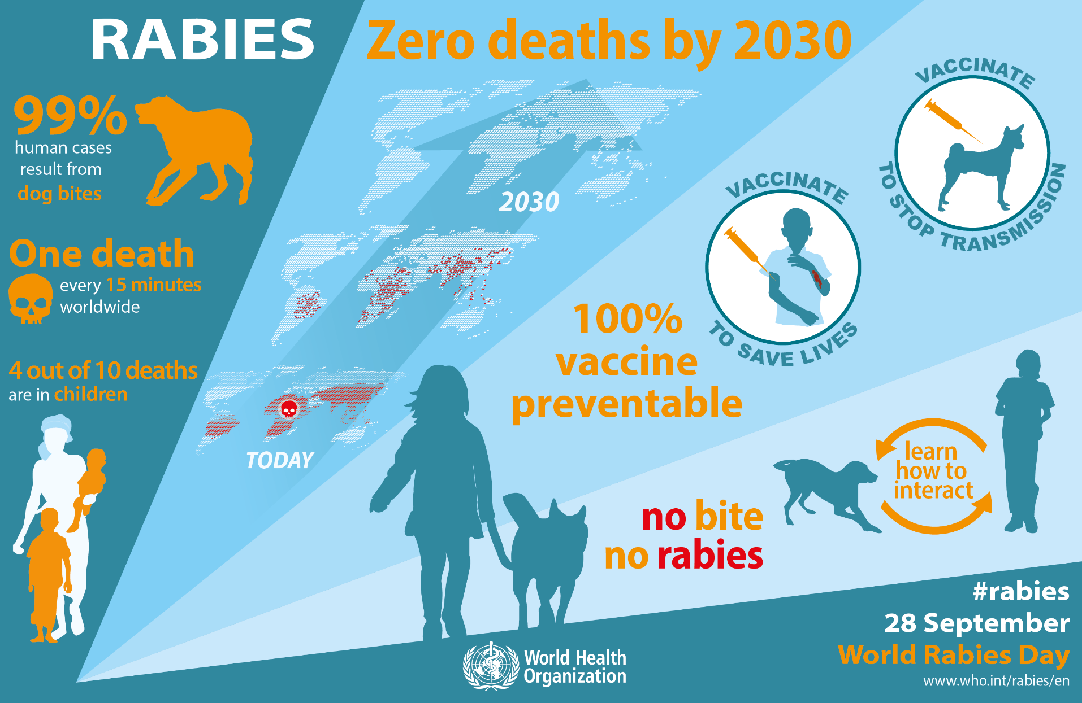
Visit us online at GarrettHealth.org!

Slide 57
QUESTIONS?
Jennifer.corder@maryland.gov
Steve.sherrard@maryland.gov
Visit us online at GarrettHealth.org!

