Slide 1
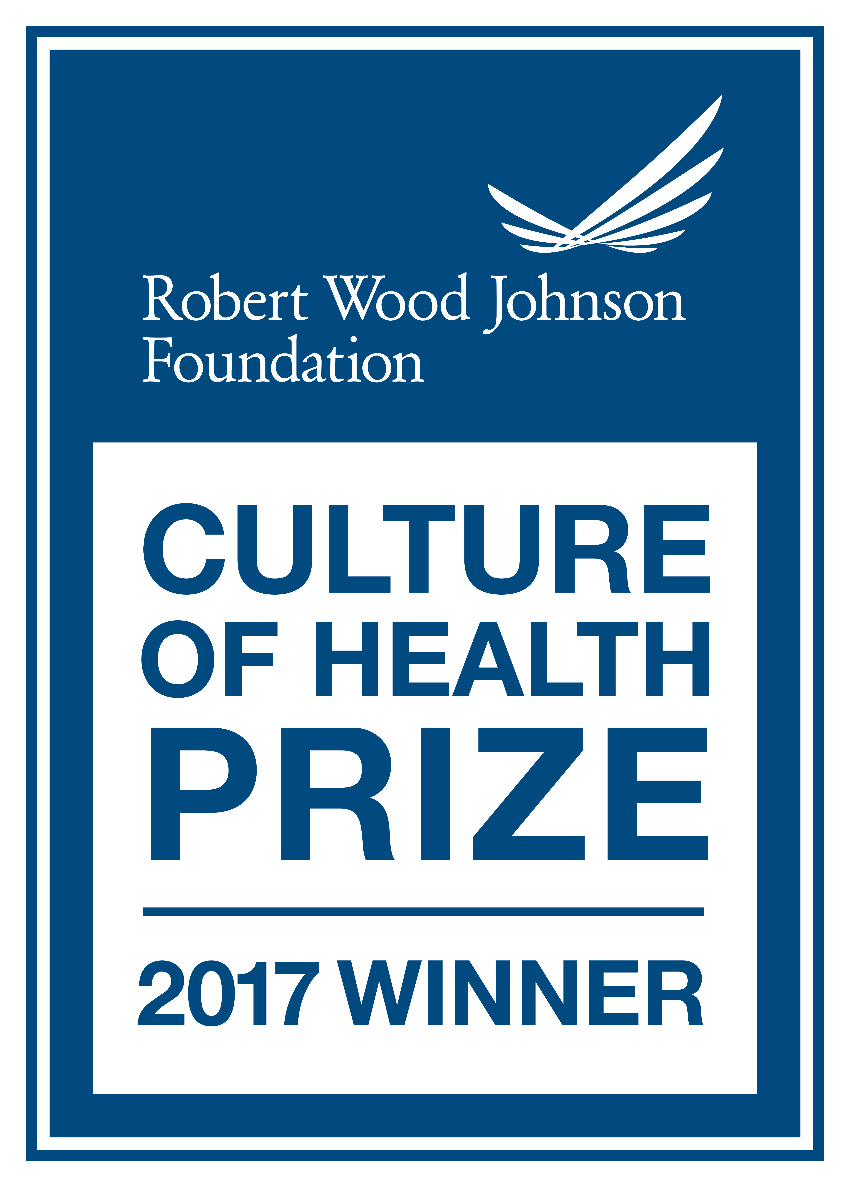
2018 STATUS OF HEALTH
Garrett County, Maryland
2020 STATUS OF HEALTH
Presented to Garrett County Board of Health By: Robert Stephens – Health Officer
5/28/2020
Notes:
41 Slides: Give credit to Beth B, Shelley, John C.
Health is a Community Effort: The presentation is organized along broad SHIP categories
In some areas the Health Department takes a lead in others we partner with the community.

Slide 2
DATA SOURCES
State Health Improvement Process, SHIP Rankings by Jurisdiction
Census Data
Vital Statistics for Garrett County and Maryland Behavioral Risk Factor Survey
Youth Risk Behavior Survey
Ready at Five Partnership
Robert Woods Johnson County Health Rankings & Roadmaps
Hyperlocal data collected on mygarrettcounty.com
Notes:
County Health Rankings and Roadmaps are interactive and gather data from multiple sources.

Slide 3
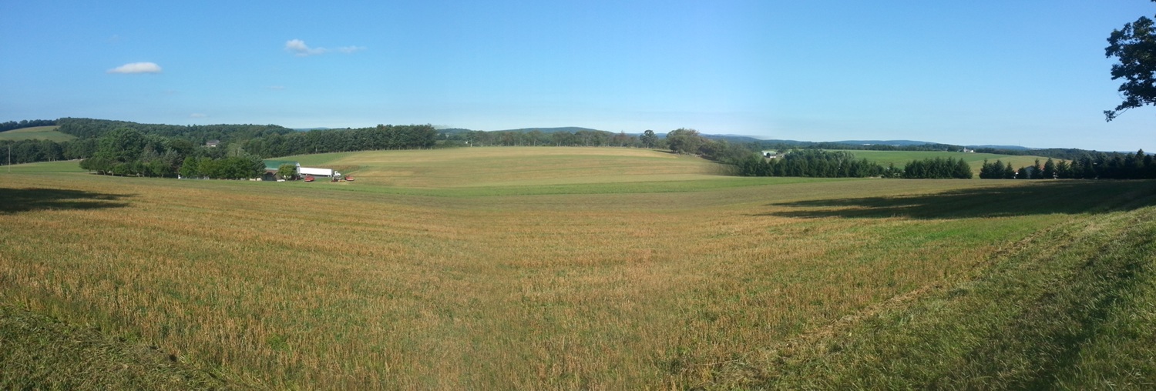
Demographics
Persons under 18 years of age: Maryland 28.2% Garrett County 23.6%
Persons 65 years old and over: Maryland 15.4% Garrett County 22.4%
Median Household Income: Maryland $81,868 Garrett County $49,619
Persons in Poverty: Maryland 9% Garrett County 12.2%
Population Per Square Mile: Maryland 594.8 Garrett County 46.5
Source: U.S. Census Bureau - Quickfacts
Notes:
No significant Change from 2019

Slide 4
Population Decline
Source: U.S. Census, Garrett County Quick Facts, 2018
Notes:
Garrett County’s population is decreasing. Since 2010, it has decreased 3.2%
MD 2010 # 5,745,538 GC 2010 30,097
MD 2016 6,016,447 GC 2016 29,425
MD 2018 6,045,680 GC 2018 29,014

Slide 5
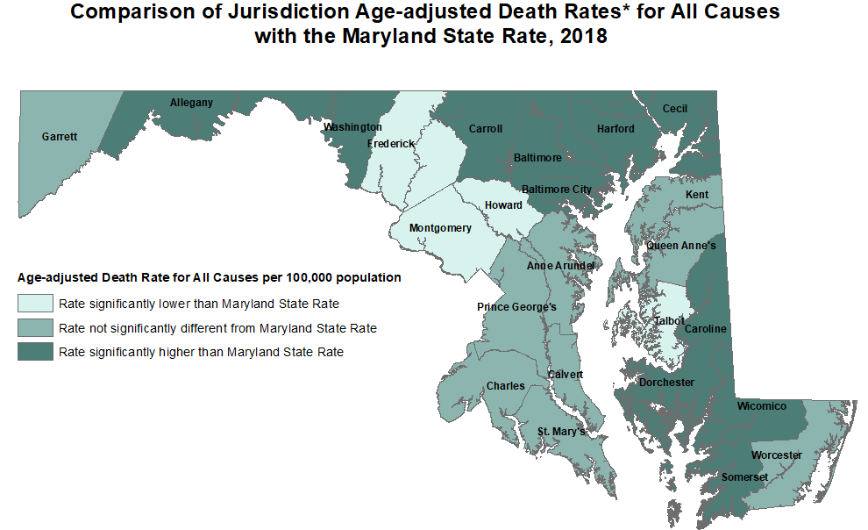
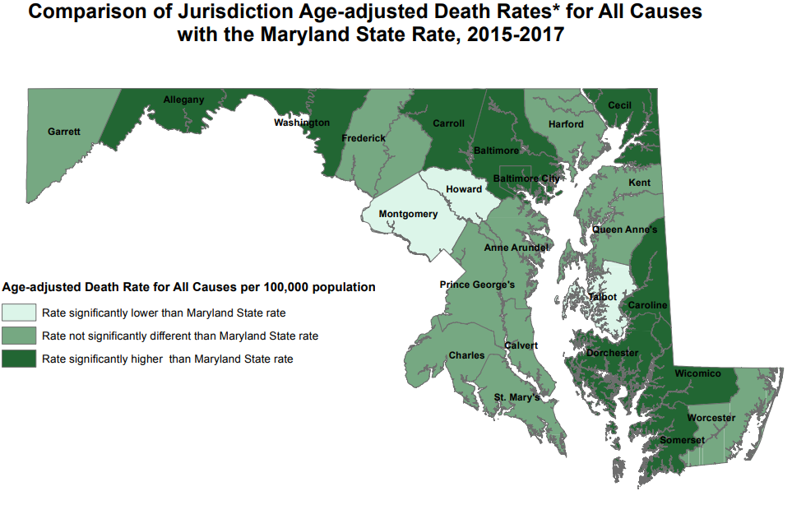
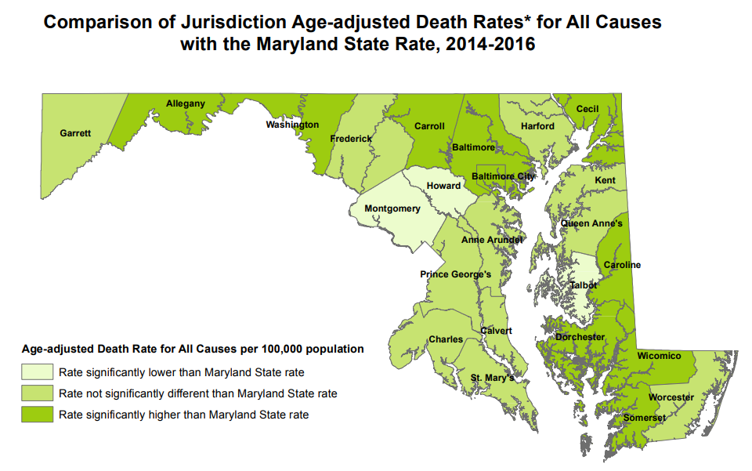
2018 Maryland Vital Statistics
Notes:
If we had one indicator to use it would be this. Age adjusted Death Rate.
Garrett Better than other far Western Counties and the shore (rural counties)

Slide 6
2018 CAUSES OF DEATH IN GARRETT COUNTY
Malignant Neoplasms 19%
Other 21%
Diabetes 3%
Alzheimer's 6%
Chronic Lower Respiratory 8%
Diseases of the Heart 28%
Cerebrovascular 5%
Source: MD Vital Statistics, 2018
Notes:
Other includes: Homicides, suicides, OD, Accidents, Septicemia, HIV, Nephritis (kidney failure), Liver (Cirrhosis)

Slide 7
2018 CAUSES OF DEATH IN GARRETT COUNTY
Malignant Neoplasms 19%
Other 21%
Diabetes 3%
Alzheimer's 6%
Chronic Lower Respiratory 8%
All in the other categories has less that 3% of deaths. Examples are: Accidents, Nephritis, Suicide,
Homicide, Poisoning (OD), Peptic Ulcer, Parkinson's, etc.
Diseases of the Heart 28%
Cerebrovascular 5%
Source: MD Vital Statistics, 2018
Notes:
Other includes: Homicides, suicides, OD, Accidents, Septicemia, HIV, Nephritis (kidney failure), Liver (Cirrhosis)

Slide 8
2018 Vital Statistics
Notes:
Decline of nearly 900 since 2010.
Net Gain in 2006 of 26
Net loss in 2018 of 50

Slide 9
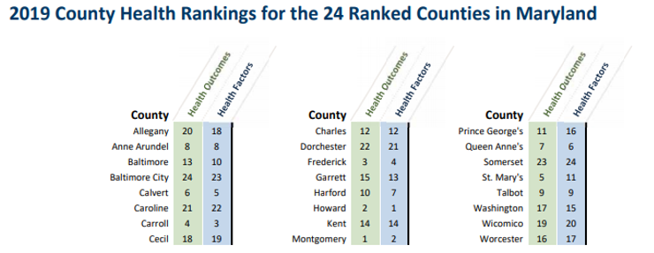
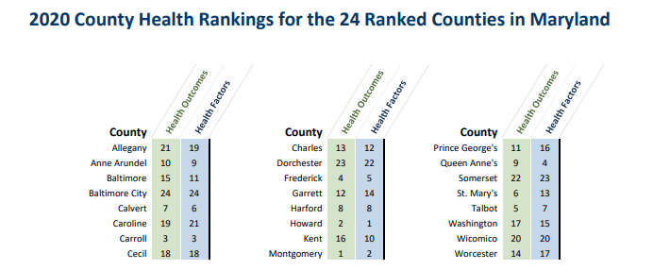
County Health Rankings and Roadmaps
Notes:
Social Determinants of Health: Income, health care, housing, geography, nutrition, transportation, social connectedness, etc. Population traits like smoking,

Slide 10
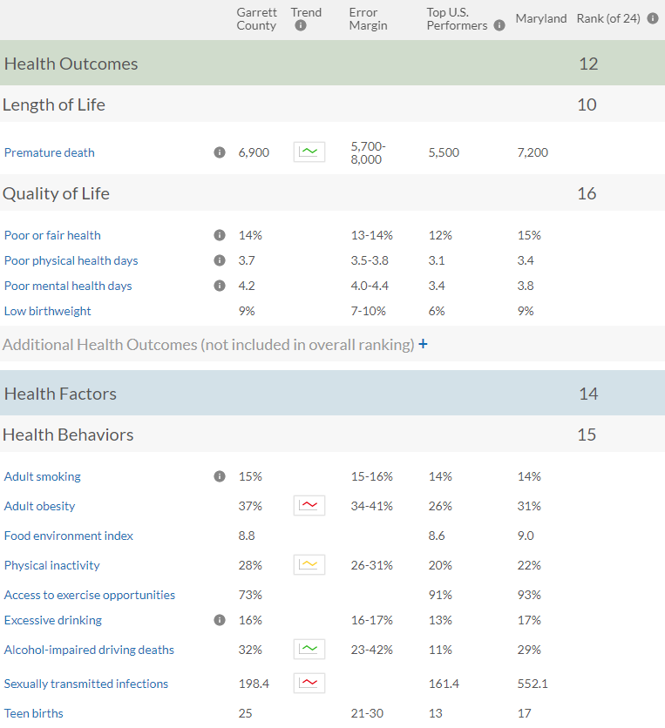
GARRETT COUNTY HEALTH RANKINGS
2020
Note: Blank values reflect unreliable or missing data
Notes:
Will notice that with healthy behaviors we need to do better.
Premature Death = Years of life lost per 100,000

Slide 11
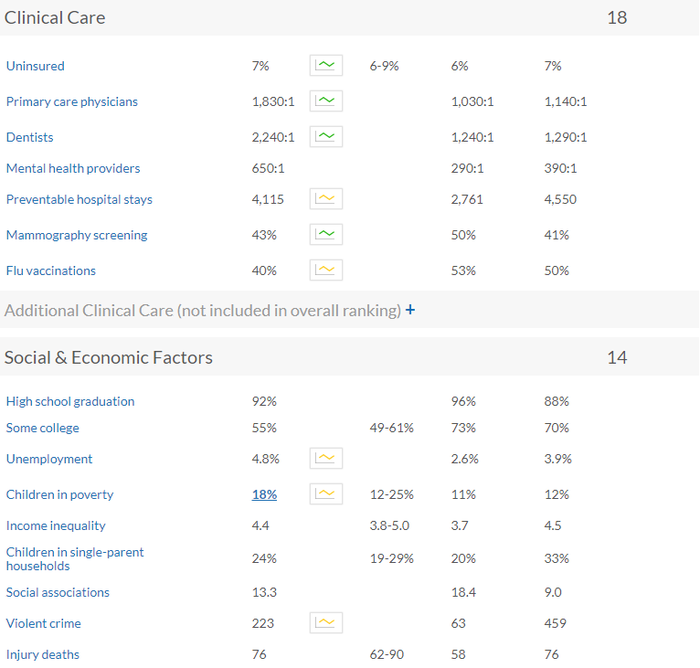
GARRETT COUNTY HEALTH RANKINGS
2020
Note: Blank values reflect unreliable or missing data
Notes:
Notice that income is not on this the Social and Economic factors

Slide 12
Garrett County Health Rankings
2020
Notes:
Notice the long commute alone is lower than the rest of MD. This may have worked in our favor with the spread of COVID

Slide 13
State Health Improvement Process
SHIP provides a framework for continual progress toward a healthier community.
Including 39 measures and 5 focus areas
Focus Areas:
Healthy Beginnings
Healthy Living
Healthy Communities
Access to Health Care
Quality Preventive Care
Notes:
The rest of the presentation is ordered along these lines.

Slide 14
Healthy Beginnings
 | Meets or Exceeds State Goal | Needs Improvement
6 Measures | Early Prenatal Care | Children Receiving Blood Lead Screening
 | Students Entering Kindergarten Ready To Learn | Babies with low birth weight
 | High School Graduation Rate
 | Teen Birth Rate
Notes:
Early Prenatal Care 78. MD GOAL 66.9
Students Entering K ready to Learn 89% (however in our CHIP we did not meet our objective of maintaining the percentage of children who enter K-baseline was at 94% [2010-2010] MD GOAL 85.5
Teen Birth Rate 23.2, MD GOAL 17.8
High School Grad Rate 93.2 , MD GOAL 95
Babies with low birth weight 10.6 MD GOAL 8 CHIP-maintain or reduce at a baseline of 8.4% --did not meet our obj
Children receiving lead screening 58.1, MD GOAL69.5

Slide 15
Mothers Who Received Prenatal Care
HP 2020 SHIP Goal 77.9
Notes:
We exceed the State Goal in this area

Slide 16
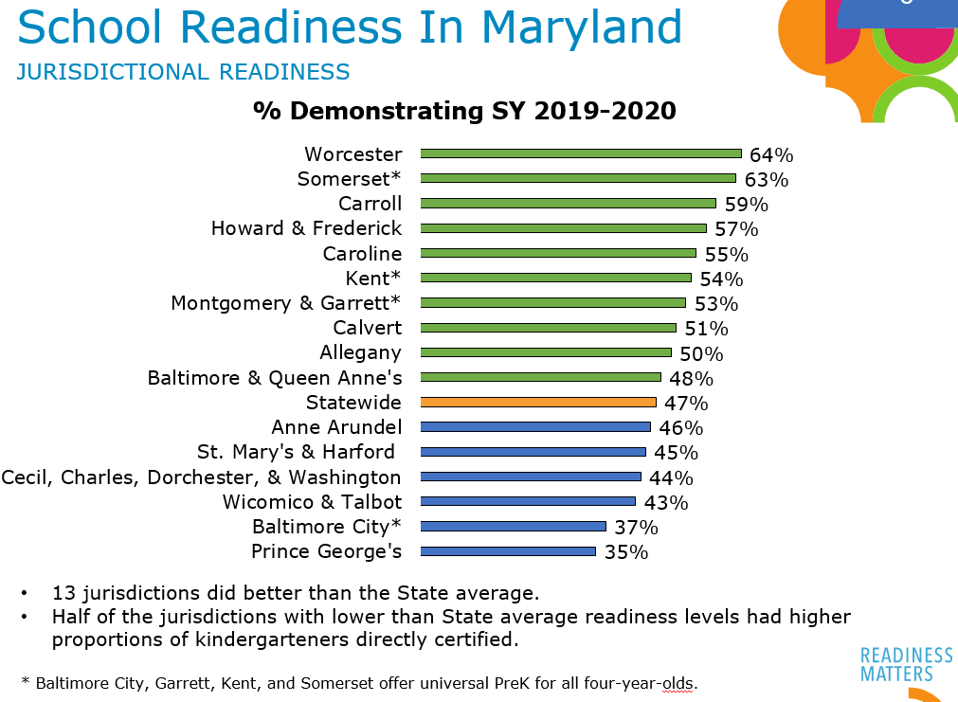
Ready at Five Partnership
Notes:
Nice to be lumped with Montgomery County on something

Slide 17
Infant Mortality Rate Per 1,000 Live Births
4 Deaths
4 Deaths
3 Deaths
Source: Maryland Vital Statistics Administration
https://health.maryland.gov/vsa
Notes:
*** Rates based on <3 events in the numerator are not presented since such rates are subject to instability
MD Garrett
2004 8.5 6.4
2005 7.3 3.2
2006 7.9 0
2007 8 0
2008 8 10.8 3 Deaths
2009 7.2 0
2010 6.7 10.8 3 deaths
2011 6.7 3.5 1 death
2012 6.3 0
2013 6.6 10.8 3 deaths
2014 6.5 14.1 4 deaths
2015 6.7 8.1 4 deaths
6.5 3.77 1 death
2017 6.5 7.57 2 deaths

Slide 18
Births to Adolescents, All Races Rates per 1,000 Females, Ages 15-17
7 births
0 births
Source: Maryland Vital Statistics Administration
https://health.maryland.gov/vsa

Slide 19
Healthy Living
 | Meets or Exceeds State Goal | Needs Improvement
8 Measures | HIV Incidence Rate | Life Expectancy
 | Chlamydia Infection Rate | Increase Physical Activity
 |  | Adolescents Who Use Tobacco Products
 |  | Adults Who Currently Smoke
 |  | Adults Who Are At A Healthy Weight
 |  | Children & Adolescents Who Are Obese
Notes:
HIV 0.0 MD GOAL 26.7
Chlamydia Infection 220 MD GOAL 431
Children and adolescents who are obese 15.6 MD GOAL 10.7
Adults who currently smoke 15.1 MD GOAL 15.5 (close…but it’s probably bc they all switched to vaping)
Adolescents who use tobacco products 34.3 MD GOAL is 15.2
Life Expectancy 79.5 MD GOAL 79.8
Increase in physical activity (11th in the ranking) measurement period 2013 45.9 MD GOAL 50.4
Moved since last time, Adults who are at a healthy weight 27.3 MD GOAL 36.6
Eight Measures
Adolescents who us tobacco products: WORST IN THE STATE

Slide 20
Percentage of students who were obese (> 95th percentile for body mass index, by age and sex)
Healthy People 2020 Target Goal: 16.1
MD SHIP 2017 Target: 10.7
2018 YRBS
Notes:
In 2014, Garrett County’s percentage was 16%, and Maryland was 11.5%. Garrett County’s rate was going down in 2016 to 13.5, but has spiked to 18.3
The Adolescent Survey showed that High School Students (even though there were only 39 responses) that 47% would like to talk to a health care professional about Weight gain/obesity and 44% would like to know the healthiest diet for them. The Middle school student survey shows that only 18.5% of the 316 responses wanted to talk to a health professional about weight gain/obesity, but 35% want to talk about the healthiest diet for them

Slide 21
Percentage of students who had five or more drinks of alcohol in a row, that is, within a couple of hours, on one or more of the past 30 days
Source: YRBS, 2016 & 2018 High School
Notes:
According to the Adolescent Wellness survey, both high school and middle school students believe 23% of the students binge drink

Slide 22
Overdose Deaths by Year
By Year | Total OD Deaths | Rx Opiate | Fentanyl | Heroin | Any Opiate | No Opiates
2010 | 4 | 2 | 0 | 0 | 2 | 2
2011 | 3 | 1 | 0 | 2 | 3 | 0
2012 | 0 | 0 | 0 | 0 | 0 | 0
2013 | 6 | 2 | 0 | 1 | 2 | 4
2014 | 2 | 2 | 0 | 1 | 2 | 0
2015 | 5 | 4 | 0 | 4 | 4 | 1
2016 | 1 | 0 | 0 | 0 | 0 | 1
2017 | 8 | 4 | 0 | 1 | 5 | 3
2018 | 3 | 2 | 2 | 1 | 3 | 0
2019 | 9 | 1 | 6 | 1 | 7 | 2
Total | 47 | 18 | 11 | 12 | 31 | 15
Average: 2010-20 | 4.1 | 1.8 | .8 | 1.1 | 2.8 | 1.2
2020 | 6 | 0 | 3 | 1 | 3 | 3

Slide 24
Accidental Poisonings – All ED Visits
2020 Data through April 2020
Source: Maryland Opioid-related Overdose Surveillance Enhancement Report (MDH)

Slide 25
Healthy Communities
 | Meets or Exceeds State Goal | Needs Improvement
4 Measures | Pedestrian Injury Rate On Public Roads | Children Maltreatment Rate
 | Affordable Housing
 | Domestic Violence
Notes:
Healthy Communities does not have any areas where the GCHD directly impacts the measures. This is the values of interagency collaboration. Pedestrian Injury Rate on public roads 3.4 (best in the state) MD GOAL 35.6
Child Maltreatment Rate 9.2, MD GOAL 8.3 In our CHIP we did not meet our objective—maintain or reduce child maltreatment baseline was 4.2
Domestic Violence 475.1, MD GOAL 445
MIGHT BE A GOOD TIME TO MENTION GARRETT TRAILS
Actually 7 Measures
3 are considered statistically insignificant because of low numbers.
SO, Out of the 4 we can count, GC is meets or exceeds the state goal in one area and needs improvement in three.
Suicide Rate, Children with elevated blood lead levels and Fall related death rate are measures with small numbers

Slide 26
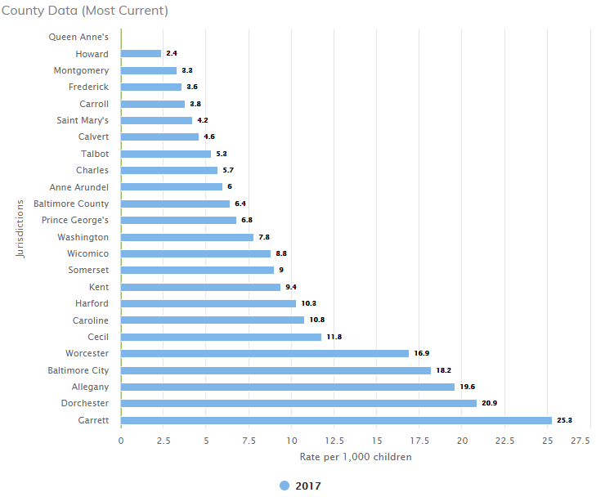
CHILD
MALTREATMENT
This indicator shows the rate of children who are maltreated per 1,000 population under the age of 18. Child abuse or neglect can result in physical harm, developmental delays, behavioral problems, or death. Abused and neglected children are at greater risk than other children for delinquency and mistreatment of their own children
MD SHIP
Notes:
The 2015 SHIP showed Garrett County at 10 and it has risen to 25.3 in 2017
Unduplicated count of children in Maryland with either an indicated or unsubstantiated finding of child maltreatment (physical and sexual abuse, mental injury-abuse, neglect, and mental injury-neglect) during the State fiscal year
Garrett County trend: 2010-4.2 / 2011-10.2 / 2012-4.9 / 2013-7.1 / 2014-9.2 / 2015-10.0 / 2016-18.4 / 2017-25.3

Slide 27
Access To Care
 | Meets or Exceeds State Goal | Needs Improvement
4 Measures | Uninsured ED Visits
 | Children Receiving Dental Care in The Last Year | *WORST IN THE STATE* Adolescents Who Received A Wellness Checkup In The Last Year
 | Persons With A Usual Care Provider
Notes:
The Adolescent wellness committee has been working hard on strategies to address the issue of low percentage of adolescents receiving a wellness check.

Slide 28
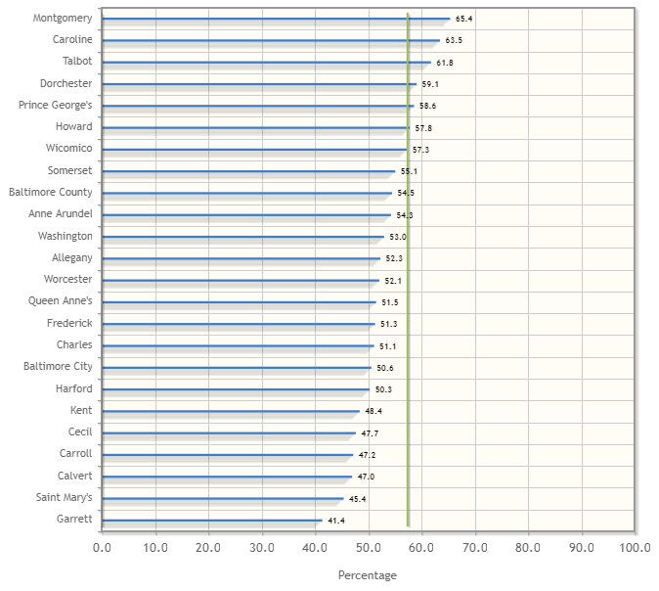
Adolescents who received
wellness checkup in last year
Measurement Period 2017
Measurement Period 2016
Garrett
41.4
Source: MD SHIP
Notes:
This indicator shows the percentage of adolescents (ages 13-20 years old) enrolled in Medicaid (320+ days) who received a wellness visit during the past year
Adolescent Wellness survey question: What keeps you from attending wellness/prevention check-ups in the last 12 months?
The most used answer for Middle and High School students “I am generally well and not in need of routine wellness visit.
The most used answer for the Middle and High School parents was the same “my child is well, and not in need of routine wellness checks.
Other close seconds were: My child had wellness exams up to age 12 and now have sports physicals and go to the doctor when needed.
Not enough time
Minimum of one hour appointment

Slide 29
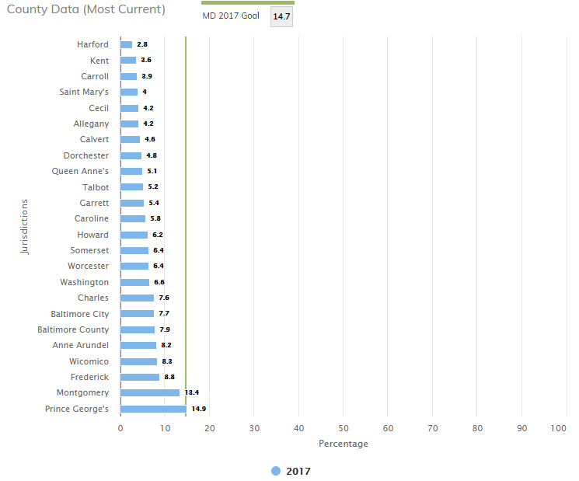
UNINSURED EMERGENCY DEPARTMENT VISITS
This indicator shows the percentage of persons without health (medical) insurance.
Garrett
5.4
Measurement Period
MD SHIP
Notes:
People without health insurance are more likely to be in poor health than the insured. Lack of health insurance can result in increased visits to the emergency department and decreased routine care visits with a primary care provider. Better job of enrollment in MA in poorer counties

Slide 30
Quality Preventive Care
 | Meets or Exceeds State Goal | Needs Improvement
10 Measures | *4th Best In The State* Age-Adjusted Mortality Rate From Cancer | Hospitalization Rate Related to Alzheimer’s or other dementias
 | ED Visit Rates Due to: Hypertension (3rd Best in State) Addiction Related Condition | ED Visit Rates Due to: Mental Health Conditions Asthma Heart Disease Diabetes
 | ED Visit Rate Due to Dental Care | Annual Seasonal Flu Vaccinations
Notes:
Twelve Measures
Two are considered statistically insignificant because of low numbers or lack of data.
Drug induced death rate and Children (19-35 months old) who receive recommended vaccines
SO, Out of the ten we can count, GC is meets or exceeds the state goal for 3 and needs improvement in 7.

Slide 31
COVID 19 Current Data
MARYLAND
TESTED: 300,444
Negative: 213,632
Positive: 48,423
Deaths: 2,270
Hospitalized: 1,338
GARRETT
TESTED: 702
Negative: 652
Positive: 10
Deaths: 0
Hospitalized: 0

Slide 32
COVID-19 Current Interventions
Coordinated Operations
Testing
Surge Planning
Contact Tracing
Executive Orders
Surveillance
Social Distancing
Protective Measures
Vulnerable Populations

Slide 33
Rapid Response Survey
COVID ASSISTANCE
Notes:
In April, more residents are receiving WIC benefits, SNAP, School, Churches, and less from Meals on Wheels and the Food Bank

Slide 34
1,720
Pageviews
913
Unique Visitors
GC2020
Garrett County Community Health Improvement Plan

Slide 35
30,011+
People monthly
(Reported by Cloudflare)
86,961+
Actively Engaged (lifetime)
$270,000
External Community Investment
MyGarrettCounty.com
Community Engagement & Health Planning Website

Slide 36
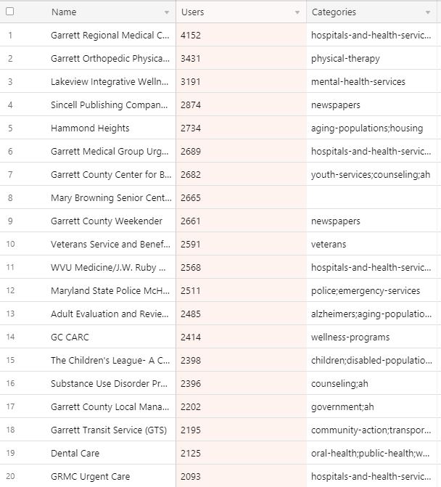
The top 20 searches as of May 2020
Can be found on mygarrettcounty.com

Slide 37
Priorities for 2021
Prevent local outbreaks of SAR CoV-2 (COVID-19)
Chronic Disease, focusing on risk factors-nutrition, physical Activity and tobacco
Access to Care & Linkages to Community Resources
Behavioral Health: Mental Health & Substance Use
Family Structure with emphasis on maternal, child and adolescent health
Social Determinants of health, specifically economic inequities and poverty

