Slide 1
Garrett County, Maryland
2017 Culture of Health Prize Winner
Presenter Name, Title
Month, Year

Slide 2
OPTION 1

Slide 3
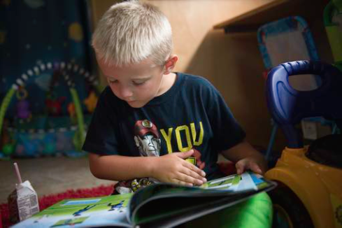
Bus Services
Brantley Lantz, 5, reads and drinks milk on the Learning Beyond the Classroom Bus, which holds a library and learning games for children. Parents can use the Wi-Fi and computers on board to apply for jobs or update resumes. The bus brings educational programming to 10 of Garrett County’s most impoverished areas once a month and is just one of the ways the county promotes early childhood education and supports families in need. “We will do everything we can to get families ready for school,” says Steve Knepp, who coordinates the program and drives the bus.

Slide 4
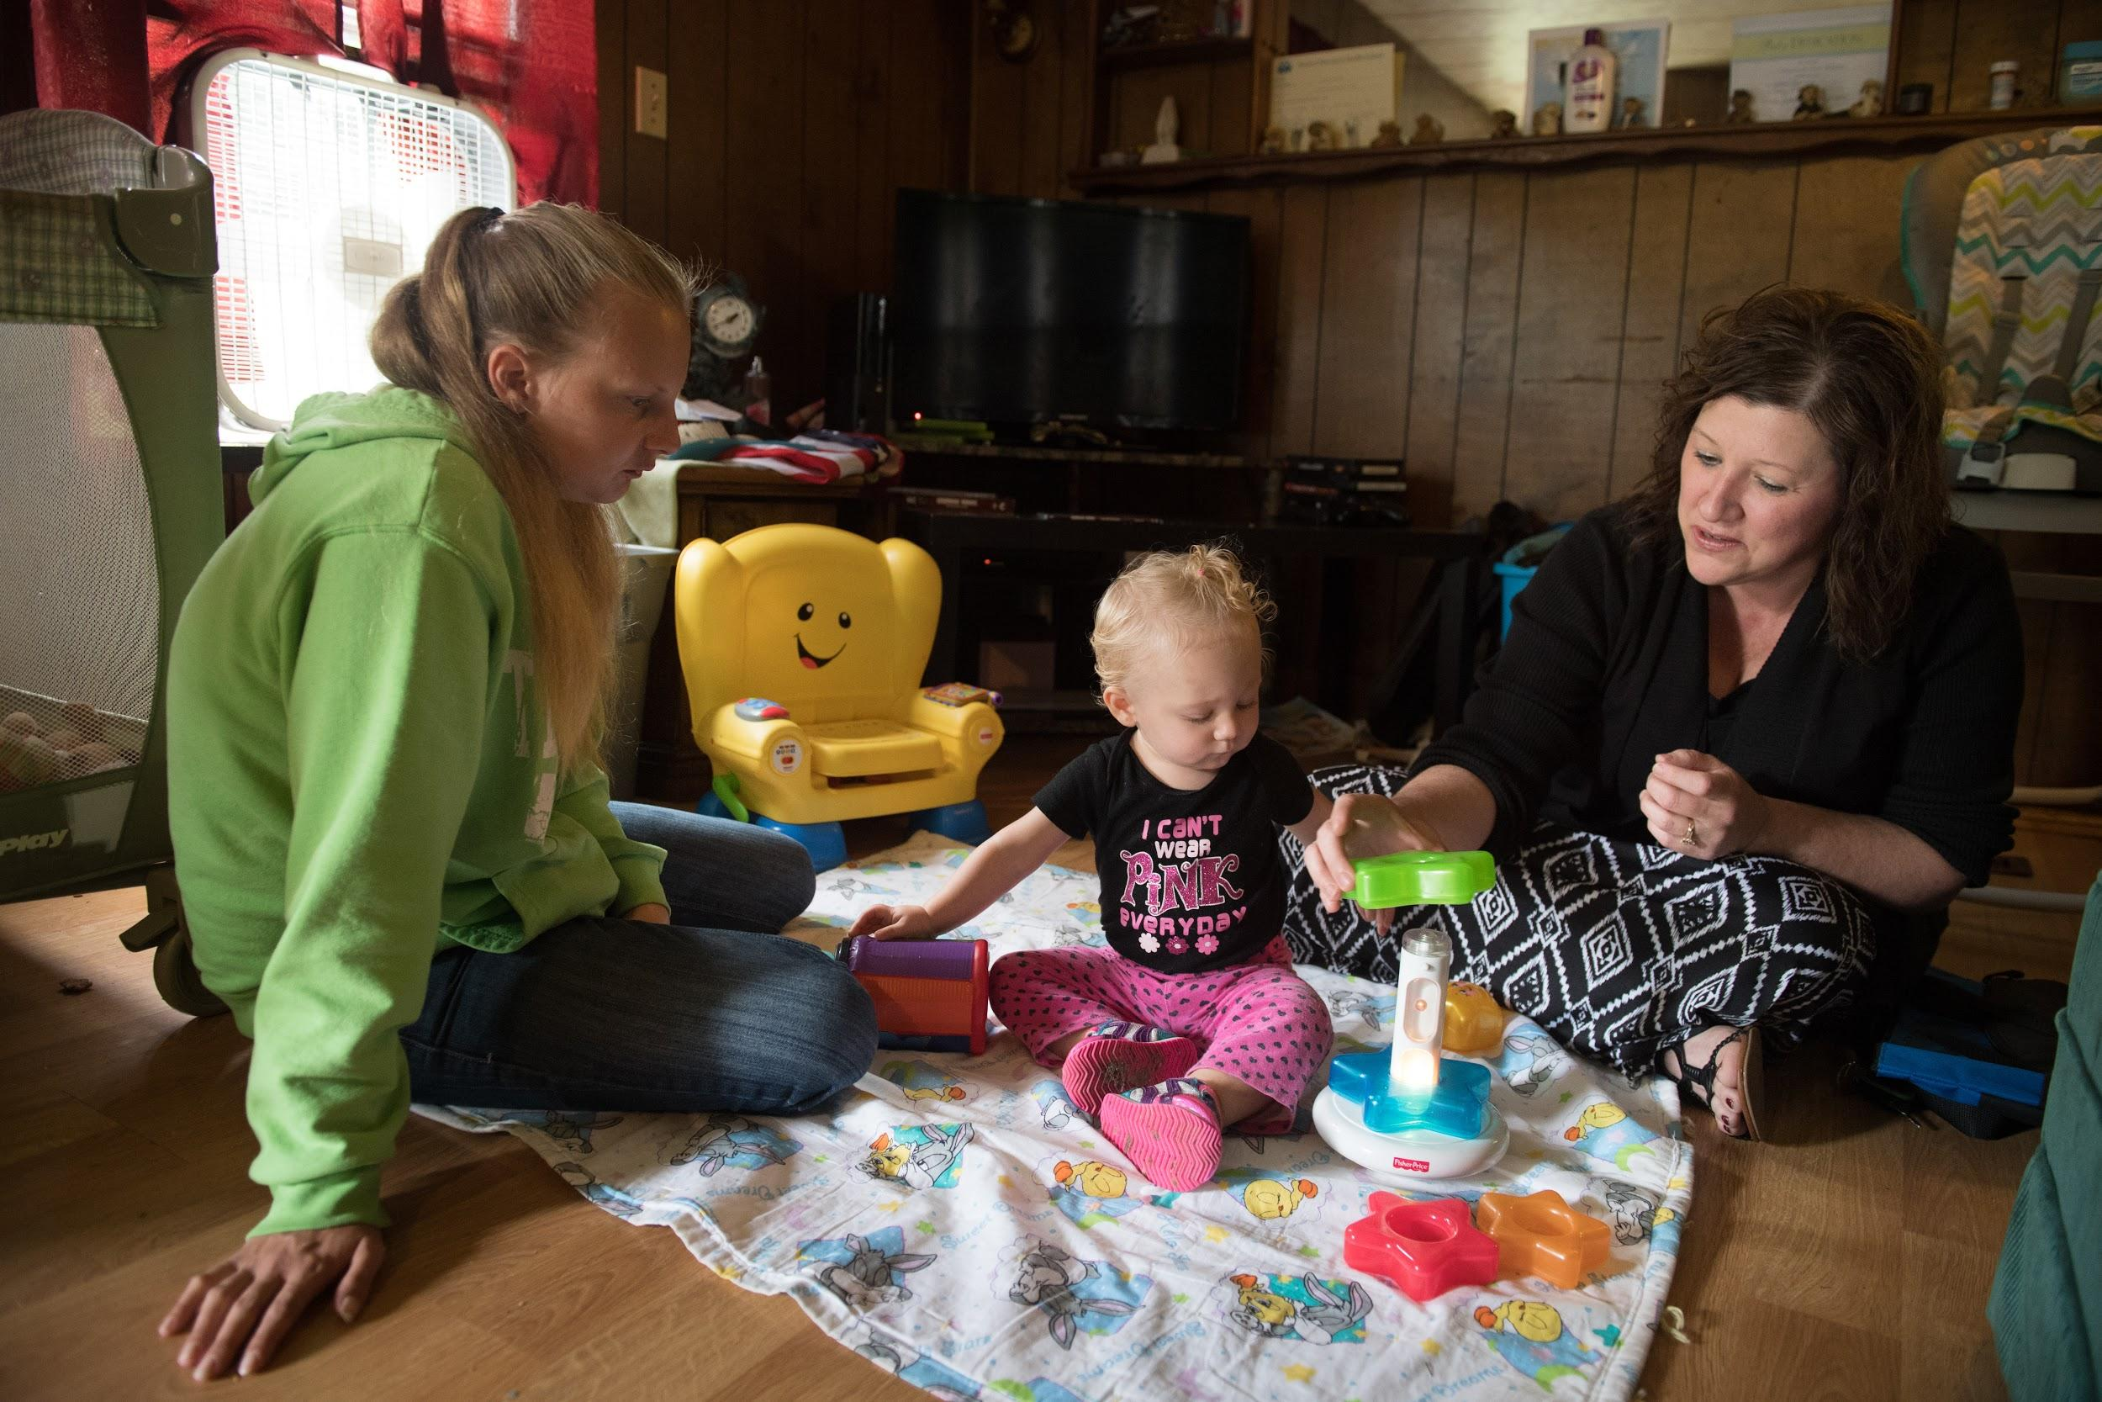
Two Generations At A Time
Maria Friend (right), director of Garrett County Health Department’s Early Care Programs visits with Sonya Kisner and her daughter Catherine Ann, 13 months, in their Oakland, Maryland, home as part of Healthy Families Garrett County. Through this and other programs, Garrett County service providers simultaneously promote health and well-being for children and their parents. A Healthy Families visiting nurse regularly monitors Catherine Ann’s physical and mental development while helping Sonya Kisner meet her personal goals, such as finishing her
high-school degree.

Slide 5
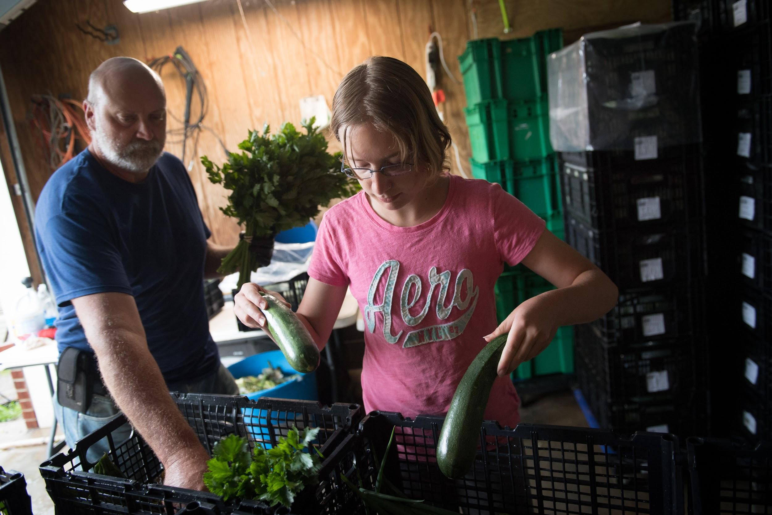
Produce On The Move
Charles DeBerry and his daughter, Anna DeBerry, 12, pack boxes of fresh produce at the DeBerry Farm, a member of the Garrett Growers Cooperative. Founded to ensure fresh food grown in Garrett County can reach as many residents as possible, the cooperative delivers fresh produce to members of its Veggie Box subscription program. Boxes are available to low-income residents at a discount, and local groups sponsor subscriptions for some
low-income families and people with chronic diseases.

Slide 6
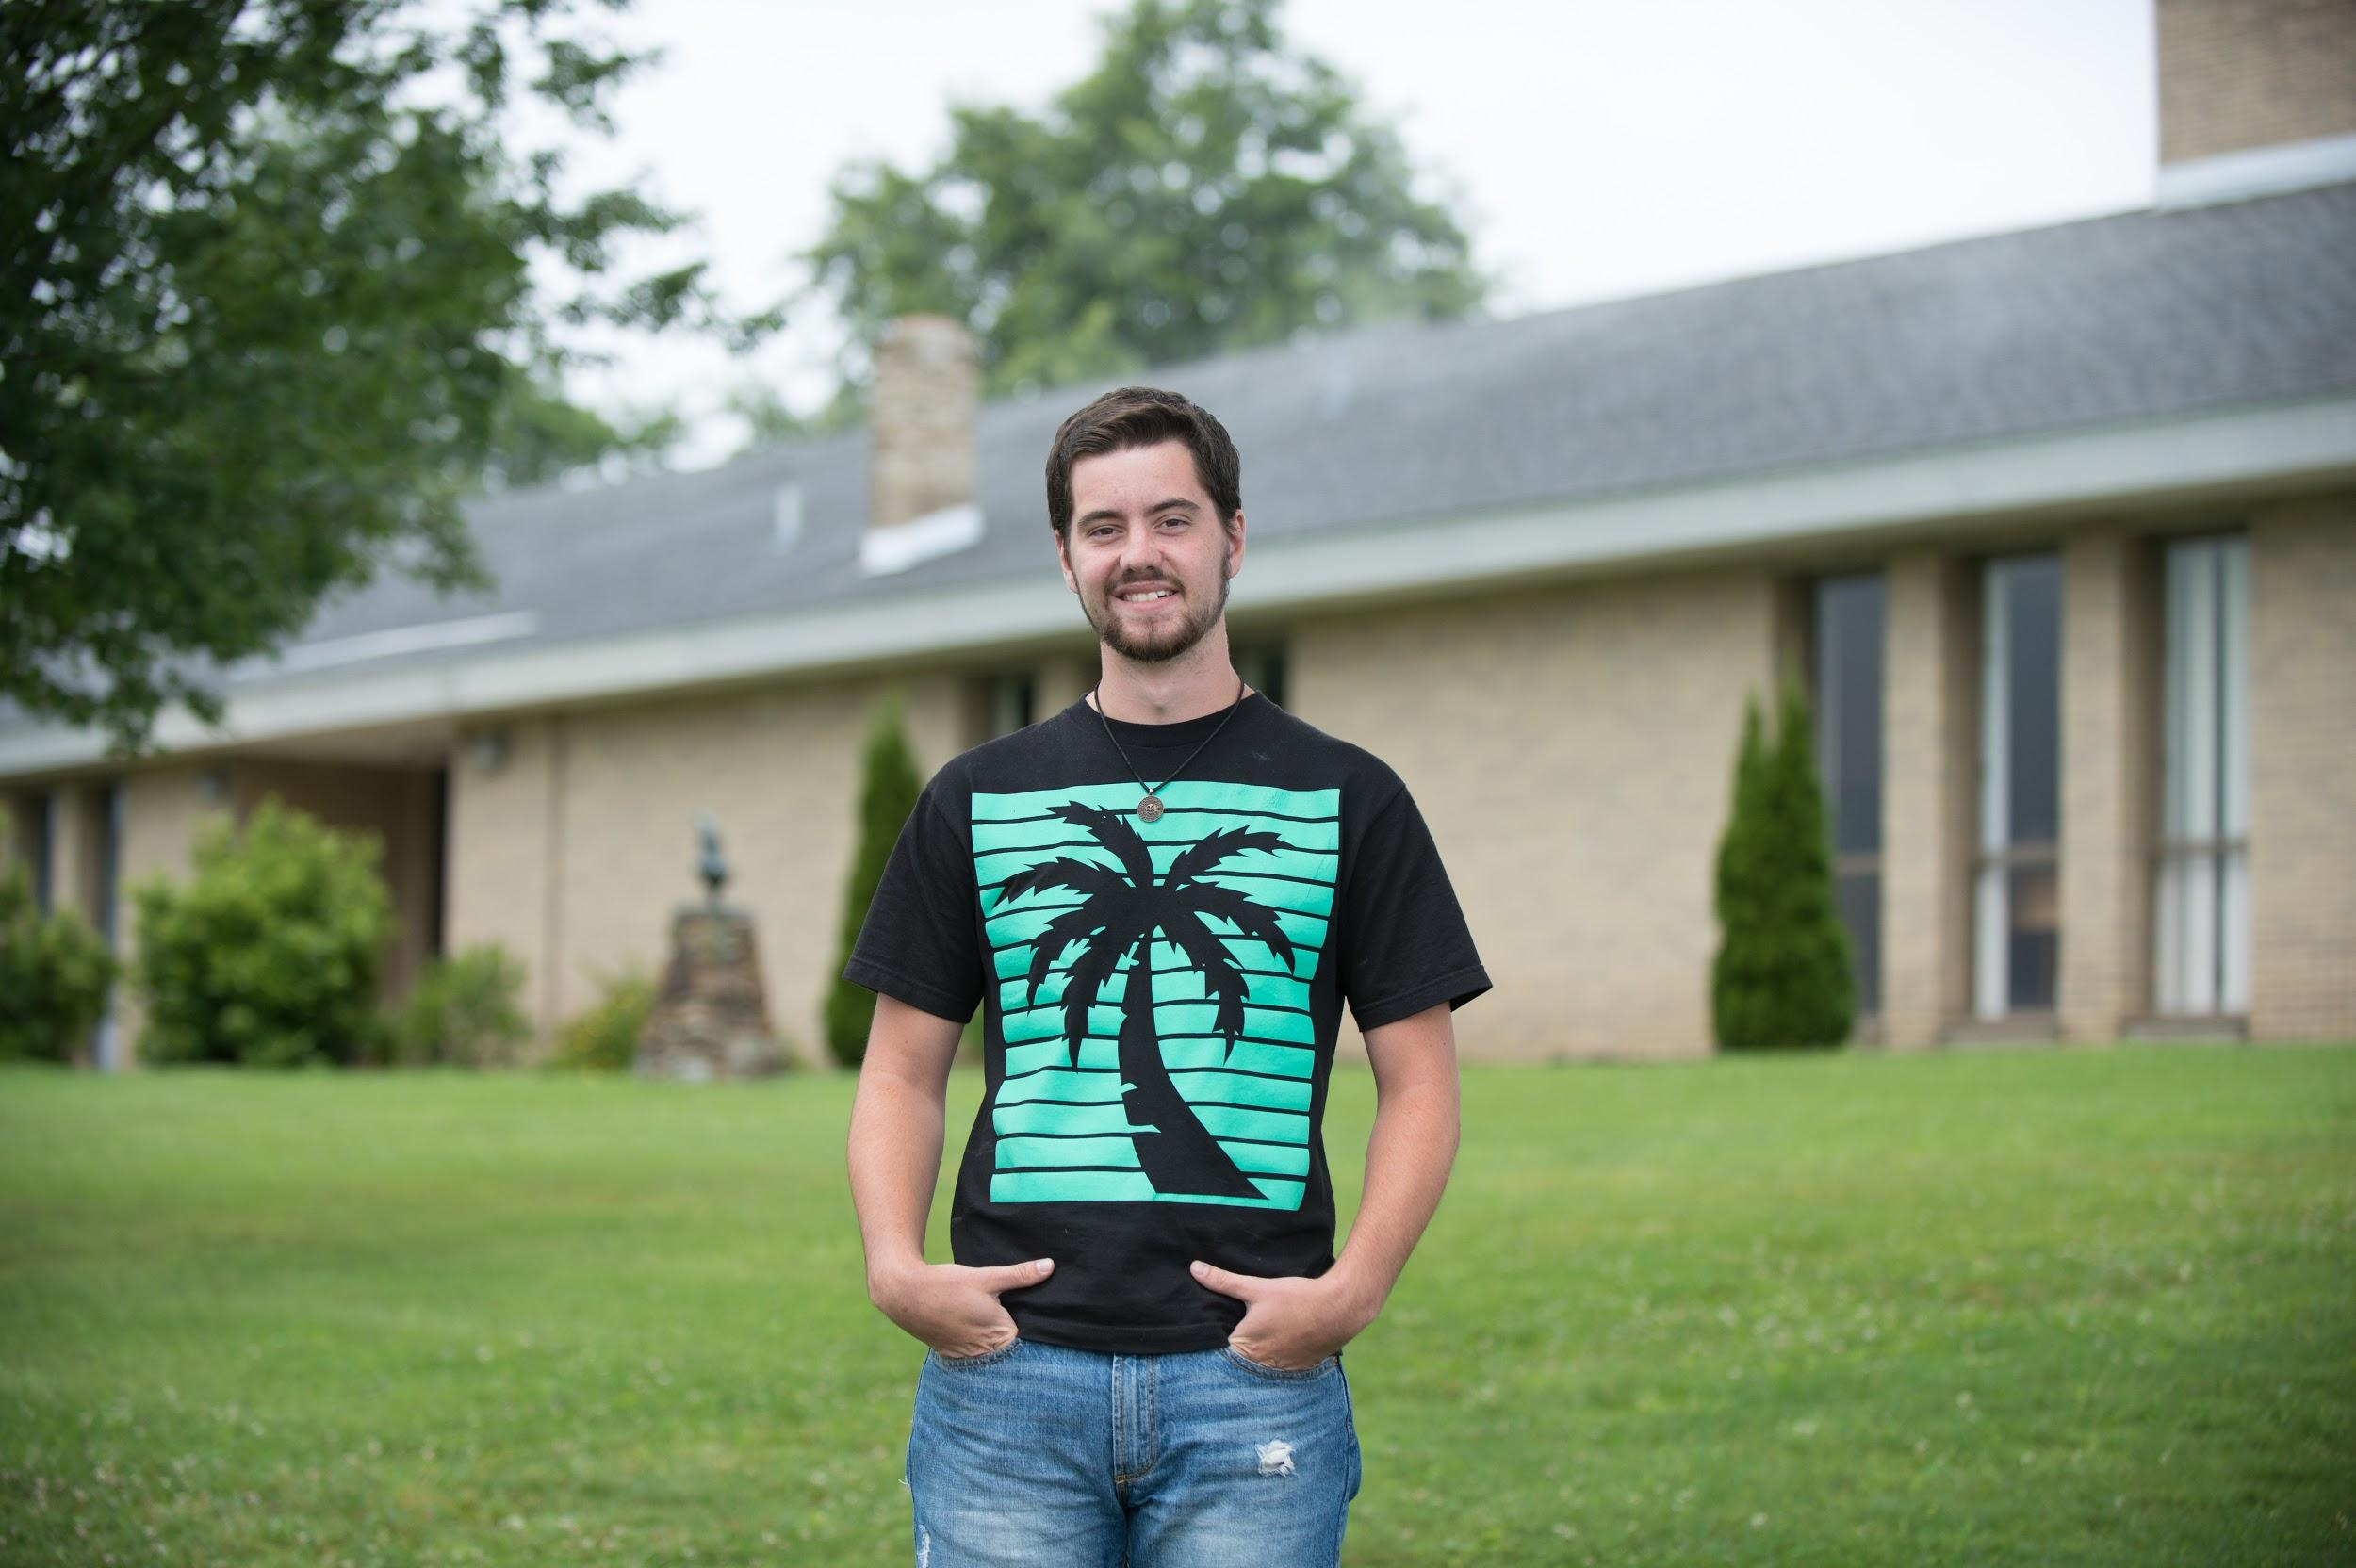
Education For All
Noah Manges stands outside Garrett College, a two-year public college in McHenry, Maryland. He has benefited from scholarships offered to Garrett County students and plans to attend a four-year university after completing his associate degree in history. For more than 10 years, county residents have been able to attend Garrett College tuition-free. Initiated to build the local workforce, the tax-funded scholarship program enables students to obtain an associate degree or certificate for trades such as welding, nursing assistant, apartment maintenance, truck driving, and mining. “We get letters all the time from people who say ‘Thank you so much. It’s made a big difference in my life,’” says County Commissioner Jim Hinebaugh.

Slide 7
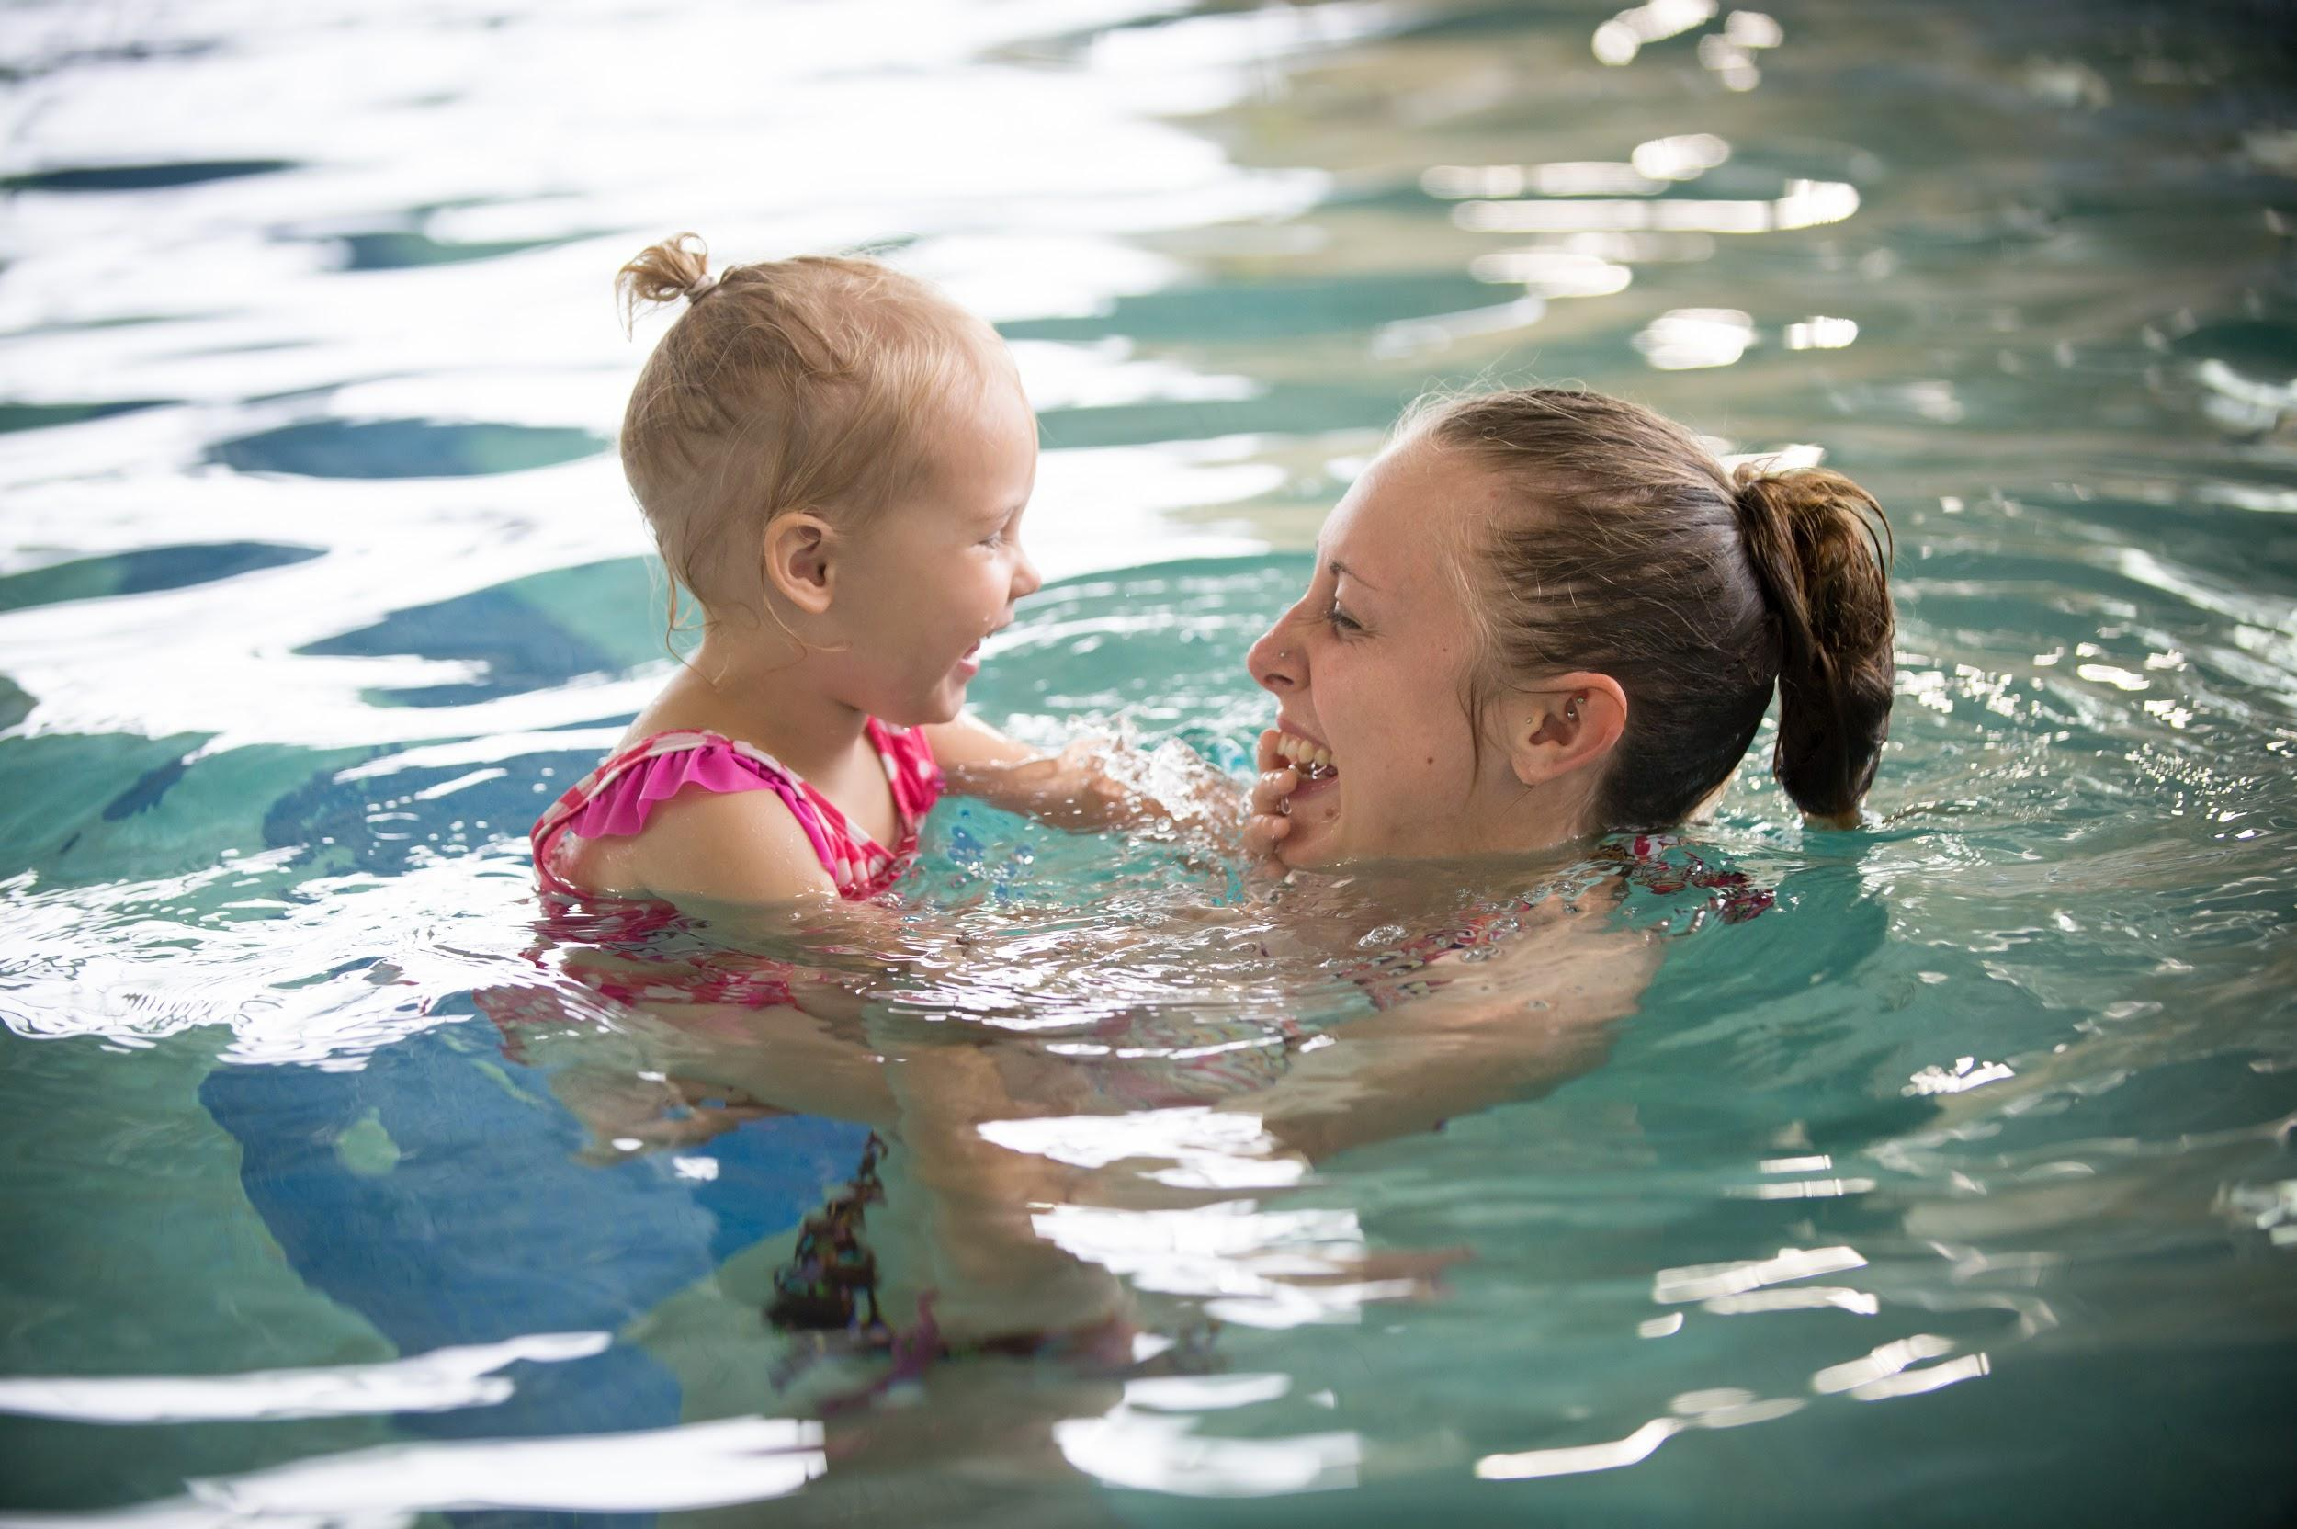
Exercise For All
Melissa Marple, a Garrett County resident, plays with her daughter, Braylon, 2, at the Garrett College Community Aquatic and Recreation Complex in McHenry, Maryland. Open to everyone for a sliding-scale fee, the 5-year-old complex offers a pool, gym, basketball court, and exercise classes. It is also the site of the “I Can Swim!” program, a free four-day session of swim lessons taught to every Garrett County kindergartner. “We want to make sure every kid in the county has the opportunity to learn to swim safely,” says Steve Putnam, director of the complex.

Slide 8
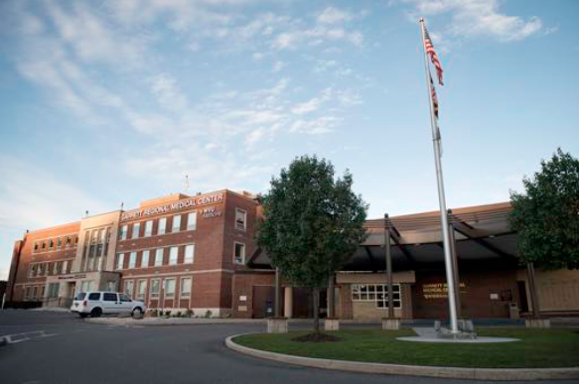
Comprehensive Care
Garrett Regional Medical Center’s affiliation with West Virginia University Healthcare has boosted health care in this rural county. The medical center has reduced readmission rates through its Well Patient Program, which assigns a team of professionals to make sure patients have the resources they need to manage their illnesses at home. Last year, the community raised $4.9 million to open a cancer wing at the medical center. Previously, residents had to travel to West Virginia or Pennsylvania for cancer care.

Slide 9
OPTION 2

Slide 10
Notes:
Brantley Lantz, 5, reads and drinks milk on the Learning Beyond the Classroom Bus, which holds a library and learning games for children. Parents can use the Wi-Fi and computers on board to apply for jobs or update resumes. The bus brings educational programming to 10 of Garrett County’s most impoverished areas once a month and is just one of the ways the county promotes early childhood education and supports families in need. “We will do everything we can to get families ready for school,” says Steve Knepp, who coordinates the program and drives the bus.

Slide 11
Notes:
Maria Friend (right), director of Garrett County Health Department’s Early Care Programs visits with Sonya Kisner and her daughter Catherine Ann, 13 months, in their Oakland, Maryland, home as part of Healthy Families Garrett County. Through this and other programs, Garrett County service providers simultaneously promote health and well-being for children and their parents. A Healthy Families visiting nurse regularly monitors Catherine Ann’s physical and mental development while helping Sonya Kisner meet her personal goals, such as finishing her high-school degree.

Slide 12
Notes:
Charles DeBerry and his daughter, Anna DeBerry, 12, pack boxes of fresh produce at the DeBerry Farm, a member of the Garrett Growers Cooperative. Founded to ensure fresh food grown in Garrett County can reach as many residents as possible, the cooperative delivers fresh produce to members of its Veggie Box subscription program. Boxes are available to low-income residents at a discount, and local groups sponsor subscriptions for some low-income families and people with chronic diseases.

Slide 13
Notes:
Noah Manges stands outside Garrett College, a two-year public college in McHenry, Maryland. He has benefited from scholarships offered to Garrett County students and plans to attend a four-year university after completing his associate degree in history. For more than 10 years, county residents have been able to attend Garrett College tuition-free. Initiated to build the local workforce, the tax-funded scholarship program enables students to obtain an associate degree or certificate for trades such as welding, nursing assistant, apartment maintenance, truck driving, and mining. “We get letters all the time from people who say ‘Thank you so much. It’s made a big difference in my life,’” says County Commissioner Jim Hinebaugh.

Slide 14
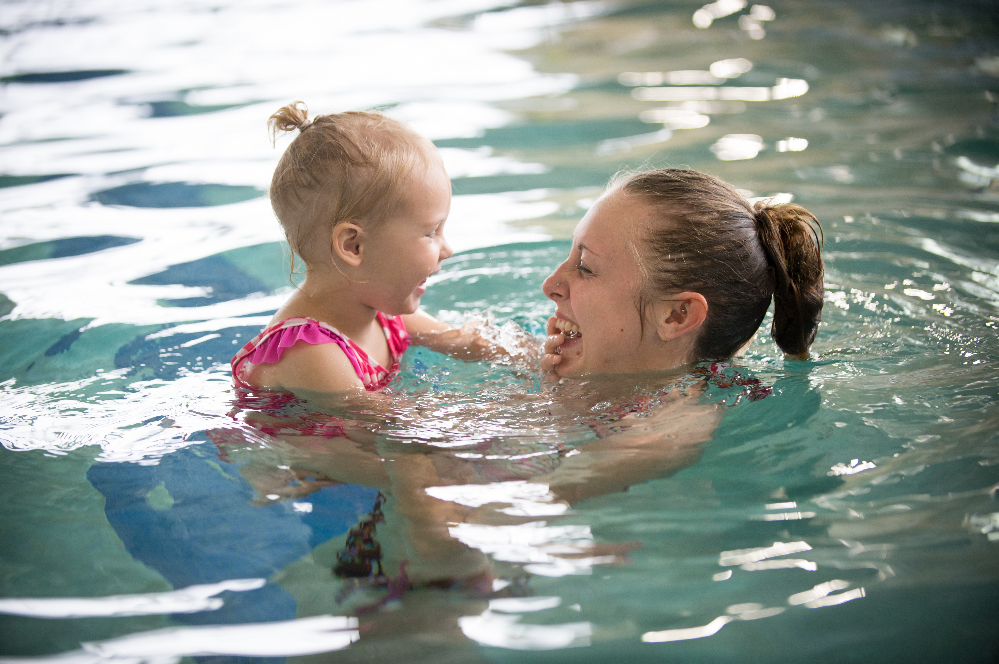
Notes:
Melissa Marple, a Garrett County resident, plays with her daughter, Braylon, 2, at the Garrett College Community Aquatic and Recreation Complex in McHenry, Maryland. Open to everyone for a sliding-scale fee, the 5-year-old complex offers a pool, gym, basketball court, and exercise classes. It is also the site of the “I Can Swim!” program, a free four-day session of swim lessons taught to every Garrett County kindergartner. “We want to make sure every kid in the county has the opportunity to learn to swim safely,” says Steve Putnam, director of the complex.

Slide 15
Notes:
Garrett Regional Medical Center’s affiliation with West Virginia University Healthcare has boosted health care in this rural county. The medical center has reduced readmission rates through its Well Patient Program, which assigns a team of professionals to make sure patients have the resources they need to manage their illnesses at home. Last year, the community raised $4.9 million to open a cancer wing at the medical center. Previously, residents had to travel to West Virginia or Pennsylvania for cancer care.

